Slide 1
Calculating the Lyapunov Exponent
Time Series Analysis of Human Gait Data

Slide 2
Key Topics
Biological Significance
Algorithm to Lyapunov Exponent
Reconstruction
Nearest Neighbor
D_{j}(i)
Curve Fitting
GUI
Reverse Dynamics
Conclusion

Slide 3
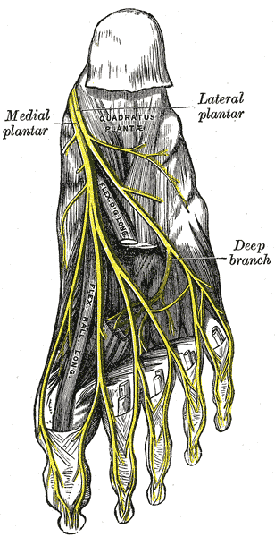
What is Peripheral Neuropathy?
Peripheral neuropathy is a progressive deterioration of peripheral sensory nerves in the distal extremities.
Affects more than 20 Million Americans.
Symptoms:
Muscle weakness
Cramps
Fasciculation i.e. muscle twitches
Muscle Loss
Bone Degeneration

Slide 4
Causes
A number of factors can cause neuropathies:
Trauma or pressure on the nerve.
Diabetes.
Vitamin deficiencies.
Alcoholism.
Autoimmune diseases.
Other diseases.
Inherited disorders.
Exposure to poisons.

Slide 5
Why is this being researched?
Studying human gait of affected and non-affected
Pinpoint the problem areas by comparing both data sets.
Learning what parts of the body are malfunctioning could help treat peripheral neuropathy.
General contributions
Accurately measuring stability in human gait could lead to possible prevention of future accidents.

Slide 6
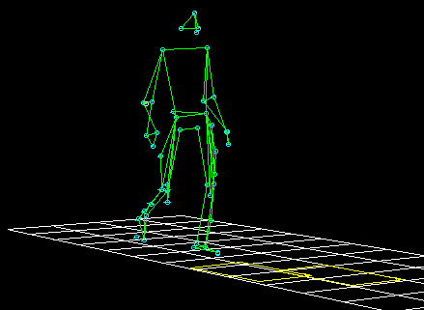
Data Collection Process
Patients has reflective sensors adhered to anatomical landmarks on the outside of the legs, arms, and head.
Starts walking on treadmill within the range of infrared cameras.
Steady walking on treadmill for approximately 80 seconds.
Captures 60 angles/second
Collects 4900 data points.

Slide 7
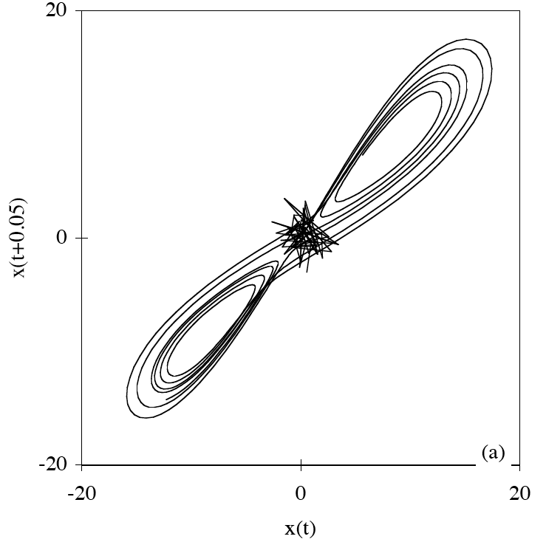
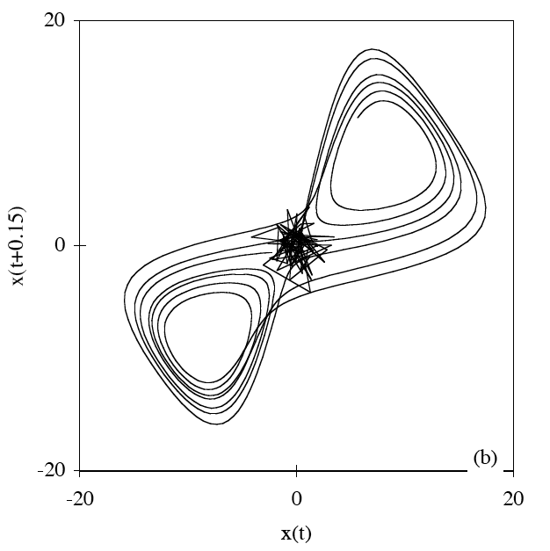
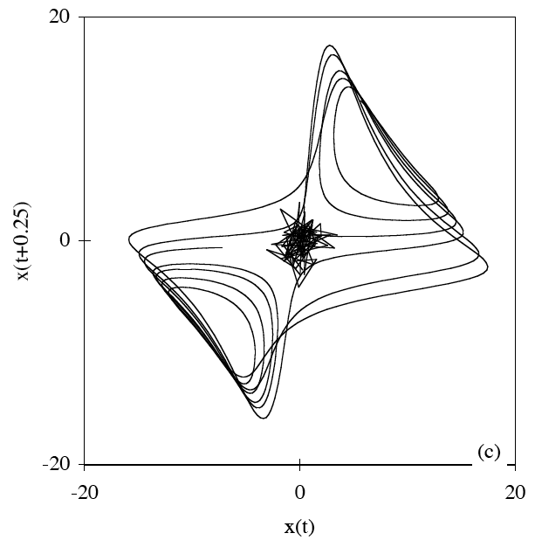
Reconstruction
Important to properly capture dynamics of the system
i.e. position → velocity
Implemented Method of Delays
Embedding Dimension (n) –variables of the reconstruction (experimentally, dimension of 5 is suggested)
Lag (L)-number of consecutive vectors to skip for reconstruction

Slide 8
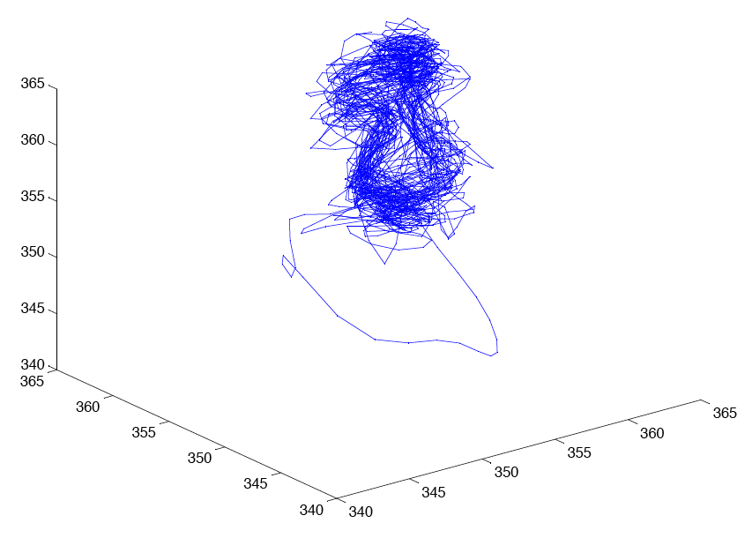
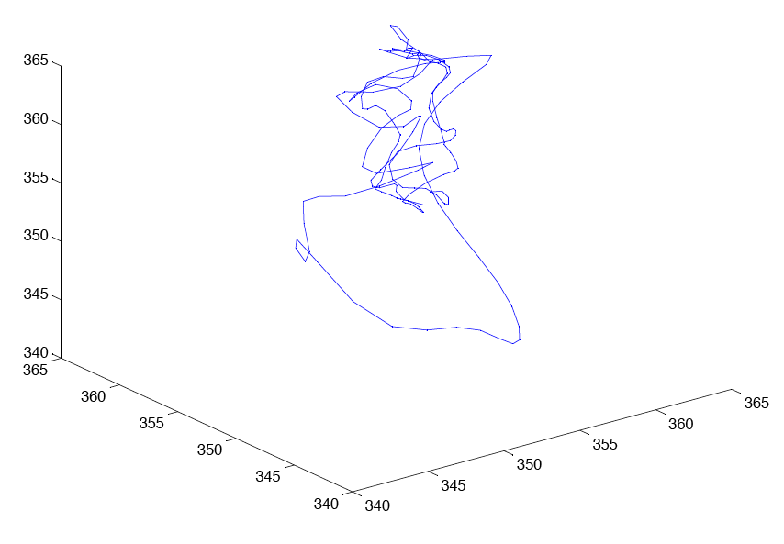
Reconstruction

Slide 9
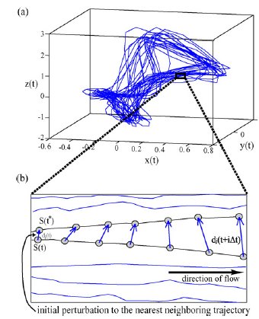
Nearest Neighbor
d_{j}(i) = ||X_{j} – X_{j’}||
Reference point X_{j}
Nearest neighbor X_{j’}
d_{j}(0) = min_{xj’} ||X_{j} – X_{j’}||
d_{j}(1) = ||X_{j + 1}– X_{j’ + 1}||
||j – j’|| > mean period

Slide 10
D_{j}(i)
Two curve fitting models →two D_{j}(i) algorithms
d_{j}(i) ≈ C_{j}e^{λ1(iΔt)}
Linear Model
Previous used fit
Average the lnd_{j}(i) for each i
lnd_{j}(i) ≈lnC_{j}+ λ₁(iΔt)
Double Exponential Model
Experimental Model
Average of d_{j}(i) for each I
d_{j}(i) ≈ C_{j}e^{λ1(iΔt}

Slide 11
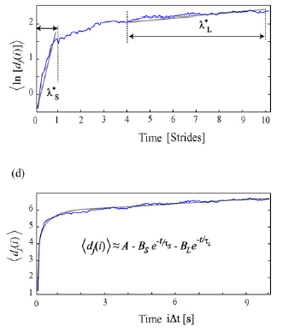
Curve Fitting
Linear Model
lnd_{j}(i) ≈lnC_{j}+ λ₁(iΔt)
Calculates two linear fits
short term: 0 – 1 stride
long term: 4 – 10 stride
Double Exponential Model
d_{j}(i) ≈ A – B_{s}e^{-t/τs} – B_{L}e^{-t/τ}
Four unknown variables
B_{s} , B_{L}
τ_{s} ,τ_{L}

Slide 12
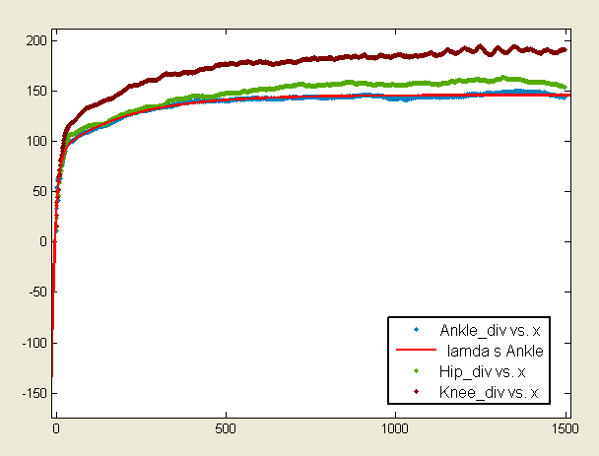
Curve Fitting

Slide 13
Curve Fitting
General model: f(x) = a-bs*exp(-x/ts)-bl*exp(-x/tl)
Coefficients (with 95% confidence bounds): a = 145.9 (145.7, 146) bl = 56.69 (55.93, 57.45) bs = 60.32 (58.33, 62.32) tl = 203.8 (199.8, 207.7) ts = 10.8 (10.15, 11.45)
Goodness of fit: SSE: 4809 R-square: 0.9854 Adjusted R-square: 0.9853 RMSE: 1.794

Slide 14
GUI Demo

Slide 15
Reverse Dynamics
We are using an approximation scheme to compute the Lyapunov exponent.
Using embedding dimension m leads to m Lyapunov exponents
Spurious exponents
Reverse dynamics can be used to identify spurious exponents.
 |  |  | Book 1
 |  |  | Hip | Knee | Ankle
Normal | Short-term |  | 0.0311652 | 0.0345363 | 0.0241968
 | Long-term |  | 0.00133618 | 0.0015417 | 0.00102537
Reverse | Short-term |  | 0.0305798 | 0.0352694 | 0.0276853
 | Long-term |  | 0.00169744 | 0.00172776 | 0.000978649
Results show we have the same exponents under normal and reverse dynamics.

Slide 16
Conclusion & Acknowledgments
Updates to the graphical user interface (GUI)
Methods to updating both the single and double exponential, accompanied with a study on
Reverse Dynamics was established.
Implementing the single and double exponential models in the GUI were not completed this could be added as a further update to the GUI.
We would like to thank Professor Li Li, Professor Lee Hong, Brad Manor, Alvaro Guevara, and Professor Wolenski for all of their helpful comments and advice over the course of the semester.

