Slide 1
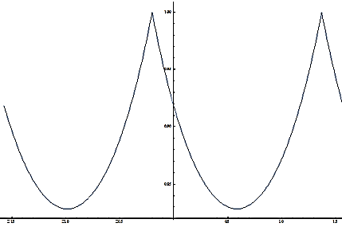
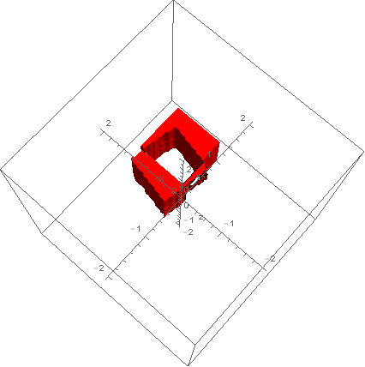
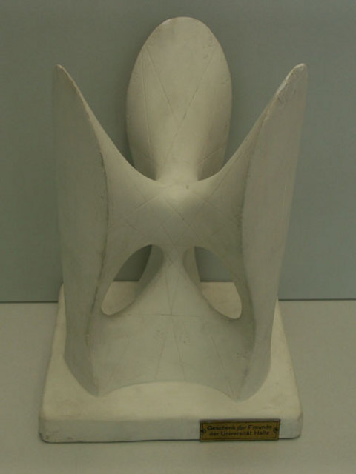
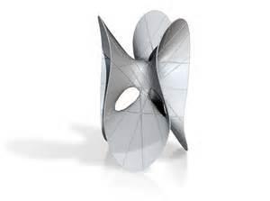
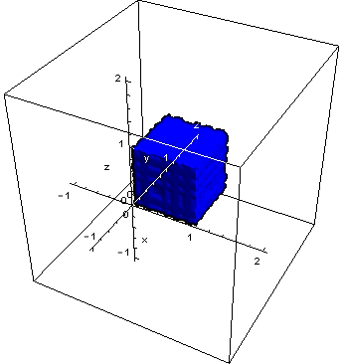
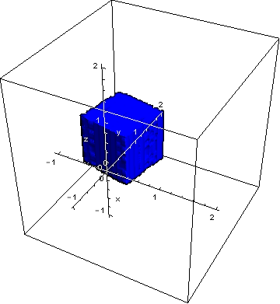
Assessing 3-D Printers: Methods of Image Alignment and Metric Construction
Dustin Wright, Jeremy Tillay, and Brandon Oubre
Louisiana State University
Introduction
A Preliminary Approach to Image Alignment (cont.)
The Construction of a Metric
The goal of this project is to develop a metric to compare two 3-D printers. To do this, we will construct an ideal image in the form of a three dimensional intensity matrix from the information encoded in an STL (Standard Tessellation Language) file, and compare it to real-world data, taken from scans of the 3-D printed test object, by designing an appropriate metric. First we must align the images, and then compare how similar they are when aligned as closely as possible.
We can visualize the $θ$ that maximizes our cross correlation function by graph it with respect to theta.
Note that the function is periodic with period $\frac{π}{2}$, which is consistent with rotation of a cube in one direction.
Before alignment, the graph of $|f(x, y, z) – g(x, y, z)|$is:
This is the key to measuring differences between our printed objects, integrating a function of the absolute value of the difference of the two functions.
$f$ and $g$ will be 0 wherever this difference is empty air and if there is matter a value can be prescribed according to its position in 3-space.
For example, testing the resolution of an image could be done by printing a bumpy object and prescribing large values at points where bumps should be and lower values towards the center.
Conversely, testing the structural consistency could be done by prescribing large values at the center of an object and lower values at the edges.
A Preliminary Approach to Image Alignment
We will show our alignment algorithm on two misaligned cubes:
We make the assumption that the printed objects that can be laid flat.
To align the images, we define two functions $f$ and $g$ over $R^{3}$ corresponding to the intensity matrices of the images.
We then translate the images so that their center of masses are located at the origin. This is translation alignment.
Next we must find rotational alignment. Rotation along the z-axis will not change the location of the center of mass, but it will change the amount of overlap in the two functions.
Consider the cross correlation function:
This will have a maximum at the theta corresponding to the best rotational alignment of the functions.
An Alternate Approach to Image Alignment
An alternative approach that we researched, instead of aligning the images in two steps, implements simultaneous translational and rotational alignment. Given two images, we compute their Radon transforms. Working with this sinogram data proves to be computationally inefficient, so to mitigate this, we instead take the radial Fourier transform of each of these as well as their projections.
We then compute the cross-correlation of these two objects as follows, using line-by-line multiplication:
$$c\left(α, β, γ,r,η\right)=\iint{ {\hat{r}}_{β,γ}\left(p, ε\right) }\hat{g}\left(p−rsin(ε+η),ε+α\right) dp dε$$
Where $\hat{r}$corresponds to the ideal object and $\hat{g}$ corresponds to the printed object.
Once we have this convolution, we take the inverse Fourier transform so we are left with sinogram data once again. To calculate the cross correlation coefficients, we integrate with respect to epsilon by summing over the sine curves given in this function.
Like in the previous method, we are trying to find the rotation with the greatest overlap between images. Once we have the maximum of these coefficients, we know how much to rotate our image by. Translational alignment is computed by phase multiplication, and rotational alignment is computed by a commutation of lines of our Radon transform.
Conclusions
The hardest part of comparing a 3D object to its STL file is the alignment of the two objects, and there are many promising ways to do this with different tradeoffs for different methods.
One algorithm was coded for this project, though it could substantially benefit from computational improvements.
We have developed some sample metrics, but there are a variety of different metrics that could be developed to emphasize different features.
$$\iiint{\left[f(x, y, z) g(xcosθ − ysinθ, xsinθ + xcosθ, z)]dV\right.}$$

