Slide 1
Assessing 3-D Printers
Jeremy Tillay
Dustin Wright
Brandon Oubre

Slide 2
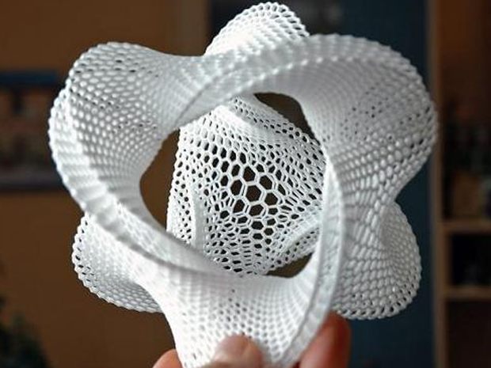
http://www.wize3d.com/wp-content/uploads/2014/04/3d-printing-shapeways.png

Slide 3
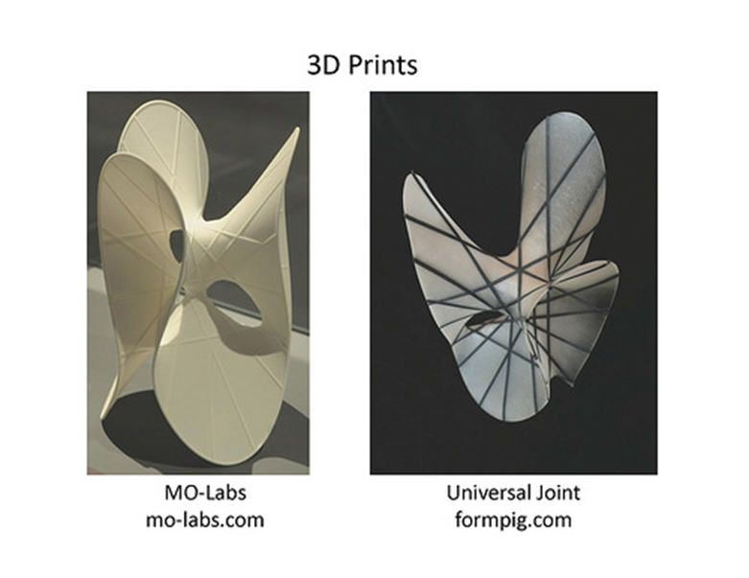
https://sketchesoftopology.wordpress.com/2014/04/25/mathematics-with-3d-printing/

Slide 4
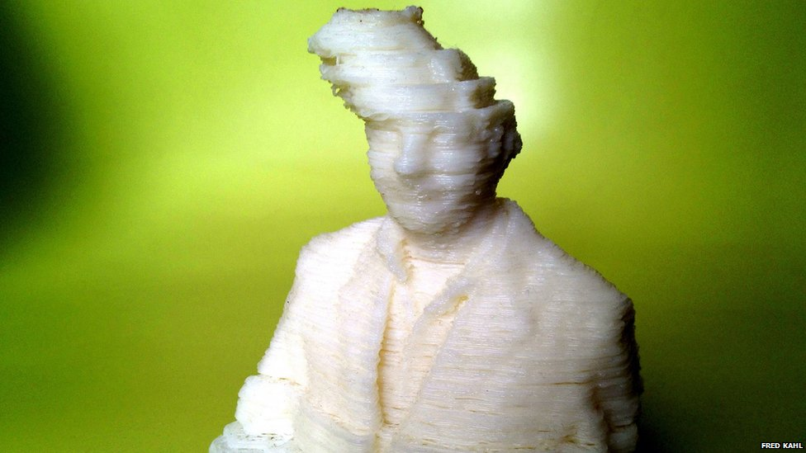
The Problem
http://40.media.tumblr.com/247ed071b5a926360173ec94cd5a13d1/tumblr_mrs21h4a8I1qzbl5oo1_1280.jpg

Slide 5
3-D Imaging and STL Files
Input: STL file that triangulates a structure with normal vector giving orientation
Output: An imperfect realization of this object. Plastic may melt, the printer itself may have issues
3-D Image: A scan that will be put through an inverse radon transform and generate a matrix of values corresponding roughly to the amount of matter at a given point in the scan

Slide 6
Current Technique
Threshold values in intensity matrix.
Find surfaces of thresholded matrix.
Randomly scatter points along the surfaces.
Use the iterative closest point algorithm to align the matrix with the STL point cloud.
Selection of threshold is somewhat arbitrary and scattering of points is random.

Slide 7
Alignment
Before we design a comparison, we must first align our figures.
Redefine our matrices as functions
(Scaling)
Shifting by center of mass
Rotating to find maximum overlap
THEN designing a metric to compare

Slide 8
Math!
Assume we are given two cubes and they are scaled properly. Create two functions f and g that correspond to the 3-D matrices from the STL file and scan respectively

Slide 9
Shifting
After calculating the center of mass, we can shift both cubes so that their centers are located at the origin. This just leaves a rotational misalignment

Slide 10
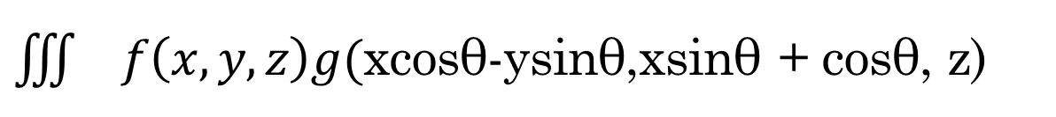
$\iiint{f\left(x, y, z\right)g(}$xcosθ-ysinθ,xsinθ + cosθ, z)
Graph with respect to theta
Max occurs at the alignment offering the most overlap, periodically occurs every 90°
Computationally inefficient

Slide 11
Numerical Evaluation (Metric)
Print 3-D objects of varying complexities that can be laid flat.
Integrate |f(x, y, z) – g(x, y, z)| where f and g are our aligned functions that take on values we choose
For example, f and g are 1 where there is matter and 0 otherwise. Emphasizes only total difference in structure
Inherently subjective

Slide 12
Potential for Error
Threshold for value corresponding to density of air vs. plastic.
Relies on object being laid flat
Computationally expensive function and a human analysis of a max of a graph to find rotational alignment
Our alignment finds maximal overlap, but may not give the “best-looking” metric.
Standard 3-D imaging error relies on quality of scanner

Slide 13
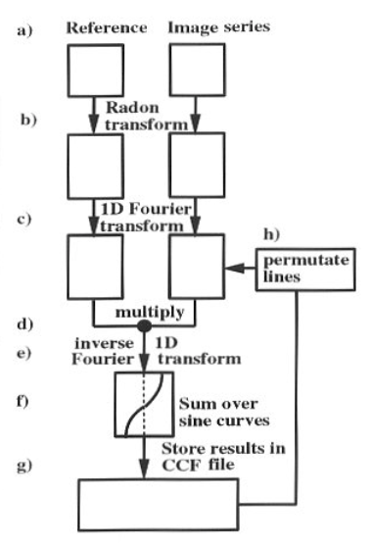
Alternative Approach
Radermacher, M. (1997). “Radon Trans-form Techniques for Alignment and Three-Dimensional Reconstruction from Ran-dom Projections”.Scanning MicroscopyVol11, Pages 171-177.

Slide 14
Conclusion
We decided to create an ideal representation of an object given its STL file.
If we can find a computationally efficient way to find the maximum of the correlation function, then we can align two given intensity functions.
  We are making a simplifying assumption that rotational correction only needs to occur in the XY plane.
We have identified another method of aligning two intensity matrices using the cross correlation of Radon transforms.
We have found potential metrics for numerically assessing the different qualities of printers.

