Slide 1
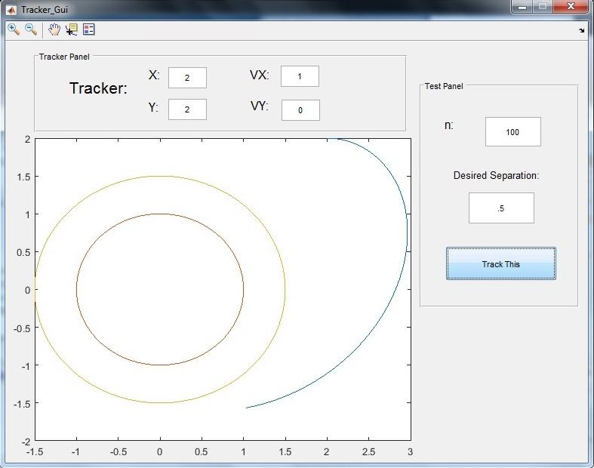
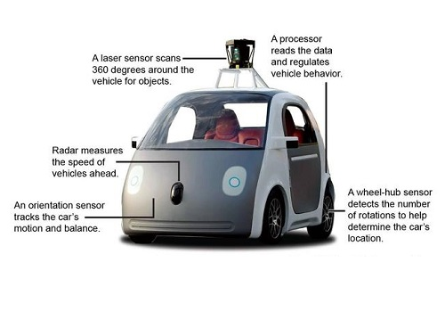
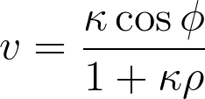
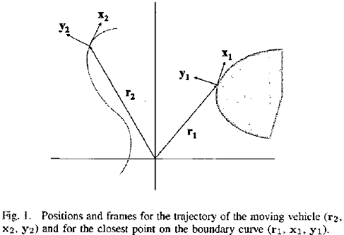
Simulations of Curve Tracking using Curvature
Based Control Laws
Graduate Student: Robert Sizemore
Undergraduate Students: Marquet Barnes,Trevor Gilmore, Megan Harper, Thomas Le
Introduction
We explore a steering control law that enables an autonomous vehicle to track a simple, closed curve using information about the curve at the closest point. The control law we consider is described in [1], and is applicable for the special case of smooth curves with constant curvature (e.g. circles and lines). Such control laws as the one we studied in this project are crucial for the design of self-driving cars and autonomous mobile robots.
Tracker Graphical User Interface
Mathematical Description of the Problem
Our vehicle is assumed to be moving at fixed unit speed subject to steering control in the presence of an obstacle D (an open region in the plane bounded by a simple closed curve). We consider our vehicle and the corresponding closest point on the boundary curve of D as a pair of interacting particles. By using the corresponding Frenet-Serret frames (see Fig. 1 below), we can derive the velocity v of the closest point as a function of the distance from the vehicle to the closest point ρ, the curvature at the closest point κ, and the angle ϕ between the tangent to the curve at the closest point and the heading direction of the vehicle.
Mathematically, we say that our vehicle tracks the curve if the relative distance ⍴ between the vehicle and the closest point converges to a constant ⍴₀ (some defined “safe distance” from the boundary) and if the angle ɸ between the heading direction of the vehicle x₁ and the tangent to the curve at the closest point x₂ converges to 0.
Using the velocity of the closest point as defined earlier, and letting u denote our sought after steering control law (effectively the curvature of our vehicles trajectory), then the corresponding dynamical system governing the relative motions of the vehicle and the closest point on the boundary curve are given by:
Our steering control u should be chosen such that for solutions of the above system, ρ converges to ρ₀ and ϕ converges to ϕ₀. In [1], the author’s propose the following steering control law:
Here ρ and ϕ are easily computable from position, tangent, and normal vectors for the vehicle and closest point. Similarly, the curvature of a parametrized curve is easily computable.
The steering control law u
About the GUI
Created using MATLAB’s GUIDE tool
The boundary curve is hardcoded into the GUI
Curve is specified by parametric equations x(t) and y(t), in our demonstration we consider the unit circle.
Our vehicle’s trajectory is plotted by iterating along arcs of circles with curvature given by our control law.
We use a tracker object to store our vehicle’s position and velocity between iterations
User specifies vehicle’s initial position and direction, the total number of iterations and the desired separation
The boundary curve, the vehicle’s trajectory and the equilibrium curve are plotted in a window.
Conclusion/Future Directions
In [1], our control law is shown to achieve curve tracking in the case of constant curvature, a logical next step would be testing our control law for tracking more general parameterized curves with nonconstant curvature, or even user-drawn curves, where there is no guarantee of success. In [2], a more sophisticated switching control law is discussed which can achieve curve track in the more general case of nonconstant curvature.
References
“Boundary following using gyroscopic control” 2004 F. Chang, E.W. Justh, P.S. Krishnaprasad
“Curve Tracking Control for Autonomous Vehicles with Rigidly Mounted Range Sensors” 2009 Jonghoek Kim, Fumin Zhang, Magnus Egerstedt
Acknowledgments
Thank you to our professor Dr. Peter Wolenski.
Thanks to PHD student Robert Sizemore, for guiding us in this project by helping us understand the paper and the MatLab basics.
Thanks to Dr. Zhang for his extensive research into the field of curve tracking.

