Slide 1
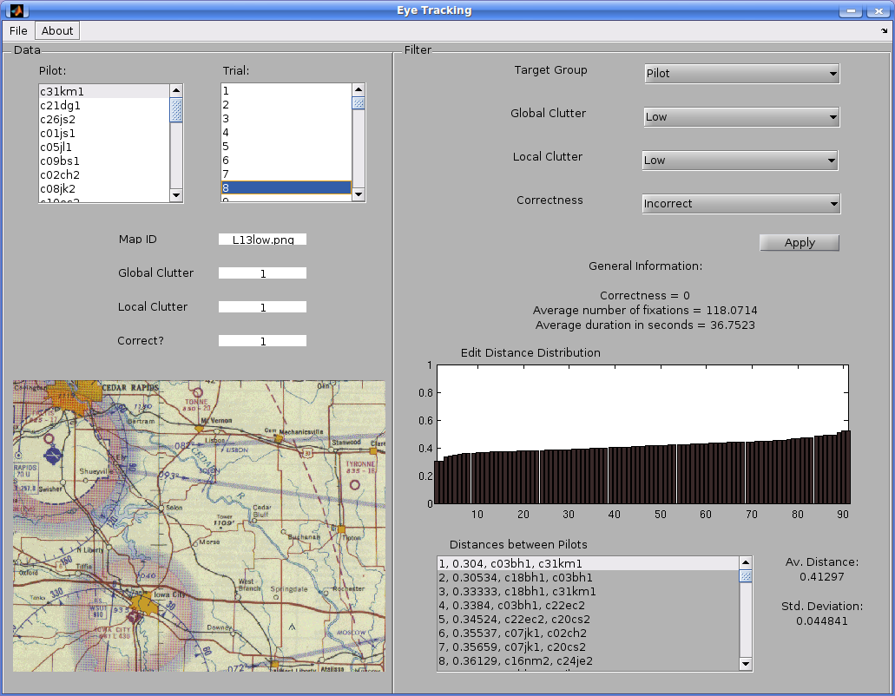
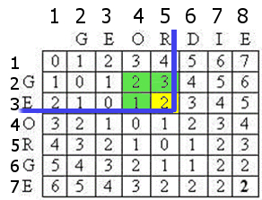
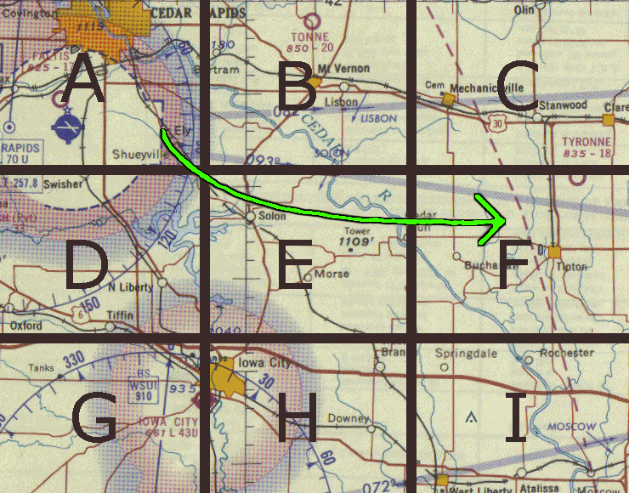
Analyzing Visual Scan Paths of Professionals and Novices
using Levenshtein Distance
Zach Belou, Justin Clemmons, Rebecca Gravois, Norwood Hingle, Jessica Wojtkiewicz
Introduction
The idea for this project came from Dr. Melissa Beck, from the LSU Psychology Department, and her experiment on comparing visual scan paths. Dr. Beck and her group tested pilots and undergraduate students’ ability to find a target icon in low, medium and high global clutter as quickly as possible. Eye tracking software tracked the scan paths of the participants as they tried to find the target before being timed out. The scan paths were formed from strings of consecutive fixation points, where participants’ eyes lingered for a few moments. The data provided by Dr. Beck was in the form of a spreadsheet with each row being one fixation. Data was recorded by individual participant, then by trial number, then by fixation point. Our goal with this project was to find a way to compare scan paths and create a user interface to compare the paths. Our methodology to find the scan paths was to convert the consecutive fixation points character strings. This process is outlined below. After converting scan paths to character strings, we used Levenshtein Distance to compute the similarities between paths. This information, along with basic summary statistics on participant scan behavior is included in our graphic user interface. The interface allows users to specify which scan paths they would like to compare based on the level of local clutter, global clutter, and correctness
Interface
Overview
In addition to creating a structure within MATLAB for the data given to us by Dr. Beck, our group created a Graphical User Interface (GUI) in MATLAB to portray the work that we completed throughout
the semester. Our GUI organizes the data and presents the information in a visually appealing and
easy-to-understand manner, which allows a user to see specific trials completed during an experiment without hassling with a complicated spreadsheet in Excel. In our GUI, there are three main parts: data,
filter, and edit distance distribution. The picture above is a screenshot of the GUI that we created.
On the left side of the GUI is a column that directly correlates to the spreadsheet given to us by Dr. Beck. The user must click on one of the 12 pilots in the first list box as well as one of the 72 trials
completed by the chosen pilot in the second list box. Once the user does this, the map shown during the chosen trial, the amount of global and local clutter, and whether the pilot was correct or not is shown on the left column of the GUI. For global clutter, the value one corresponds to low global clutter, two to medium global clutter, and three to high global clutter. For local clutter, the value zero corresponds to absent target, one to low local clutter, and two to high local clutter. For correctness, the value one means the pilot was correct during the trial chosen and zero means the pilot was not correct.
On the right side of the GUI, the user is able to apply a filter to the data within the structure by selecting the amount of global clutter, amount of local clutter, and correctness of the trials. The edit distance distribution and the distances between all pairwise combinations of pilots that have passed the filter are also shown in the axes and list box on the bottom-right side of the GUI. The average distance and the standard deviation between all combinations of the pilots listed are also displayed.
Edit Distance
$${lev}_{a,b}\left(i,j\right)= \left\{\begin{aligned}&\max\left(i,j\right) if\min\left(i,j\right)=0 \\ &min\left\{\begin{aligned}&{lev}_{a,b}\left(i−1,j\right)+1 \\ &{lev}_{a,b}\left(i,j−1\right)+1 \\ &{{lev}_{a,b}\left(i−1,j−1\right)+1}_{\left(a_{i}≠b_{j}\right)}\end{aligned}\right\} otherwise \end{aligned}\right\}$$
This example demonstrates how the similarity between two character strings is represented using the Levenshtein Matrix. Each entry denotes the dissimilarity, or distance, within different parts of each string. For example, in computing entry (4,4), you can easily observe that the distance between GEO and GEO is 0. (no dissimilarity). The entry (5,3) would denote the distance between GEOR and GE. Using the formula above, we add one to the entry directly above (5,3), 3+1=4, add one to the entry directly to the left of (5,3), 1+1=2, and add one (because R≠E) to the entry directly upper left and diagonal to (5,3), 2+1=3. Because the minimum of these computations is 2, the entry for (5,3) is 2. We compute the rest of the entries in a similar way, starting at the entry at top left corner of the matrix, until we arrive at the entry on the bottom right corner of the matrix, which tells us the total Levenshtein distance between the two strings.
Path to String Conversion
A grid was overlaid on the scanned image containing the target and each cell in the grid was assigned a unique character. For each trial, the path of the eye movements was scanned and converted into a sequence of characters in a string. For example, in the picture above, the scan path (denoted by the green arrow) corresponds to the sequence AEF as it passes through these cells. Edit or Levenshtein distance is a method of comparing scan paths by measuring dissimilarity between two character strings. Similarity between paths is represented as the number of transformation steps (insertion, deletion, substitution) between two strings to transform one string into the other.
Conclusion
During our project, we were successfully able to read the fixation data into a structural array, convert the fixation paths of each trial into character strings based on the grid pattern specified, use Levenshtein Distance to compare two scan paths to each other, and create a graphic user interface to display our findings. The structure of the array that now reads the data will make statistical analysis easier in the future. The Levenshtein Distance is a promising lead to compare scan paths, but other distance formulas can be looked into in order to compare a greater number of paths at once. Our project focused on reading the data and being able to present the data in an easy to understand format, but future work can focus on fixation duration, correctness, and saccade length. By transforming the scan paths into character strings, the data has been converted into a form similar to DNA sequences. It might be useful to look up methods used for DNA comparison and categorization. This will be worth looking into in future work on this experiment.
References
“Searching in Clutter: Visual Attention Strategies of Expert Pilots” 2012 Melissa R. Beck, Michael Trenchard, Amanda van Lamsweerde, Rebeccah R. Goldstein, Maura Lohrenz
“A Comparison of Scan Path Comparison Methods” pg.2 2014 Nicola C. Anderson, Fraser Anderson, Alan Kingstone, Walter F. Bischof
Acknowledgments
Thank you to our professor Dr. Peter Wolenski.
Thanks to PHD student Aleksandr Smirnov, for guiding us in this project and helping with coding.
Thanks to Dr. Mellissa R. Beck, LSU Associate Professor of Psychology.

