Slide 1
Analyzing Visual Scan Paths of Professionals and Novices using Levenshtein Distance
Zach Belou, Justin Clemmons, Rebecca Gravois,
Norwood Hingle, Jessica Wojtkiewicz

Slide 2
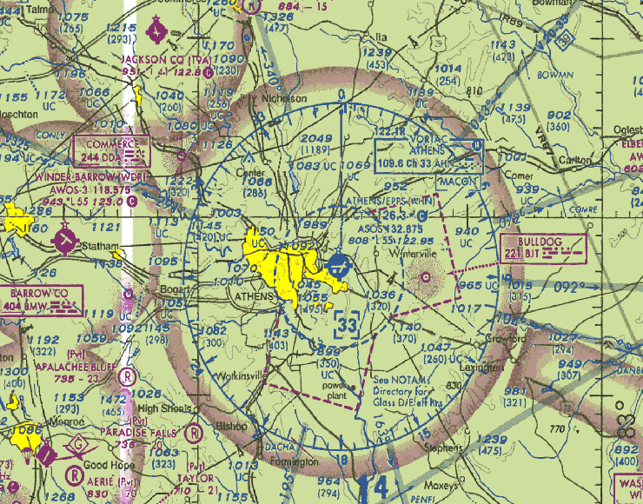
Introduction
Navy pilots and undergraduates scan naval radar maps for a target icon
Goal of the experiment: To find the target icon as quick as possible
Eye tracking software was used to analyze the scan path of the participant
Our goal was to compare the scan paths of professionals vs. undergraduate

Slide 3
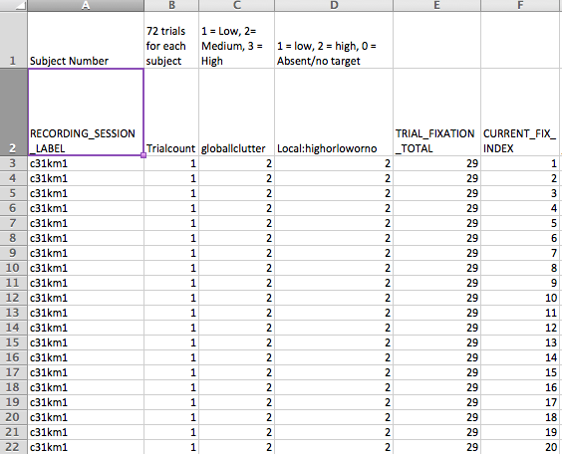
Data Structure
We originally received the data in an Excel file
Each line in the Excel file is a new fixation
We inputted this data into a nested structure of arrays
Array of Pilots: each element indicates a new participant
Array of Trials: each element indicates a new trial
Array of Fixations: each element indicates a new fixation point on the map

Slide 4
Path-String Converter
Path string:
“GEB”

Slide 5
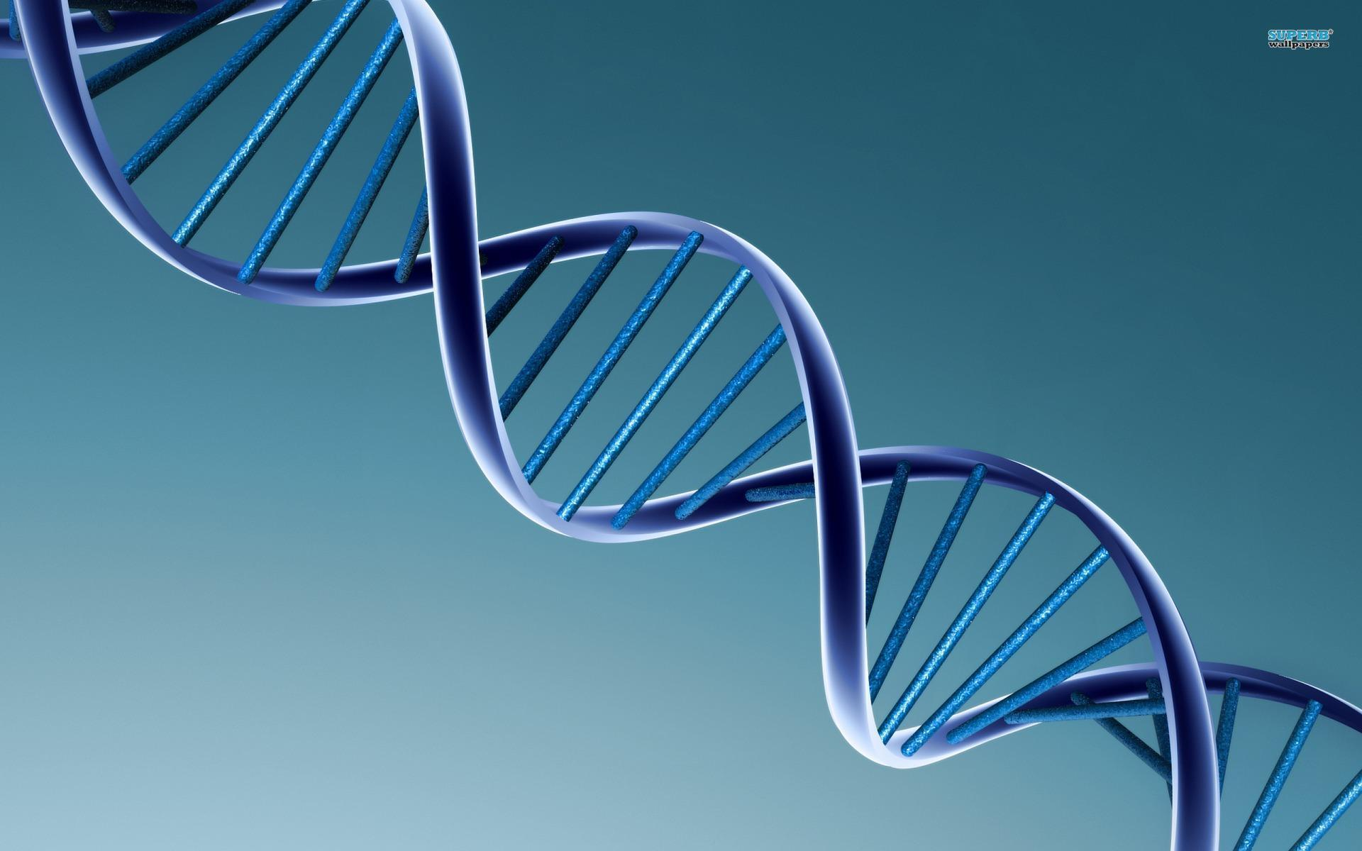
Levenshtein Distance Examples
Compares two strings or nucleotide sequences by analyzing the similarities within each sequence of bases.
- AGGCTATCACCTGACCTCCAGGCCGA - -TGCCC - - -
TAG –CTATCAC - -GACCGC - -GGTCGA TTTGCCCGAC
Comparison of genes from different species can:
Expose mutations
Shed light on function of specific gene
Reveal possible evolutionary trends

Slide 6
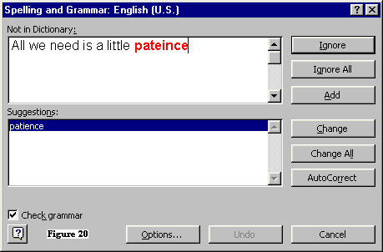
Approximate String Matching
Finds matches for short strings in longer texts, where there are low levels of dissimilarity (Fuzzy String Searching)
Wide range of applications:
Spellcheck
Record Linkage
Spam Filtering
Music identification from small snatches
Natural Language Translation Software

Slide 7
Levenshtein Distance
Background
Russian Scientist Vladimir Levenshtein develops in 1965
Used in spell check
Used in DNA

Slide 8
Example
Strings based on grid coordinates
Uses insertion(1), deletion(1), substitution(2)
Use minimum value in each cell
Bottom right value becomes minimum distance
Trace back tells us similar parts
 |  | E | X | E | C | U | T | I | O | N
 | 0 | 1 | 2 | 3 | 4 | 5 | 6 | 7 | 8 | 9
I | 1 | 2 | 3 | 4 | 5 | 6 | 7 | 6 | 7 | 8
N | 2 | 3 | 4 | 5 | 6 | 7 | 8 | 7 | 8 | 7
T | 3 | 4 | 5 | 6 | 7 | 8 | 7 | 8 | 9 | 8
E | 4 | 3 | 4 | 5 | 6 | 7 | 8 | 9 | 10 | 9
N | 5 | 4 | 5 | 6 | 7 | 8 | 9 | 10 | 11 | 10
T | 6 | 5 | 6 | 7 | 8 | 9 | 8 | 9 | 10 | 11
I | 7 | 6 | 7 | 8 | 9 | 10 | 9 | 8 | 9 | 10
O | 8 | 7 | 8 | 9 | 10 | 11 | 10 | 9 | 8 | 9
N | 9 | 8 | 9 | 10 | 11 | 12 | 11 | 10 | 9 | 8
+2
+1
+1

Slide 9
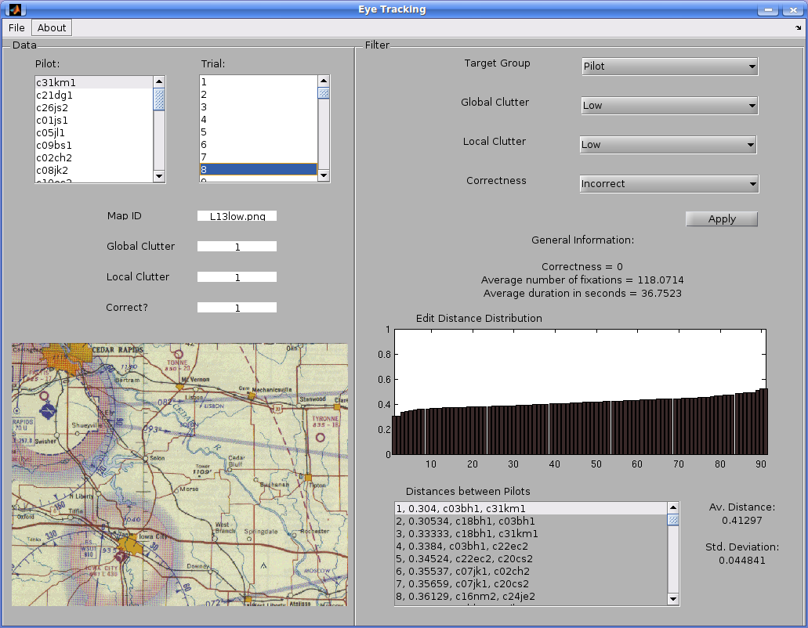
Interface

Slide 10
Summary
Importing the scan path data from spreadsheet into structural array
Converting the coordinate distance of fixations into character strings
Comparing scan paths with Levenshtein Distance

Slide 11
Future Work
Scan path comparisons between more trials
More advanced statistics on scan paths to compare
Similarities between character string scan paths and DNA sequencing

