Slide 1
Infant Suck Detection Interface
By: Amy Adair, Abiti Adili, Zachary Bradshaw, Joshua Brock, Brandon Dellucky, Heewon Hah, Margarite Laborde, Hugo Leiva, Miles Robicheaux, Sima Sobhiyeh, Zhaoxia (Mary) Wang, Jerome Weston

Slide 2
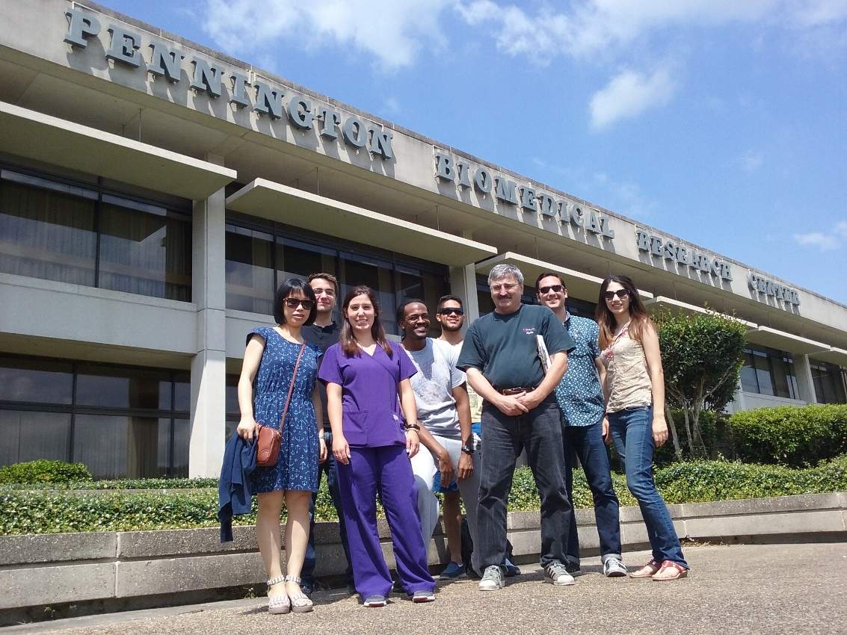
Collaboration with Pennington
Their Goals
Study infant suck behavior
Analyze connection between infant sucking and weight gain
Our Goals
Create GUI to detect sucks in signal
Improve methods of data analysis within the program

Slide 3
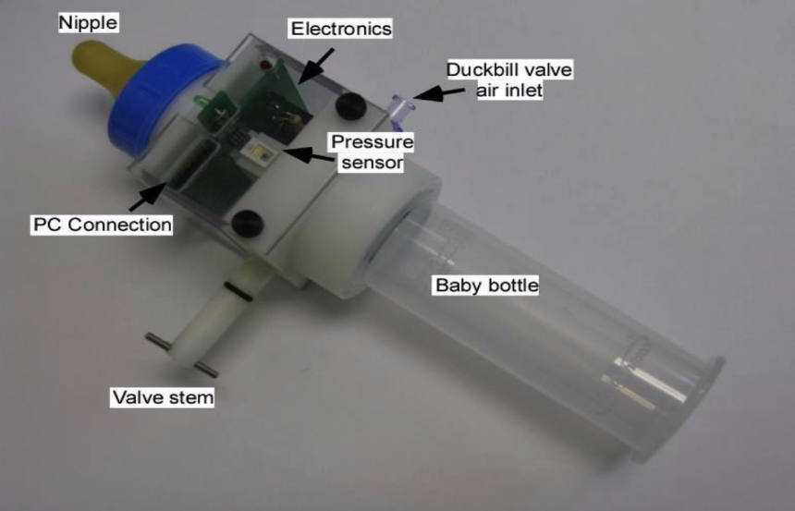
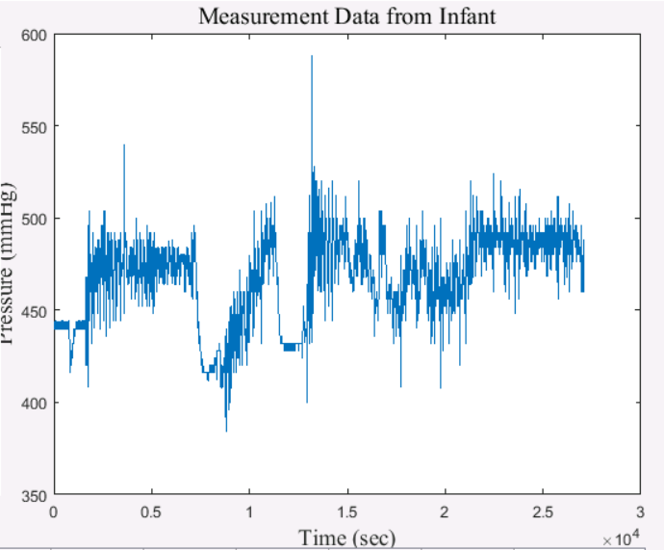
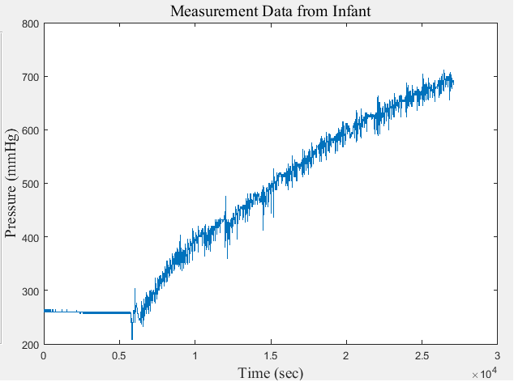
The Device and its Data
What the bottle does
  Measures pressure on the bottles nipple
Possible Issues
  Data Collection Error
    Seals – If loose, skewed pressure values
    Reusable Chip – Degrade?
    Different Chips –Different results ?
Device or Analysis?

Slide 4
Problems with the Original Program
GUI was not user-friendly
  Multiple Windows
  Slow
Implementation of code was sloppy
  Too many for loops
  Didn’t use Mat Lab's strengths
    Matrix and Vector Operations
  Memory was not Pre-allocated
Algorithms were inefficient

Slide 5
Analysis of a Signal
Previous Approaches
Wavelet Transforms
  Reported not to work
Neural Network
  Output not acceptable for testing data
  Correlation between data and NN trained with its parameters
Proper Orthogonal Decomposition
  Current Method
  Prototype was an average of several data samples
“Detection, Identification and Classification of Suck, Swallow and Breathing Activity In Premature Infants During Bottle-Feeding” by Fedra Adnani

Slide 6
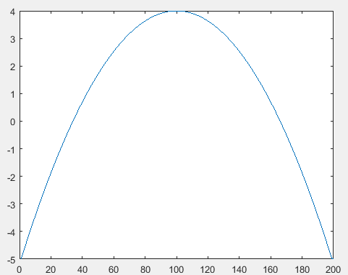
Analysis of a Signal
Noise vs Suck
Correlation between prototype and data window
Minimum width check
Threshold check
Original Prototype

Slide 7
Analysis of a Signal
Original Algorithm
First While Loop:
  Moves window step by step through the entire signal
Second While Loop:
  Computes correlation coefficient until a window is found with sufficient correlation
  Checks that max – min pressure is greater than threshold (after third loop is complete)
  Checks that window is less than size of widest suck
Third While Loop:
  Adjusts starting point of data window to compute the optimal correlation coefficient
  Checks that window is greater than size of smallest suck
Third Loop
Second Loop
First Loop

Slide 8
Analysis of a Signal
Reordered Algorithm
First While Loop:
  Moves window step by step through the entire signal
  Checks that norm of the signal is greater than threshold
Second While Loop:
  Computes correlation coefficient until a window is found with sufficient correlation
  Checks that window is less than size of widest suck
Third While Loop:
  Adjusts starting point of data window to compute the optimal correlation coefficient
  Checks that window is greater than size of smallest suck
Third Loop
Second Loop
First Loop

Slide 9
Analysis of a Signal
Loop Iterations For One Data Set
Before Reorder
First Loop Only: 0
Second While Loop: 19,905
Third While Loop: 24
Total Iterations: 19,929
After Reorder
First Loop Only: 1,819
Second While Loop: 2,555
Third While Loop: 21
Total Iterations: 4,395

Slide 10
Solving Inefficiencies
Problem: Original method of suck detection is slow
because it performs a brute force template matching
through the entire signal sample by sample.
Our Solution: Obtain suspected suck positions. Then perform suck detection only on that small subset of containing initially estimated suck positions.
Problem: Original algorithm performs template matching with every possible suck width at every position.
Our Solution: Calculate an initial estimate of the suck width and only perform suck detection on a small neighborhood of the estimated suck width.

Slide 11
The Proposed Algorithm
Pre-Processing
Finding the Initially Estimated Sucks
Perform Suck Detection on Initially Estimated Sucks

Slide 12


Block 1: Preprocessing
Low pass filter
x(n)
X(k)
$\hat{X}$(k)
$\hat{x}$(n)
Fast Fourier
Transform
Thresholding
Function
Inverse Fast Fourier
Transform
1) Take Discrete Fourier Transform (DFT).
2) Threshold low frequencies
3) Inverse DFT.

Slide 13
Block 1: Preprocessing
High pass filter
  Apply the Moving Average filter to smooth the signal. Once the signal has been preprocessed, we find the initially estimated sucks.

Slide 14
Block 2: Finding the Initially Estimated Sucks
Threshold and Crop
Threshold and crop original signal to remove all
amplitudes smaller than the minimum suck strength.
Find Local Peaks and Valleys
Find local peaks and valleys of the thresholded signal.
Calculate Widths
Associates two valleys to each peak, the first valley as
as the start and the second valley as the end of a suck.
Reverting to Original Signal Positions
Inserting the cropped sections back into the signal to
obtain actual suck positions.

Slide 15
Block 3: Perform Suck Detection on Initially Estimated Sucks
The original detection method uses template matching. This template is a simple parabola that acts as a prototype of a suck.
Instead of using a parabola, we developed a prototype from the characteristics of the data. To build this prototype we used Proper Orthogonal Decomposition (POD).

Slide 16
Proper Orthogonal Decomposition (POD)
The POD method allows us to create prototypes from the data itself.
Allows for multiple prototypes as well
More accurate than simple parabola

Slide 17


POD Analysis Procedure
Take snapshots ($u_{i}$) of data
Organize snapshots in a matrix ($U$)
Form the symmetric correlation matrix ($C$) of this data
Find the eigenvalues ($λ_{i})$ and eigenvectors ($v_{i})$ of C
  N Real-valued eigenvalues
  Orthonormal Basis
Motivation: Minimization of Error
$$u_{i}=[ \begin{matrix}u_{i,1} & … & u_{i,n}\end{matrix} ]$$
$$U=\left[\begin{matrix}| & | & \begin{matrix}… & |\end{matrix} \\ u_{1} & u_{2} & \begin{matrix} … & u_{N}\end{matrix} \\ | & | & \begin{matrix}… & |\end{matrix} \\ & & \begin{matrix} & \end{matrix}\end{matrix}\right]$$
$$C= U^{T}∗U$$
$$error= \sum_{i=1}^{n}{{\left|\left.u_{i }−\sum_{j=1}^{m}{a_{ij}φ_{j}}\right|\right.}^{2}}$$

Slide 18


POD Analysis Procedure (Cont’d)
Choose eigenvectors based on dominant eigenvalues to store as prototype ($Φ)$
  Manual vs. Automatic
$$Φ=\left[v_{1},v_{2},v_{3}, …\right]$$
with eigenvalues $λ_{1},λ_{2},λ_{3}$, …
$$\frac{\sum_{i=1}^{m}{λ_{i}}}{\sum_{j=1}^{N}{λ_{j}}} ≥k$$
  (N is the total number of eigenvalues, m < N and is the number we use, and k is the cutoff)

Slide 19


POD Analysis Procedure (Cont’d)
Now take the projection of the signal window onto $Φ$
Using the user-specified cutoff, q, determine if the window is a suck
We also explored weighting each vector according to it’s eigenvalue
Further work: Spectral POD
Projection:
$$\frac{{(\sum_{i=1}^{m}{{|\left\langle v_{i}, s\right\rangle |}^{2}})}^{\frac{1}{2}}}{|\left|s\right||} ≥q$$
Weighting:
$$\frac{λ_{i}}{\sum_{j=1}^{m}{λ_{j}}}v_{i}$$

Slide 20
POD GUI
Takes the patients demographics
Creates “snapshots” from sample data by selecting a start index and window size. When created, these snapshots are automatically resampled to all have the same length
Saves/loads lists of “snapshots” to include in the creation of prototypes
Generates and view the eigenvectors.
Manual and automatic options are available to select the dominant eigenvectors. These eigenvectors will be the prototypes, which are the final out-puts of this GUI.

Slide 21
Future Plans
Explore the possibility of different demographics having different suck types
  If true, build new prototypes for the different demographics using Spectral POD
Apply the prototypes to signals of new babies
Classify the babies based on how well their suck signals match the prototypes of their demographic

