Slide 1
Effective Mentoring of Undergraduates:
It’s both a science and an art!
Saundra Y. McGuire, Ph.D.
Assistant Vice Chancellor for Learning and Teaching
Professor, Department of Chemistry
Past Director, Center for Academic Success
Louisiana State University

Slide 2
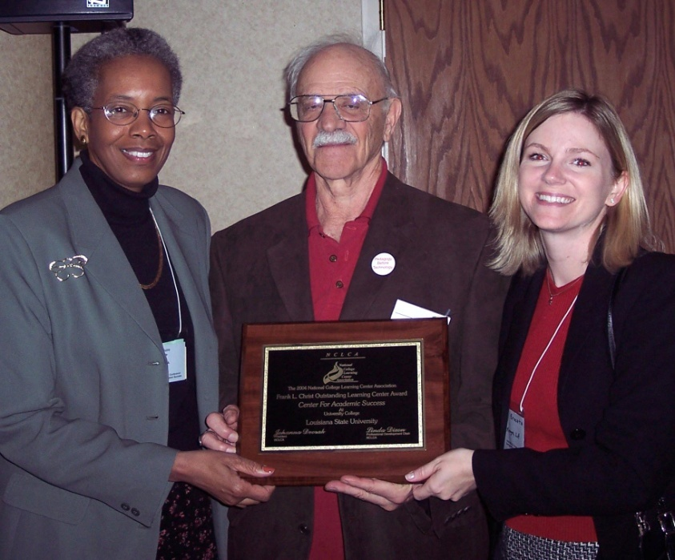

2004 National College Learning Center Association
Frank L. Christ Outstanding Learning Center Award
The Center for Academic Success

Slide 3
Reflection Question
Think of someone who is/was a good mentor to you. What were the qualities/actions/attitudes that made them a good mentor?
What’s the difference between science and art? In what sense is mentoring both?

Slide 4
The Story of Three LSU Students
Miriam, freshman calculus student
37.5, 83, 93
Robert, freshman chemistry student
42, 100, 100, 100
Terrence, junior Bio Engineering student
GPA 1.67 cum, 3.54 (F 03), 3.8 (S 04)

Slide 5
Protégé’s Cumulative Exam Record
Pursuing Ph.D. in Chemistry
2004 – 2005
9/04 Failed
10/04 Failed
11/04 Failed
12/04 Failed
1/05 Passed
2/05 Failed
3/05 Failed
4/05 Failed
2005 – 2006
10/05 Passed
11/05 Failed
12/05 Passed best in group
1/06 Passed
2/06 Passed
3/06 Failed
4/06 Passed last one!
5/06 N/A
Began work with CAS and Writing Center in October 2005

Slide 6
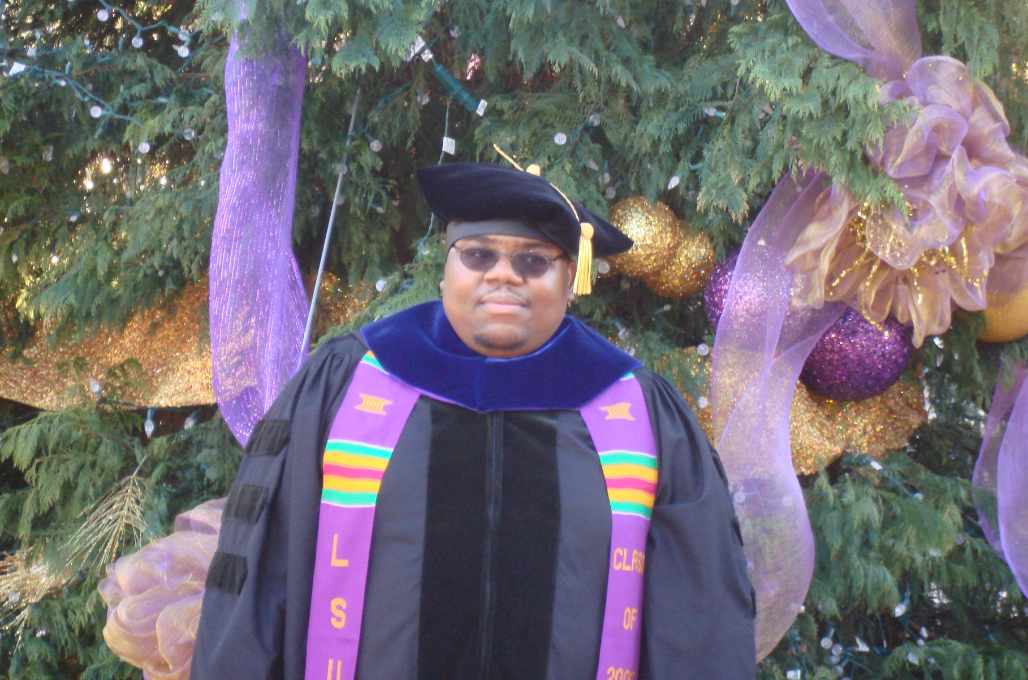
Dr. Algernon Kelley, December 2009

Slide 7
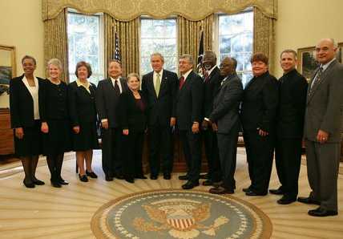
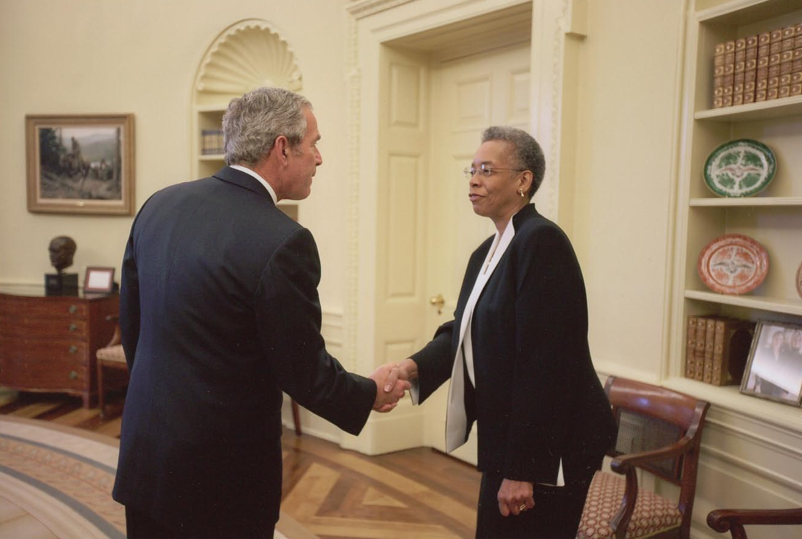
2006 Presidential Award for Excellence in Science Mathematics, and Engineering Mentoring
White House Oval Office
November 16, 2007
Saundra Y. McGuire

Slide 8
Desired outcomes
We will understand the importance
of structured mentoring based on the scientific method
We will understand the role of metacognition in mentoring
We will become more effective mentors
Our protégés will excel
with the assistance of good mentoring
We will develop mentoring skills for the rest of our academic careers

Slide 9
Overview
The Scientific Method
Definition of mentoring
Stereotype Threat
Role of metacognition in mentoring
Learning and Time Management Strategies That Work
Preparing Your Protégé for the poster presentation
Q & A & Discussion

Slide 10
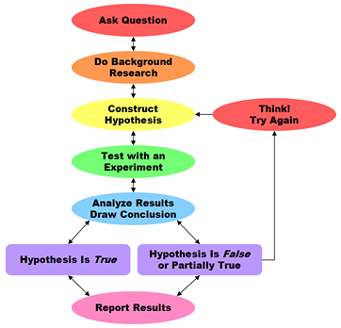
The Scientific Method
http://www.sciencebuddies.org/mentoring/project_scientific_method.shtml

Slide 11
What is a Mentor?
An individual who takes an active interest in helping a protégé set and achieve goals.

Slide 12
Applying the Scientific Method
to Mentoring

Slide 13
What is the question?
How can I be the most effective mentor to this particular protégé?

Slide 14
Background Research
What are the characteristics of my protégé?
  Learning style*
  Personality style*
  Modality preference*
  Cerebral Hemisphericity*
  Career interests
What are the protégé’s expectations of the mentoring experience?
What is the protégé’s cultural background?
*www.cas.lsu.edu

Slide 15
Reflection Question
What’s the difference, if any, between studying and learning? Which is more enjoyable?

Slide 16
Why don’t some students know how to learn or study?
It wasn’t necessary in high school
- 66% of 2003 entering first year students spent less than six hours per week doing homework in 12th grade.
- More than 46% of these students said they graduated from high school with an “A” average.
Higher Education Research Institute Study
http://www.gseis.ucla.edu/heri/03_press_release.pdf

Slide 17
Stereotype Threat: A Potential Barrier to Minority and Female Student Success
What is stereotype threat?
How might it affect students in VIGRE?
How can mentors decrease stereotype threat?

Slide 18
Construct Hypothesis
Protégé needs academic strategies
Protégé needs personal strategies
Protégé needs confidence boosting
Protégé needs independence
Others?

Slide 19
Test with Experiment
What happens if I provide protégé with specific learning strategies?

Slide 20
What we know about learning
Active learning is more lasting than passive learning
Thinking about thinking is important
  Metacognition
The level at which learning occurs is important
  Bloom’s Taxonomy

Slide 21
What learning strategies can I teach?
Metacognition
Organization and Time Management
Finding Additional Resources

Slide 22
Metacognition
The ability to:
think about thinking
plan and evaluate one’s learning
monitor and control one’s mental processing (e.g. “Am I understanding this material?”)
accurately judge one’s level of learning

Slide 23
This pyramid depicts the different levels of thinking we use when learning. Notice how each level builds on the foundation that precedes it. It is required that we learn the lower levels before we can effectively use the skills above.
Bloom’s Taxonomy
Evaluation
Making decisions and supporting views; requires understanding of values.
Graduate School
Combining information to form a unique product; requires creativity and originality.
Synthesis
Identifying components; determining arrangement, logic, and semantics.
Analysis
Undergraduate
Using information to solve problems; transferring abstract or theoretical ideas to practical situations. Identifying connections and relationships and how they apply.
Application
Restating in your own words; paraphrasing, summarizing, translating.
Comprehension
High School
Memorizing verbatim information. Being able to remember, but not necessarily fully understanding the material.
Knowledge
Louisiana State University  Center for Academic Success  B-31 Coates Hall  225-578-2872  www.cas.lsu.edu

Slide 24
Knowledge of Metacognition
Can Greatly Increase
Student Success
Some are less likely to have been cognitively challenged before?
Some are less likely to have been encouraged to “stick with it”
Some are more likely to suffer from “stereotype threat”
Most will experience the impact of a “paradigm shift”

Slide 25
Analyze Results
Hypothesis True
  Encourage continued success
Hypothesis False
  Construct new hypothesis based on protégé observation and reflection
  e.g. time management strategies needed

Slide 26
Time Management Tools
Weekly planner
Summer calendar
“To do” lists
Cell phone timer
Others?

Slide 27
Share Results
With other mentors colleagues
With VIGRE faculty
Others?

Slide 28
The Art of Mentoring
What’s the difference between an art and a science?
What makes mentoring an art?

Slide 29
Mentors Can Span the Gamut from Magical to Monstrous!
Protégés Can Cover the Spectrum from Perfect to Problematic!

Slide 30
More magical mentor behaviors
Assist in plotting a career path
Let protégé make own decisions
Maintain integrity of the relationship between the protégé and the natural supervisor
Murray, Margo & Owen, Mara A. (1991). Beyond the Myths of Mentoring. San Francisco: Josey-Bass Publishers

Slide 31
Characteristics of
Monstrous Mentors
Controlling and Manipulative
Self – Centered
Legend in their own mind
Lack respect for protégé’s
intelligence and ability
Use personal information to
undermine protégé
Take credit for protégé’s work
Unwilling to remain on professional level

Slide 32
What Mentors Should Know
Your protégé’ is not you
Listen > talk
How to brainstorm solutions with protégé
How to communicate high expectations
How to help protégé deal with setbacks
When to call in others

Slide 33
Characteristics of Perfect Protégés
Interested in Receiving Advice
Receptive to Constructive Criticism
Responsive to Coaching
Spend time preparing for mentoring session
Unafraid of asking probing questions

Slide 34
Characteristics of Problematic Protégés
  Regularly miss appointments
  Fail to heed advice
  Refuse to take responsibility
  Generally unenthusiastic and negative
  Rarely, if ever, express appreciation
  Don’t give credit to mentor for his/her contribution

Slide 35
The Role of Confidence
in Learning and Performance
Students are more likely to attempt activities at which they feel confident they can be successful.
Mentors can give students the confidence to try, and the strategies to succeed!
"If you think you can...or if you think you can't...you're right!“ Henry Ford

Slide 36
The Connection Between Emotions, Motivation, and Learning
Positive emotions lead to increased motivation, which leads to increased learning, which leads to increased success, which results in positive emotions.
Increased learning
Increased success
Positive emotions
Increased motivation

Slide 37
Start using the scientific method now to improve your mentoring
What’s the right question?
What background info do you need?
What hypotheses can you generate?
What experiments can you try?
What will the results imply?
To whom can you report the results?

Slide 38
Final Note
Please visit the CAS website at www.cas.lsu.edu, and feel free to contact me at smcgui1@lsu.edu. I wish you great success as you help your proteges achieve great success this summer!
Saundra McGuire

Slide 39
References
Aronson, J., Fried, C.B., & Good, C. (2002). Reducing the Effects of Stereotype Threat on African American College Students by Shaping Theories of Intelligence. Retrieved August 5, 2007 from http://www.atkinson.yorku.ca/~jsteele/files/04082317412924405.pdf
Bruer, John T. , 2000. Schools For Thought: A Science of Learning in the Classroom. MIT Press.
Bransford, J.D., Brown, A.L., Cocking, R.R. (Eds.), 2000. How people learn: Brain, Mind, Experience, and School. Washington, DC: National Academy Press.
Halpern, D.F and Hakel, M.D. (Eds.), 2002. Applying the Science of Learning to University Teaching and Beyond. New York, NY: John Wiley and Sons, Inc.
Nilson, Linda, 2004. Teaching at It’s Best: A Research-Based Resource for College Instructors. Bolton, MA: Anker Publishing Company.

Slide 40
References Continued
Murray, M. and Owen, M. (1991). Beyond the Myths of Mentoring. San Francisco, CA: Josey-Bass.
Peddy, S. (2001). The Art of Mentoring: Lead, Follow, and Get Out of the Way. Houston, TX: Bullion Books.
Peirce, W. (2003). Metacognition: Study Strategies, Monitoring, and Motivation. Retrieved August 4, 2007 from
http://academic.pg.cc.md.us/~wpeirce/MCCCTR/metacognition.htm
Zull, James (2004). The Art of Changing the Brain. Sterling, VA: Stylus Publishing.

