Slide 1
Acing Undergraduate and Graduate School:
Metacognition is the Key!
Saundra Yancy McGuire, Ph.D.
Asst. Vice Chancellor for Learning & Teaching
Professor, Department of Chemistry
Past Director, Center for Academic Success
Louisiana State University
Baton Rouge, LA

Slide 2


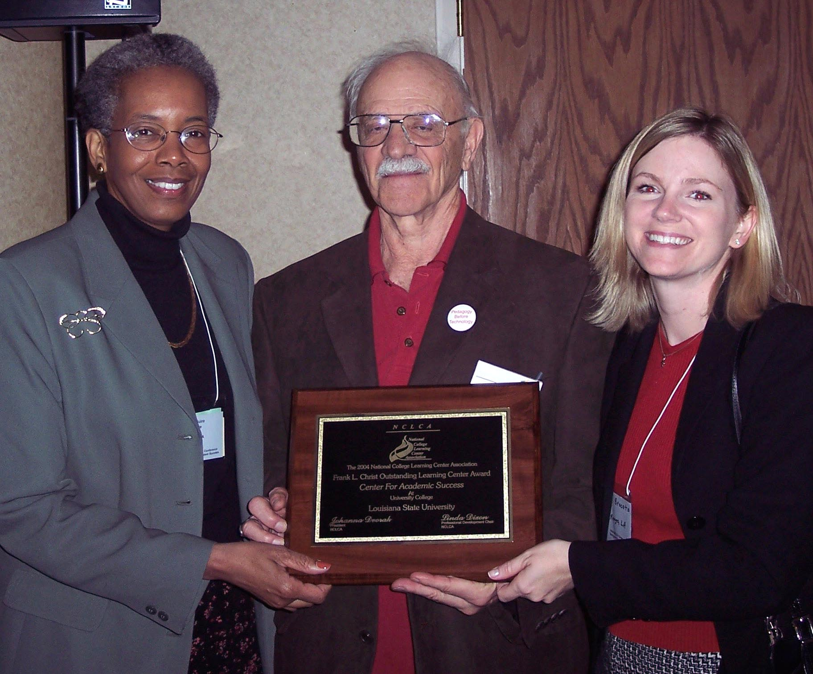
2004 National College Learning Center Association
Frank L. Christ Outstanding Learning Center Award

Slide 3
The Story of Four LSU Students
Travis, junior psychology student
47, 52, 82, 86 B in course
Robert, first year chemistry student
42, 100, 100, 100 A in course
Maryam, first year art student
57, 87 B in course
Dana, first year physics student
80, 54, 91, 97, 90 (final) A in course

Slide 4
Dana’s Spring 2010 Grades
Courses
Dept Course Grade Hrs Carried Hrs Earned Quality Pts
BIOL 1201 A 3.00 3.00 12.00
CSC 1253 A 3.00 3.00 12.00
MATH 2090 A 4.00 4.00 16.00
MEDP 2051 A 3.00 3.00 12.00
PHYS 2221 A 3.00 3.00 12.00
Current Cumulative GPA: 3.88

Slide 5
Final Examination Improvement
Date of Final Exam: December 14, 2005
Meeting with Student No. 1: December 12, 2005
Meeting with Student Nos. 2 & 4: December 2, 2005
Meeting with Student No. 3: December 8, 2005
The final was worth 100 points with a 10 bonus question.

Slide 6
How’d They Do It?
They became expert, strategic learners
by using metacognition!
They studied to LEARN,
not just to make the grade!

Slide 7
What we will cover today
Why university students may be inefficient learners
Metacognitive learning strategies that work, and why they work
Barriers to using these strategies and how to overcome them

Slide 8
Reflection Questions
Does your current GPA reflect your academic ability or the effort/time you have put into your courses to date?
What’s the difference, if any, between
studying and learning? Which, if either, is more enjoyable? Why?
Approximately how many hours per week
do you study at UW

Slide 9
Use Metacognition to Become an Expert Learner

Slide 10
Metacognition
The ability to:
think about thinking
be consciously aware of oneself as a problem solver
to monitor and control one’s mental processing
to be aware of the type of learning that you are doing

Slide 11
Travis, junior psychology student
47, 52, 82, 86
Problem: Reading Comprehension
Solution: Preview text before reading
Develop questions
Read one paragraph at a time
and paraphrase information

Slide 12
Robert, freshman chemistry student
42, 100, 100, 100
Problem: Using examples to do homework problems
Solution: Study information before trying
homework problem
Use example to test skill
Do homework problems as if doing a test or quiz (no looking at solution manual or examples!)

Slide 13
Maryam, freshman art student
57, 87
Problem: Not seeing the underlying structure of different types of art
Solution: Focus on characteristics of different artists’ work in order to indentify the painter of an unfamiliar piece of art

Slide 14
Dana, first year physics student
80, 54, 91, 97, 90 (final)
Problem: Memorizing formulas and using www. cramster.com
Solution: Solve problems with no external aids and test mastery of concepts

Slide 15
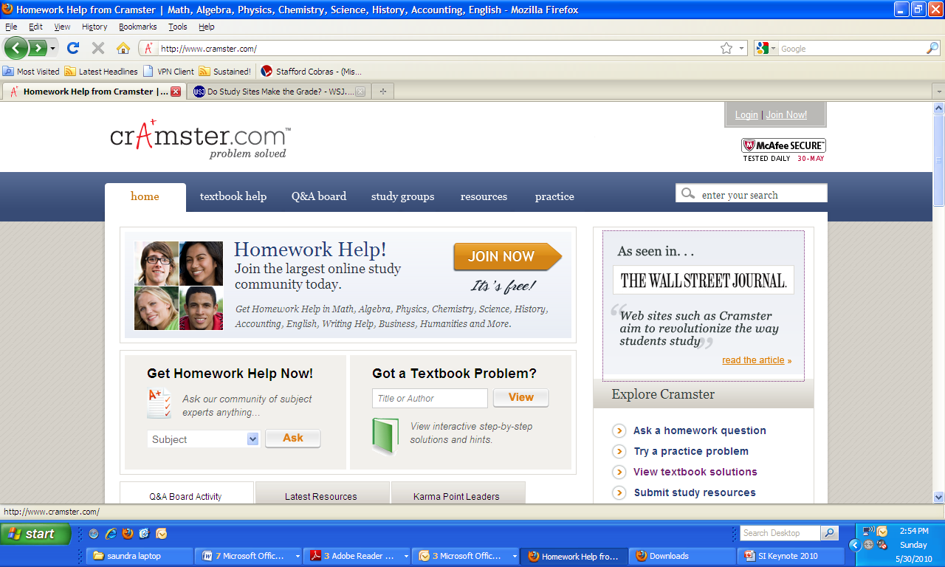

Slide 16
Dana’s Spring 2010 Grades
Course Grade Hrs Carried Hrs Earned Quality Pts
Biology A 3.00 3.00 12.00
Comp Sci A 3.00 3.00 12.00
Math A 4.00 4.00 16.00
Med. Phys A 3.00 3.00 12.00
Mechanics A 3.00 3.00 12.00
Current Cumulative GPA: 3.88

Slide 17
Counting Vowels in 45 seconds:
Let’s test our speed and accuracy
For the words on the next slide,
count all of the vowels

Slide 18
Dollar Bill
Dice
Tricycle
Four-leaf Clover
Hand
Six-Pack
Seven-Up
Octopus
Cat Lives
Bowling Pins
Football Team
Dozen Eggs
Unlucky Friday
Valentine’s Day
Quarter Hour

Slide 19
Write down all the words or phrases you remember

Slide 20
Dollar Bill
Dice
Tricycle
Four-leaf Clover
Hand
Six-Pack
Seven-Up
Octopus
Cat Lives
Bowling Pins
Football Team
Dozen Eggs
Unlucky Friday
Valentine’s Day
Quarter Hour
What are the words arranged according to?

Slide 21
NOW, how many words or phrases do you remember?

Slide 22
Turning Yourself into an
Efficient, Expert Learner
Do “think aloud” exercises
Constantly ask yourself “why” and “what if” questions
Always test your understanding by verbalizing or writing about concepts; practice retrieval of information
Move your activities higher on the Bloom’s taxonomy scale by comparing and contrasting, thinking of analogies, thinking of new pathways, etc.

Slide 23
This pyramid depicts the different levels of thinking we use when learning. Notice how each level builds on the foundation that precedes it. It is required that we learn the lower levels before we can effectively use the skills above.
Bloom’s Taxonomy
Evaluation
Graduate School
Making decisions and supporting views; requires understanding of values.
Combining information to form a unique product; requires creativity and originality.
Synthesis
Identifying components; determining arrangement, logic, and semantics.
Analysis
Undergraduate
Using information to solve problems; transferring abstract or theoretical ideas to practical situations. Identifying connections and relationships and how they apply.
Application
Restating in your own words; paraphrasing, summarizing, translating.
Comprehension
High School
Memorizing verbatim information. Being able to remember, but not necessarily fully understanding the material.
Knowledge
Louisiana State University  Center for Academic Success  B-31 Coates Hall  225-578-2872  www.cas.lsu.edu

Slide 24
At what level of Bloom’s did you have to operate to make A’s or B’s in high school?
Knowledge
Comprehension
Application
Analysis
Synthesis
Evaluation

Slide 25
At what level of Bloom’s do you think you’ll need to be to make A’s at the university level?
Knowledge
Comprehension
Application
Analysis
Synthesis
Evaluation

Slide 26
Study Strategies Gold Nugget
The Study Cycle with
Intense Study Sessions

Slide 27
How do you move yourself higher on Bloom’s Taxonomy?
Use the Study Cycle!

Slide 28

The Study Cycle
4
Reflect
3
Review
Preview
Preview before class – Skim the chapter, note headings and boldface words, review summaries and chapter objectives, and come up with questions you’d like the lecture to answer for you.
4
Reflect
Attend
Attend class – GO TO CLASS! Answer and ask questions and take meaningful notes.
Review after class – As soon after class as possible, read notes, fill in gaps and note any questions.
Review
Study – Repetition is the key. Ask questions such as ‘why’, ‘how’, and ‘what if’.
Intense Study Sessions* - 3-5 short study sessions per day
Weekend Review – Read notes and material from the week to make connections
Study
Assess your Learning – Periodically perform reality checks
Am I using study methods that are effective?
Do I understand the material enough to teach it to others?
Assess
*Intense Study Sessions
1 | Set a Goal | (1-2 min) | Decide what you want to accomplish in your study session
2 | Study with Focus | (30-50 min) | Interact with material- organize, concept map, summarize, process, re-read, fill-in notes, reflect, etc.
3 | Reward Yourself | (10-15 min) | Take a break– call a friend, play a short game, get a snack
4 | Review | (5 min) | Go over what you just studied
Center for Academic Success
B-31 Coates Hall ▪ 225.578.2872 ▪www.cas.lsu.edu

Slide 29
Time Management is
Life Management

Slide 30
Tools for organizing your life:
Fixed Schedules
  “Semester-at-a-Peek”
  “Week-at-a-Peek”
Planners
To Do Lists
  Today
  This Week
  Sticky Notes
Notes:
As you examine each of these tools, think about those you want to implement in your personal time management strategy.
The first tool is “fixed schedules”...

Slide 31
The Semester Schedule
Notes:
While referring to each syllabus from your classes, mark all major due dates, quizzes, exams, holidays, special events, and other deadlines on a calendar that shows the whole semester at a glance. (You can usually get one at the Learning Assistance Center--or at a local student book store or office supply store.) It is one of the best ways to keep mindful of the BIG PICTURE. You will start to notice certain weeks that will be very busy-- and those weeks that are not as crazy. This overview is extremely important as you to plan your study time.
The semester schedule is an excellent tool. Most students find it helpful to complete one each semester. This overview of your entire semester is essential to good planning. Tests and other due dates will not sneak up on you when this is hanging on the front of your refrigerator, tacked over your desk, or taped to your front door for easy and frequent reference.

Slide 32
The “Week at a Peek” Schedule
Notes:
A fixed schedule includes those items that, for the most part, do not change--they are “fixed”. For example, most students complete a “Week-at-a-Peek” schedule (see example) at the beginning of the semester. It includes their classes and club or organizational meetings that are constant throughout the semester.
Again, this type of schedule is particularly important at the beginning of the semester, but you won’t probably need it after a few weeks. By then you have memorized your “fixed” weekly schedule.
Another fixed schedule we recommend you create at the beginning of the semester is the “Semester-at-a-Peek” schedule...

Slide 33
Tips to remember...
Use daylight hours wisely!
1 day light hour =
about 1 1/2 evening hours.
Notes:
It’s true for most people, so try to study during the day. Those small 15-30 minute “free moments” between meetings or classes are valuable for short, yet important review sessions.

Slide 34
ABC’s of Excellence
Adopt the right ATTITUDE
Begin appropriate BEHAVIOR
Consistently make a COMMITMENT

Slide 35
Attitude
“It’s your attitude, not your aptitude,
that determines your altitude.”
Zig Ziglar

Slide 36
Behavior
It’s the difference between knowing
and doing that determines success. Anonymous
Don’t let other folks hijack your future!

Slide 37
Commitment
It’s not over ‘til it’s over, and YOU determine when it’s over!
Change strategies when necessary, but never give up your goals. If you can dream it, you can achieve it!

Slide 38
So, What Can You Do, Starting Now, to Ensure that Your GPA will reflect your ability?
Spend more time studying
(at least 2 hours/week for every hour in class)
Aim for higher learning levels and 100% mastery
Use office hours and study groups productively
Use the Study Cycle
with Intense Study Sessions
Use Metacognition to Study Smarter!!!

Slide 39
Writing Exercise
What two strategies will you commit to using until the end of the semester?

Slide 40
If you don’t try it in within the next 48 hours...
… you probably never will.

Slide 41
Final Note
Please visit our website at www.cas.lsu.edu.
We have on-line workshops and information that will teach you additional effective study strategies. I wish you a fantastically successful future!
Dr. Saundra McGuire

