Slide 1
Effective Mentoring:
It’s both a science and an art!
Saundra Y. McGuire, Ph.D.
Assistant Vice Chancellor for Learning and Teaching
Professor, Department of Chemistry
Past Director, Center for Academic Success
Louisiana State University

Slide 2
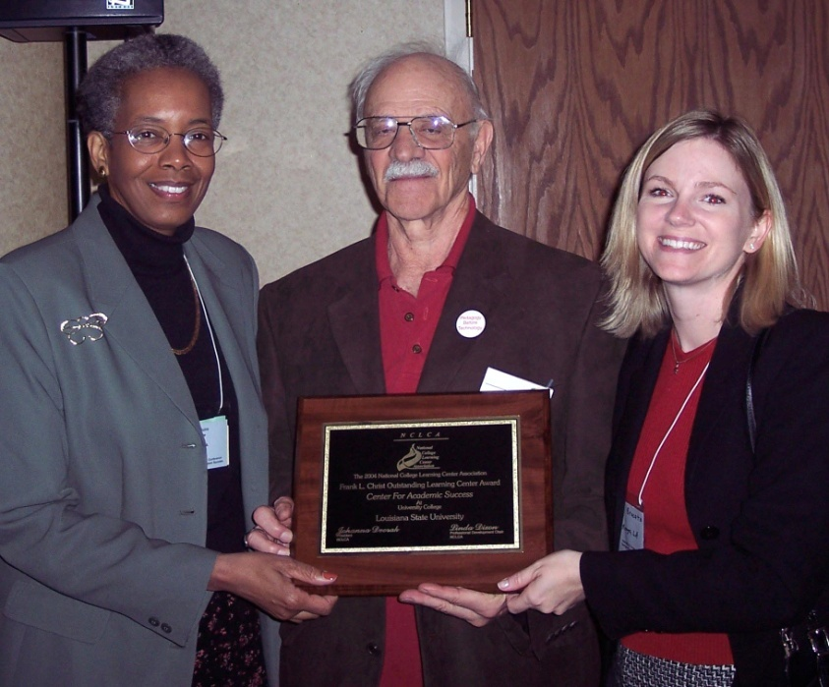
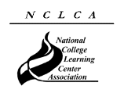
2004 National College Learning Center Association
Frank L. Christ Outstanding Learning Center Award
The Center for Academic Success

Slide 3
Reflection Questions
Think of someone who is/was a good mentor to you. What were the qualities/actions/attitudes that made them a good mentor?
What’s one thing you know now about college that you wish you had known when you started?

Slide 4
The Story of Four Students
Miriam, freshman calculus student
37.5, 83, 93
Robert, freshman chemistry student
42, 100, 100, 100
Dana, freshman physics student
80, 54, 91, 97, 90 (final exam)
Terrence, junior Bio Engineering student
GPA 1.67 cum, 3.54 (F 03), 3.8 (S 04)

Slide 5
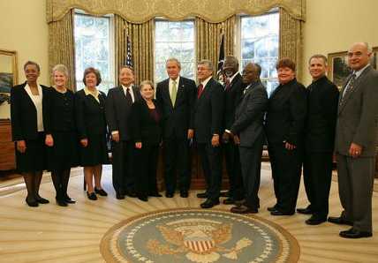
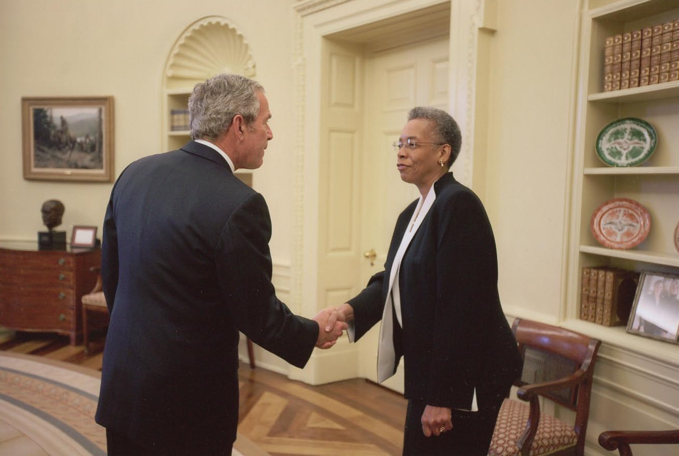
2006 Presidential Award for Excellence in Science Mathematics, and Engineering Mentoring
White House Oval Office
November 16, 2007
Saundra Y. McGuire

Slide 6
Desired outcomes
We will understand the importance
of structured mentoring
We will understand the role of metacognition in mentoring
We will become more effective mentors
Our protégés will excel
with the assistance of good mentoring

Slide 7
Overview
Definition of mentoring
Role of metacognition in mentoring
Learning and Time Management Strategies That Work
Q & A & Discussion

Slide 8
What is Your Role as a Mentor?
To actively promote academic and personal growth in your protégé by sharing knowledge and insights that the two of you have gained over the years.
Note that you don’t have to have all of the answers -- just knowledge of strategies and resources.

Slide 9
What is the question?
How can I be the most effective mentor to this particular protégé?

Slide 10
Understanding Your Protégé
What are the characteristics of my protégé?
  Learning style*
  Personality style*
  Modality preference*
  Cerebral Hemisphericity*
  Career interests
What are the protégé’s expectations of the mentoring experience?
What is the protégé’s cultural background?
*www.cas.lsu.edu

Slide 11
Reflection Question
What’s the difference, if any, between studying and learning? Which is more enjoyable?

Slide 12
Why don’t students know how to learn or how to study?
It wasn’t necessary in high school
- 63% of 2010 entering first year students spent less than six hours per week doing homework in 12th grade.
- More than 48% of these students said they graduated from high school with an “A” average.*
- Students’ confidence level is high
71.2 % believe their academic ability is above average or in the highest 10 percent among people their age
*2010 Higher Education Research Institute Study

Slide 13
Helping Your Protégé Learn More
Active learning is more lasting than passive learning
Thinking about thinking is important
  Metacognition
The level at which learning occurs is important
  Bloom’s Taxonomy

Slide 14
What learning strategies can you teach and/or model?
Metacognition
Organization and Time Management
Finding Additional Resources

Slide 15
Metacognition
The ability to:
think about thinking
plan and evaluate one’s learning
monitor and control one’s mental processing (e.g. “Am I understanding this material?”)
accurately judge one’s level of learning

Slide 16
This pyramid depicts the different levels of thinking we use when learning. Notice how each level builds on the foundation that precedes it. It is required that we learn the lower levels before we can effectively use the skills above.
Bloom’s Taxonomy
Evaluation
Making decisions and supporting views; requires understanding of values.
Graduate School
Combining information to form a unique product; requires creativity and originality.
Synthesis
Identifying components; determining arrangement, logic, and semantics.
Analysis
Undergraduate
Using information to solve problems; transferring abstract or theoretical ideas to practical situations. Identifying connections and relationships and how they apply.
Application
Restating in your own words; paraphrasing, summarizing, translating.
Comprehension
High School
Memorizing verbatim information. Being able to remember, but not necessarily fully understanding the material.
Knowledge
Louisiana State University  Center for Academic Success  B-31 Coates Hall  225-578-2872  www.cas.lsu.edu

Slide 17
Counting Vowels in 30 seconds
How accurate are you?

Slide 18
Dollar Bill
Dice
Tricycle
Four-leaf Clover
Hand
Six-Pack
Seven-Up
Octopus
Cat Lives
Bowling Pins
Football Team
Dozen Eggs
Unlucky Friday
Valentine’s Day
Quarter Hour

Slide 19
How many words or phrases do you remember?
5
2 or less
3 – 5
6 – 8
9 – 12
13 or more

Slide 20
Knowledge of Metacognition
Can Greatly Increase
Student Success
Some are less likely to have been cognitively challenged before
Some are less likely to have been encouraged to “stick with it”
Some are more likely to suffer from “stereotype threat”
Most will experience the impact of a “paradigm shift”

Slide 21
Time Management Tools
Weekly planner
Summer calendar
“To do” lists
Cell phone timer
Others?

Slide 22
The Art of Mentoring
What’s the difference between an art and a science?
What makes mentoring an art?

Slide 23
The Art of Mentoring
What’s the difference between an art and a science?
What makes mentoring an art?

Slide 24
Mentors Can Span the Gamut from Magical to Monstrous!
Protégés Can Cover the Spectrum from Perfect to Problematic!

Slide 25
More magical mentor behaviors
Assist in plotting a career path
Let protégé make own decisions
Maintain integrity of the relationship between the protégé and the natural supervisor
Murray, Margo & Owen, Mara A. (1991). Beyond the Myths of Mentoring. San Francisco: Josey-Bass Publishers

Slide 26
Characteristics of
Monstrous Mentors
Controlling and Manipulative
Self – Centered
Legend in their own mind
Lack respect for protégé’s
intelligence and ability
Use personal information to
undermine protégé
Take credit for protégé’s work
Unwilling to remain on professional level

Slide 27
What Mentors Should Know
Your protégé’ is not you
Listen > talk
How to brainstorm solutions with protégé
How to communicate high expectations
How to help protégé deal with setbacks
When to call in others

Slide 28
Characteristics of Perfect Protégés
Interested in Receiving Advice
Receptive to Constructive Criticism
Responsive to Coaching
Spend time preparing for mentoring session
Unafraid of asking probing questions

Slide 29
Characteristics of Problematic Protégés
  Regularly miss appointments
  Fail to heed advice
  Refuse to take responsibility
  Generally unenthusiastic and negative
  Rarely, if ever, express appreciation
  Don’t give credit to mentor for his/her contribution

Slide 30
The Role of Confidence
in Learning and Performance
Students are more likely to attempt activities at which they feel confident they can be successful.
Mentors can give students the confidence to try, and the strategies to succeed!
"If you think you can...or if you think you can't...you're right!“ Henry Ford

Slide 31
The Connection Between Emotions, Motivation, and Learning
Positive emotions lead to increased motivation, which leads to increased learning, which leads to increased success, which results in positive emotions.
Increased learning
Increased success
Positive emotions
Increased motivation

Slide 32
Help Your Protégé (and YOURSELF!) have a great time this summer!
It’s as easy as A, B, C

Slide 33
Attitude
“It’s your attitude,
not your aptitude,
that determines your altitude.”
Zig Ziglar

Slide 34
Behavior
It’s the difference between knowing
and doing that determines success. Anonymous

Slide 35
Commitment
It’s not over ‘til it’s over,
and only you or the protégé
can determine when it’s over!

Slide 36
Final Note
Please visit the CAS website at www.cas.lsu.edu, and feel free to contact me at smcgui1@lsu.edu. I wish you an enjoyable and productive summer experience!
Saundra McGuire

Slide 37
References
Aronson, J., Fried, C.B., & Good, C. (2002). Reducing the Effects of Stereotype Threat on African American College Students by Shaping Theories of Intelligence. Retrieved August 5, 2007 from http://www.atkinson.yorku.ca/~jsteele/files/04082317412924405.pdf
Bruer, John T. , 2000. Schools For Thought: A Science of Learning in the Classroom. MIT Press.
Bransford, J.D., Brown, A.L., Cocking, R.R. (Eds.), 2000. How people learn: Brain, Mind, Experience, and School. Washington, DC: National Academy Press.
Halpern, D.F and Hakel, M.D. (Eds.), 2002. Applying the Science of Learning to University Teaching and Beyond. New York, NY: John Wiley and Sons, Inc.
Nilson, Linda, 2004. Teaching at It’s Best: A Research-Based Resource for College Instructors. Bolton, MA: Anker Publishing Company.

Slide 38
References Continued
Murray, M. and Owen, M. (1991). Beyond the Myths of Mentoring. San Francisco, CA: Josey-Bass.
Peddy, S. (2001). The Art of Mentoring: Lead, Follow, and Get Out of the Way. Houston, TX: Bullion Books.
Peirce, W. (2003). Metacognition: Study Strategies, Monitoring, and Motivation. Retrieved August 4, 2007 from
http://academic.pg.cc.md.us/~wpeirce/MCCCTR/metacognition.htm
Zull, James (2004). The Art of Changing the Brain. Sterling, VA: Stylus Publishing.

