Slide 1

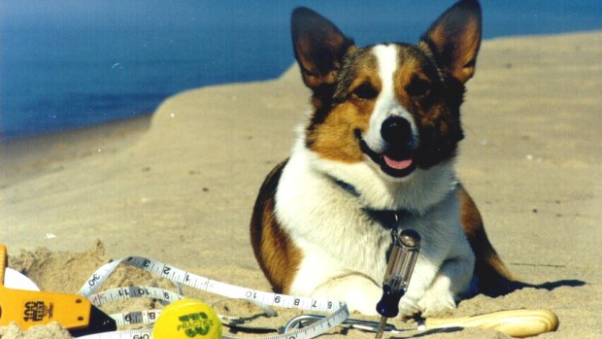
Elvis Has Left The Beach
Exploring minimal time paths through isotropic mediums
Source: CBS Detroit
MATH 4020 Capstone Course
Fall 2015

Slide 2
Team Members
Amy Adair
Austin Baroni
Darnelle Cuyler
Konner Kite
Kaijun Ye
Project Manager: Dr. Ameziane Harhad
Advisor: Dr. Peter Wolenski

Slide 3
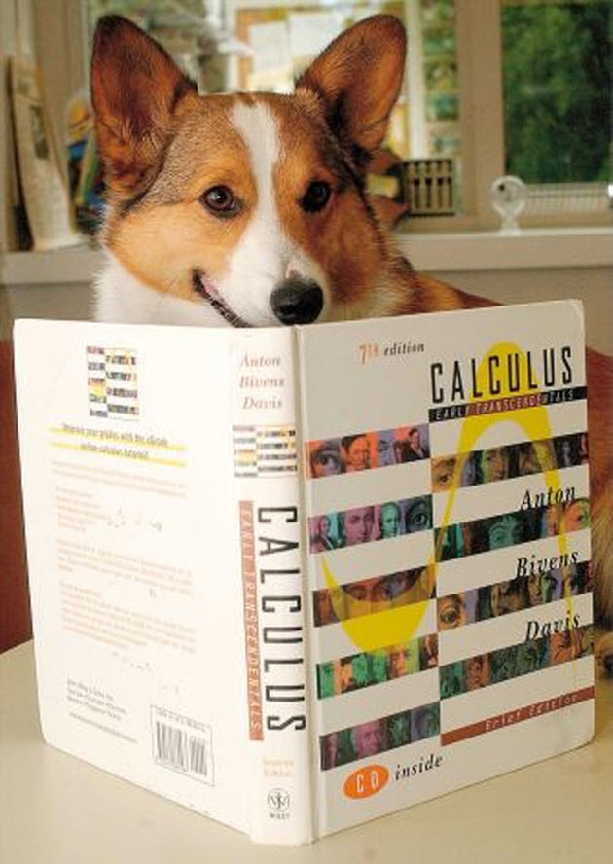
Introduction
Timothy Pennings, Do Dogs Know Calculus?
  Find optimal path
    i.e., minimizing time of travel
5-Part Project
  Shore to Sea
  Land to Sea
  Land to Shore to Sea
  Multiple Isotropic Mediums
  Non-Horizontal Boundary between Two Mediums
Source: New Dog World

Slide 4
Goals
Calculate optimal path in isotropic mediums
Draw contours illustrating paths for given time
Investigate strategies to solve for more general case
Use MATLAB to program GUI to illustrate results

Slide 5
Project 1
Elvis Travels from the Shore to the Sea

Slide 6

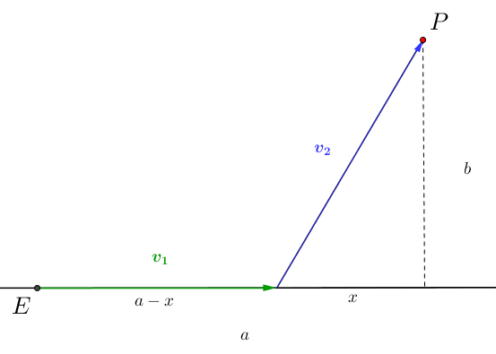
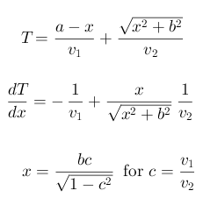
Project 1: Path
Notes:
Beginning course details and/or books/materials needed for a class/project.

Slide 7
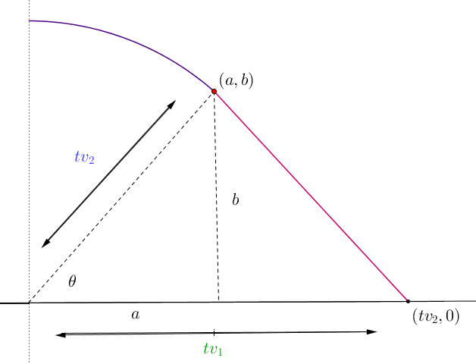
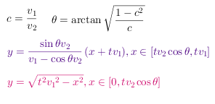
Project 1: Contour
Notes:
Beginning course details and/or books/materials needed for a class/project.

Slide 8
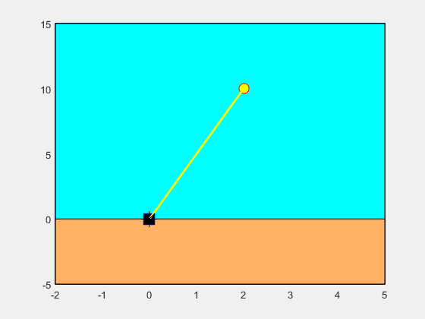
Project 1: MATLAB Animation

Slide 9
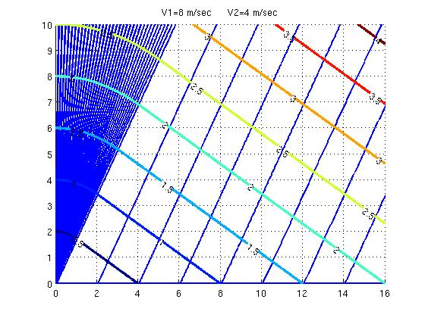
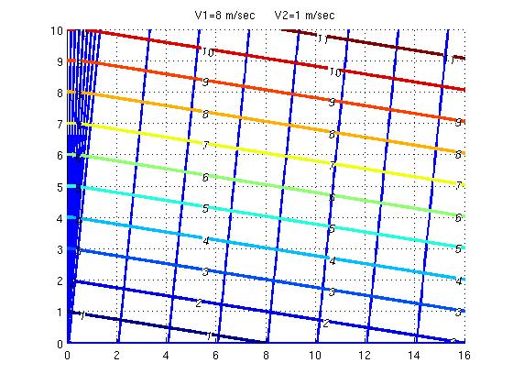
Project 1: MATLAB
Notes:
Beginning course details and/or books/materials needed for a class/project.

Slide 10
Project 2
Elvis Travels from the Land to the Sea

Slide 11

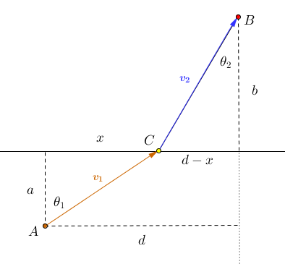
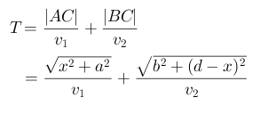
Project 2: Path
Notes:
Beginning course details and/or books/materials needed for a class/project.

Slide 12
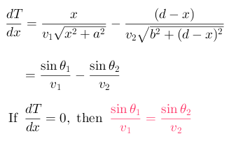
Project 2: Snell’s Law
Notes:
Beginning course details and/or books/materials needed for a class/project.

Slide 13
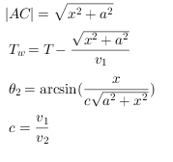

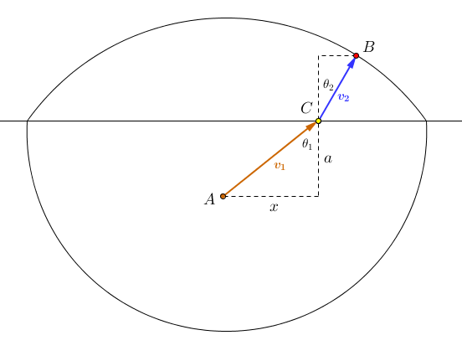
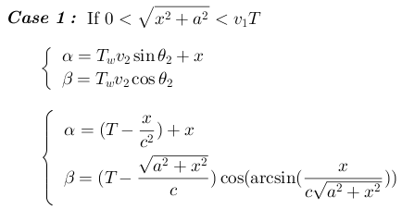
Project 2: Contour
Notes:
Beginning course details and/or books/materials needed for a class/project.

Slide 14
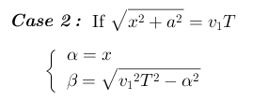
Project 2: Contour
Notes:
Beginning course details and/or books/materials needed for a class/project.

Slide 15
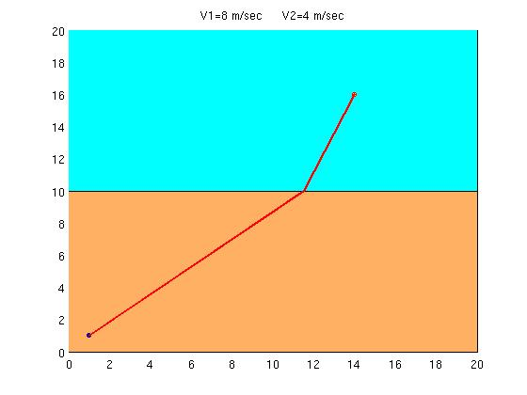
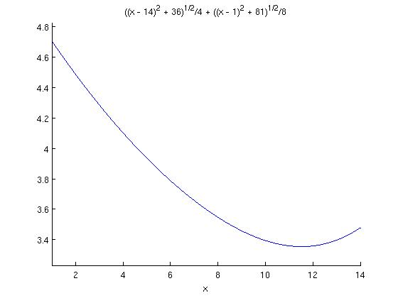
Project 2: MATLAB

Slide 16
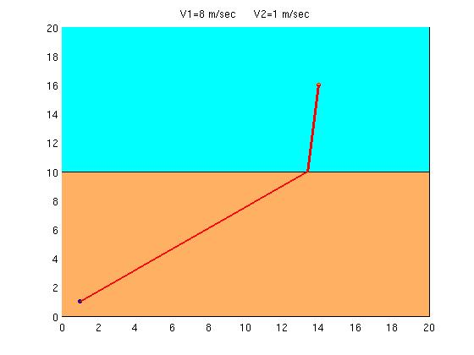
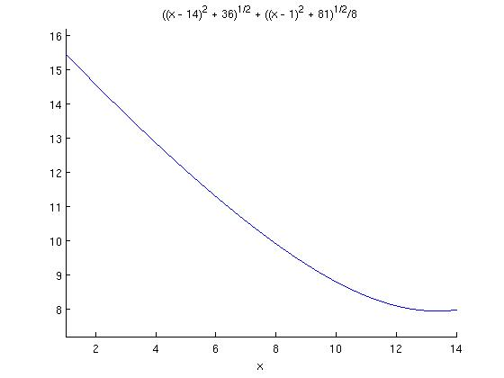
Project 2: MATLAB

Slide 17
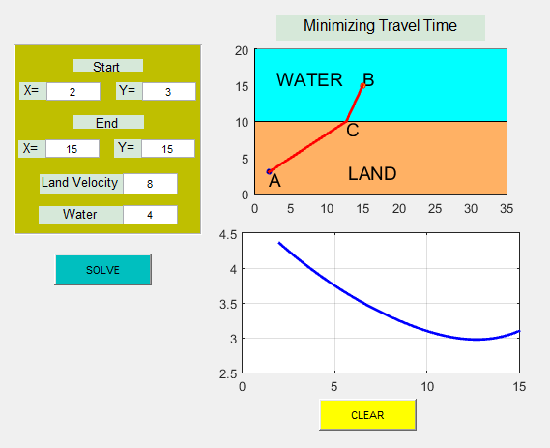
Project 2: GUI

Slide 18
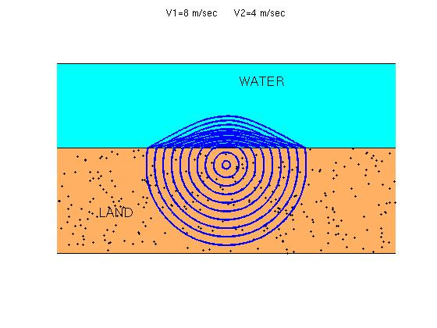
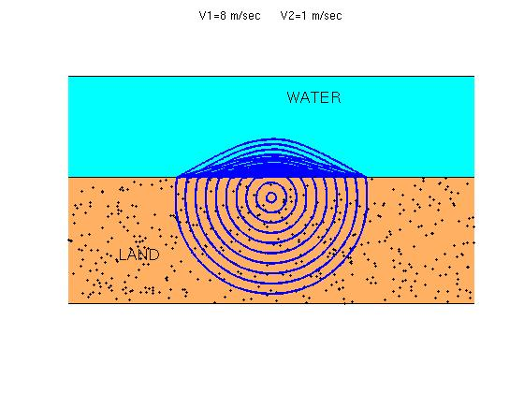
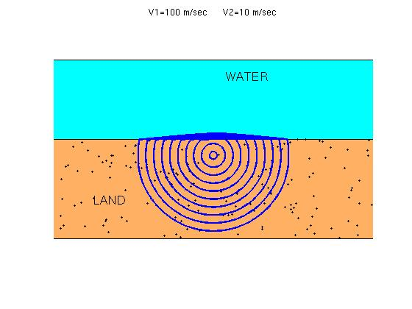
Project 2: MATLAB

Slide 19
Project 3
Elvis Travels from the Land, along the Shore, and into the Sea

Slide 20
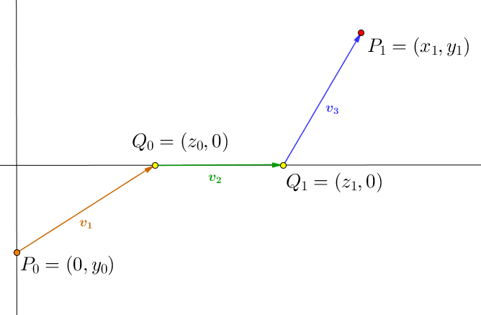

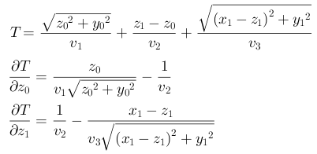
Project 3: Path
Notes:
Beginning course details and/or books/materials needed for a class/project.

Slide 21
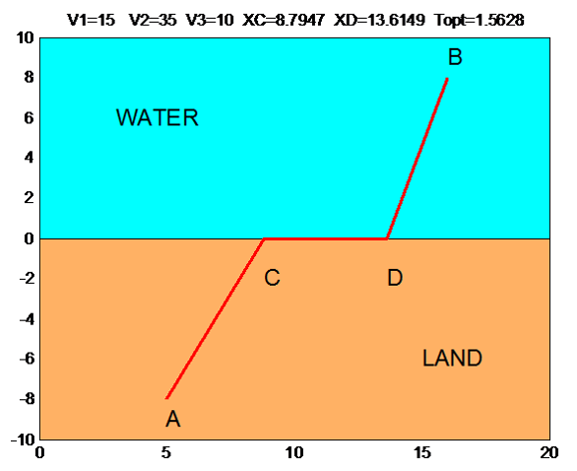
Project 3: MATLAB
Notes:
Beginning course details and/or books/materials needed for a class/project.

Slide 22
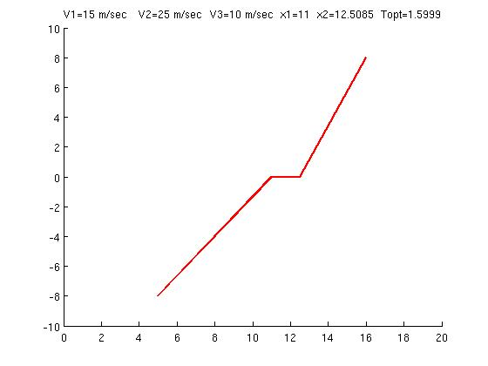
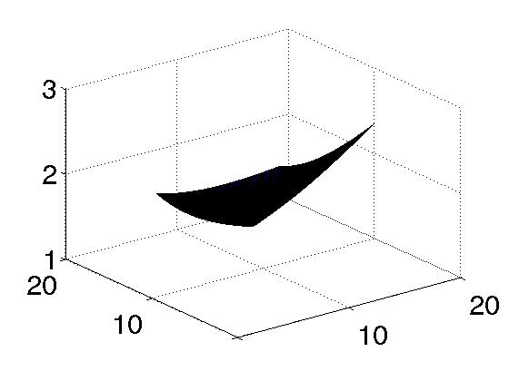
Project 3: MATLAB
Notes:
Beginning course details and/or books/materials needed for a class/project.

Slide 23
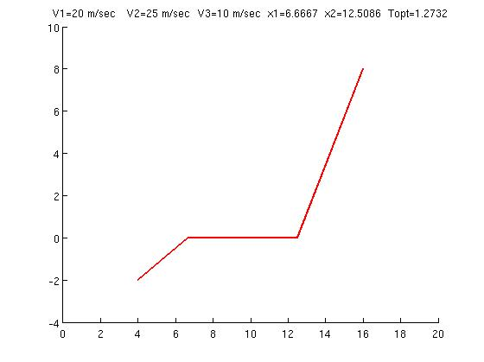
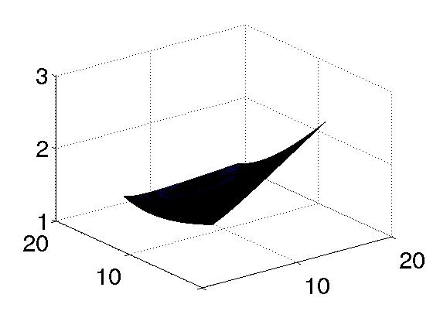
Project 3: MATLAB
Notes:
Beginning course details and/or books/materials needed for a class/project.

Slide 24
Project 4
Elvis Travels through Multiple Mediums

Slide 25
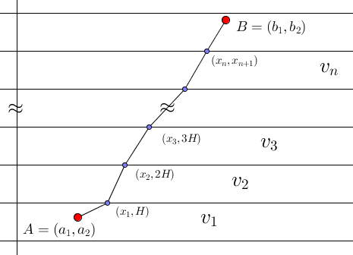

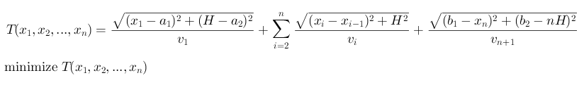
Project 4: Path
Notes:
Beginning course details and/or books/materials needed for a class/project.

Slide 26
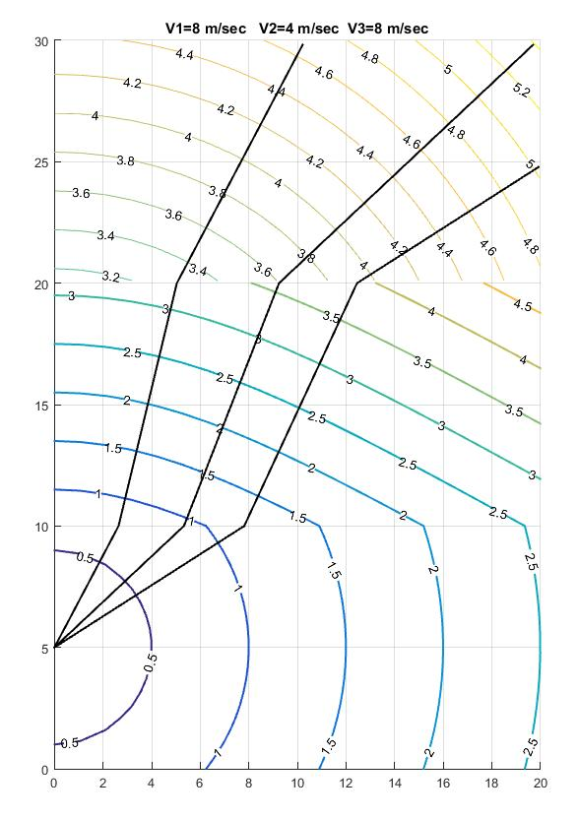
Project 4: Contours
Notes:
Beginning course details and/or books/materials needed for a class/project.

Slide 27
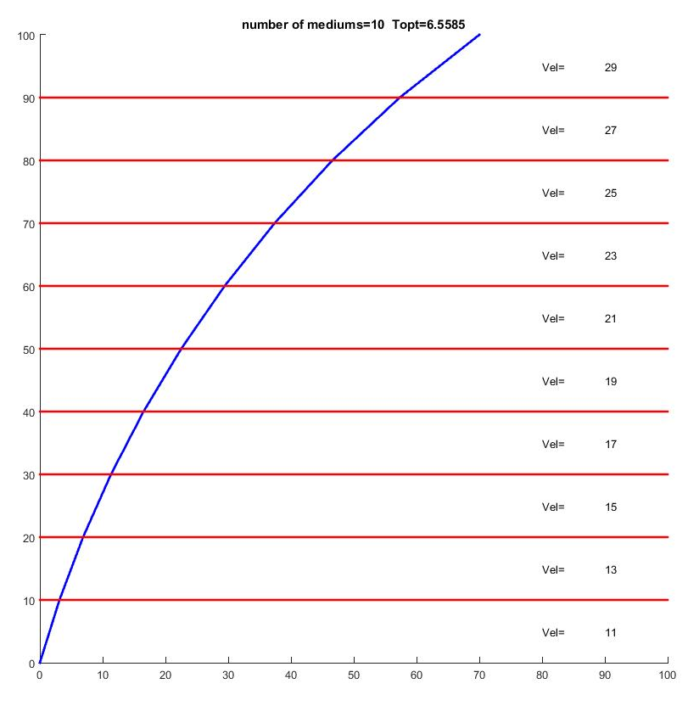
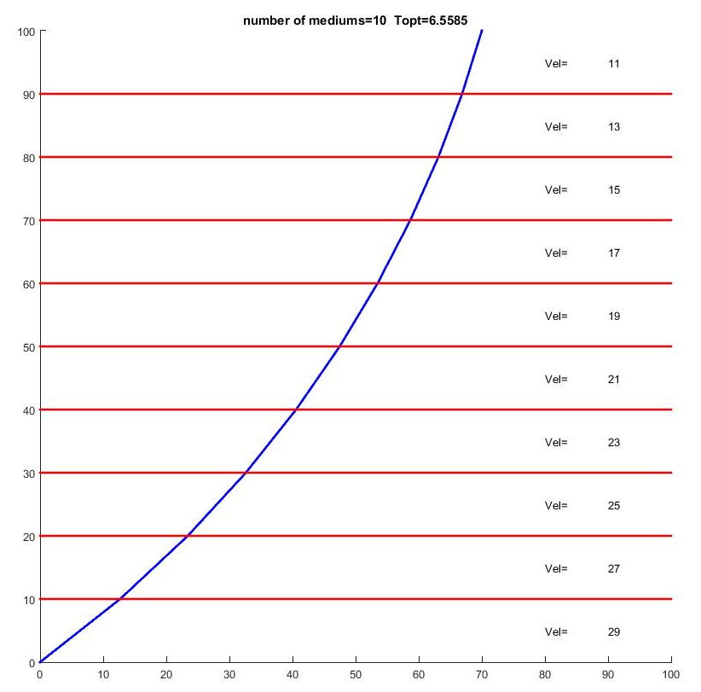
Project 4: MATLAB
Notes:
Beginning course details and/or books/materials needed for a class/project.

Slide 28
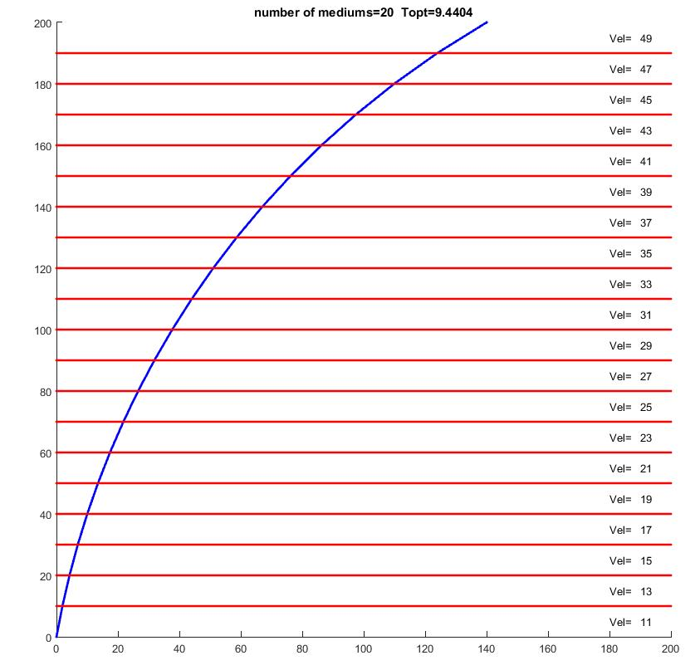
Project 4: MATLAB
Notes:
Beginning course details and/or books/materials needed for a class/project.

Slide 29
Project 5
Elvis Travels from Land to Sea through a Non-Horizontal Boundary

Slide 30
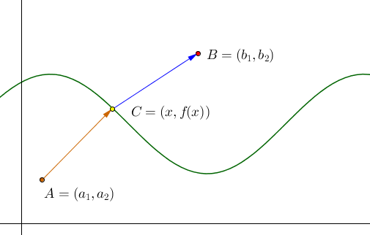


Project 5: Path
Notes:
Beginning course details and/or books/materials needed for a class/project.

Slide 31
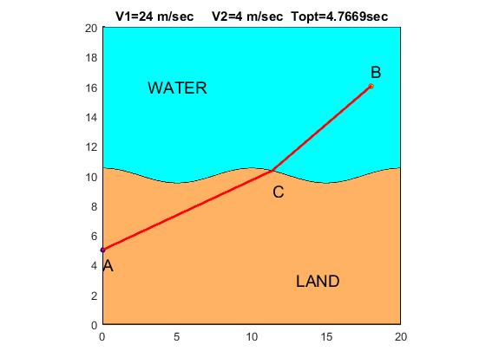
Project 5: MATLAB
Notes:
Beginning course details and/or books/materials needed for a class/project.

Slide 32
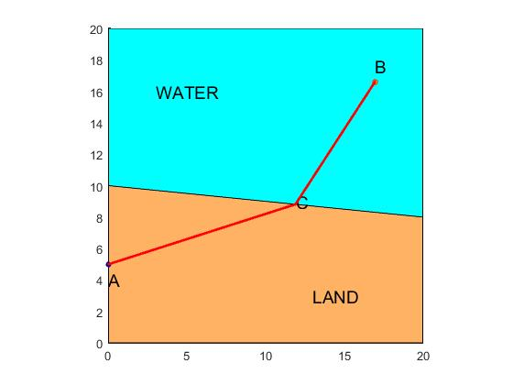
Project 5: MATLAB
Notes:
Beginning course details and/or books/materials needed for a class/project.

Slide 33
Conclusion
Applications
Open Questions

Slide 34
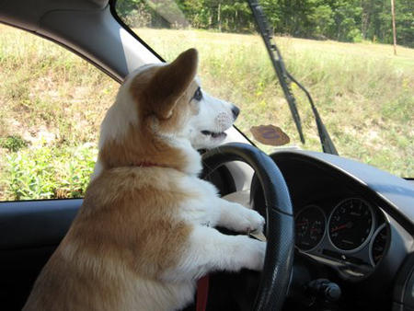
Applications
Navigation Software
  Find least time path
  through traffic
Industrial Drilling and Tunneling
  Find least costly path in digging
Source: Humor Hound

Slide 35
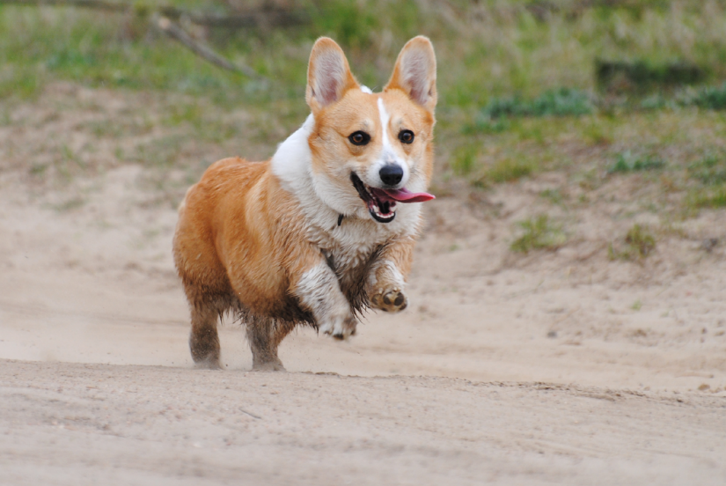
Open Questions
Can we find the least time paths for:
  Multiple mediums with non-linear boundaries
  Multiple mediums with travelable boundaries (both linear and non-linear)
  Multiple dimensions
Source: Wazniaki, Deviant Art

Slide 36
References
Pennings, T.J. (May, 2003). Do Dogs Know Calculus? The College Mathematics Journal, 34, 178-182. doi:10.2307/3595798
Jonsson, H. (Jan., 2010). Path Optimization with Application to Tunneling. Paper presented at Applied Parallel and Scientific Computing: 10th International Conference, Reykjavík, Iceland. doi:10.1007/978-3-642-28145-7_5
Images in PowerPoint:
  Title page image: Retrieved from https://cbsdetroit.files.wordpress.com/2013/07/elvis-dog.jpg?w=620&h=349&crop=1
  Introduction page image: Retrieved from http://newdogworld.com/wp-content/uploads/2013/08/Corgi-Dog-Elvis-The-Math-Genius-Dies-212x300.jpg
  Applications page image: Retrieved from http://www.humorhound.com/corgi-driving-a-car/
  Open Questions page image: Retrieved from http://wazniaki.deviantart.com/art/Corgi-299613411

