Slide 1


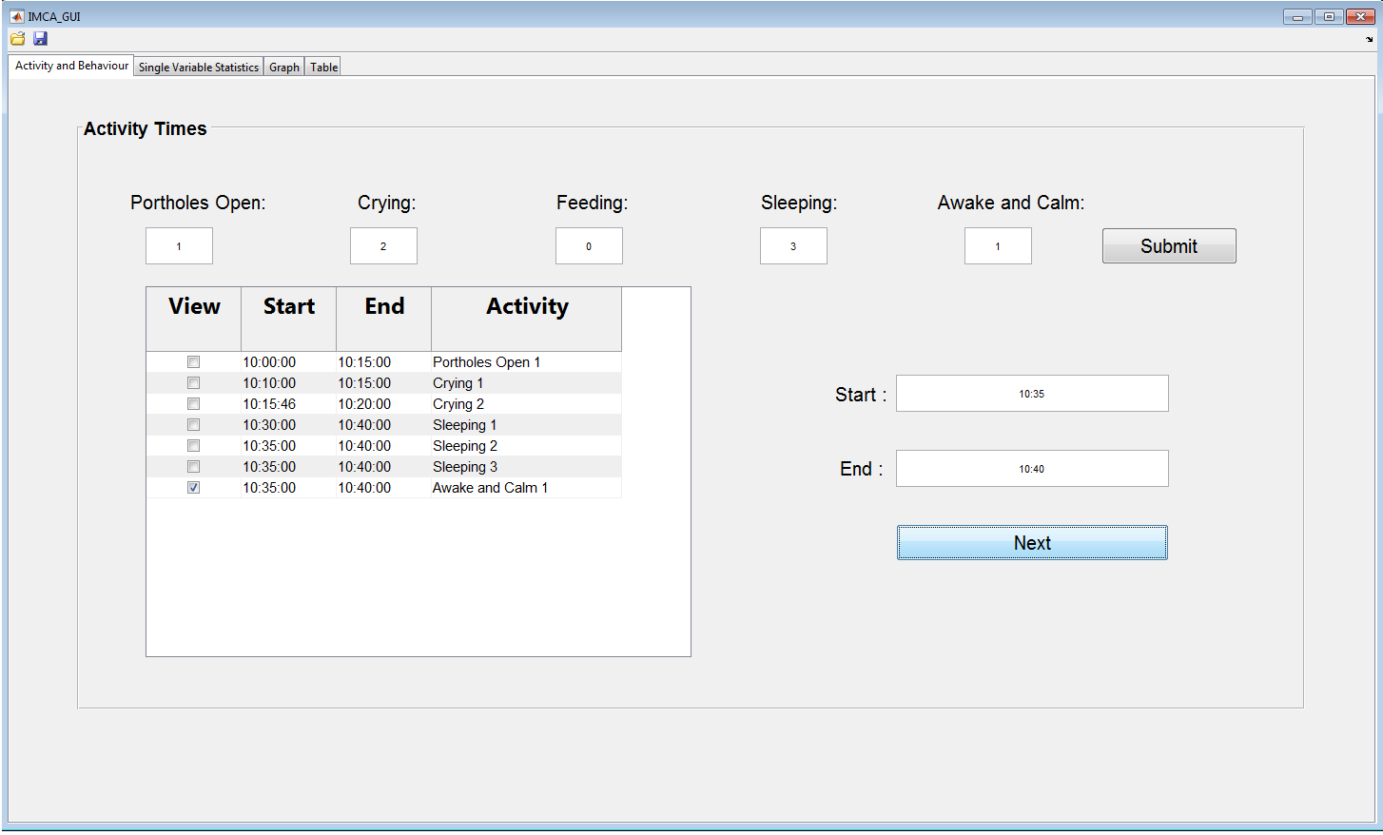
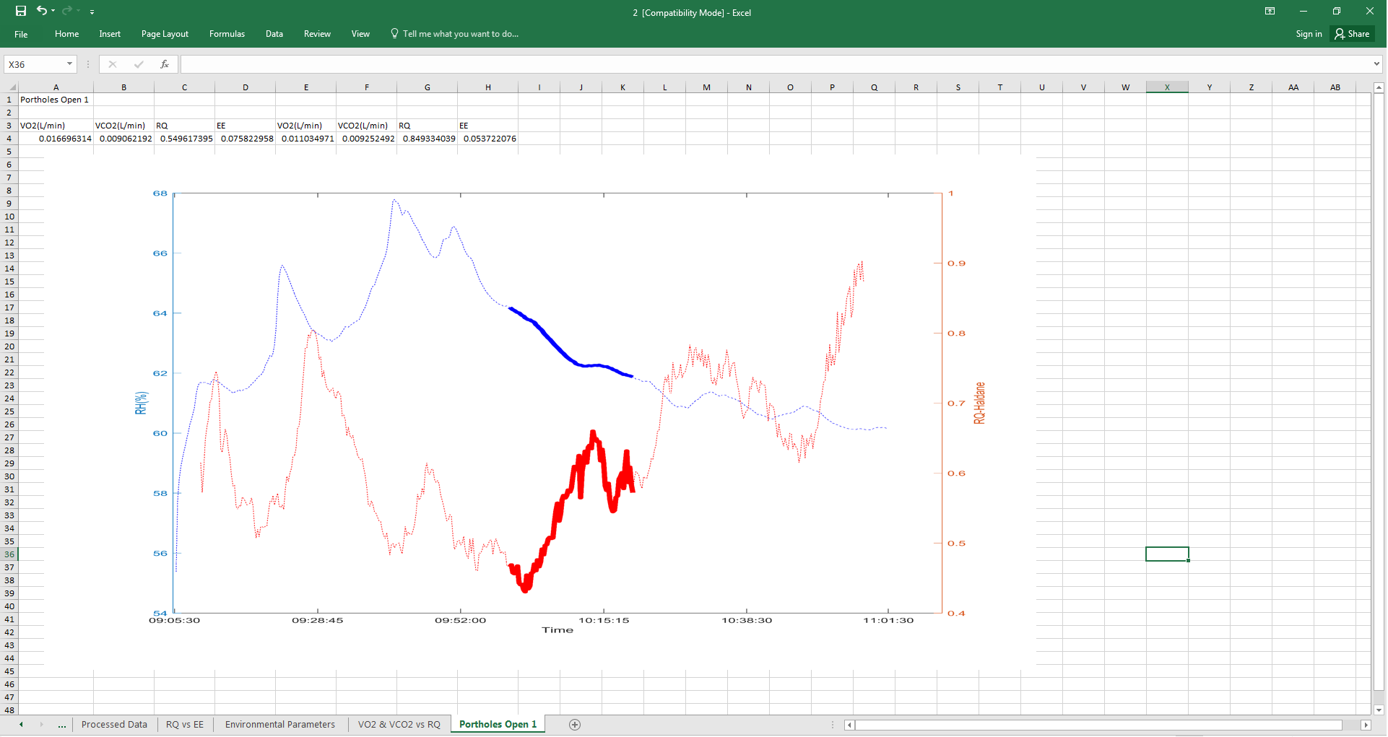
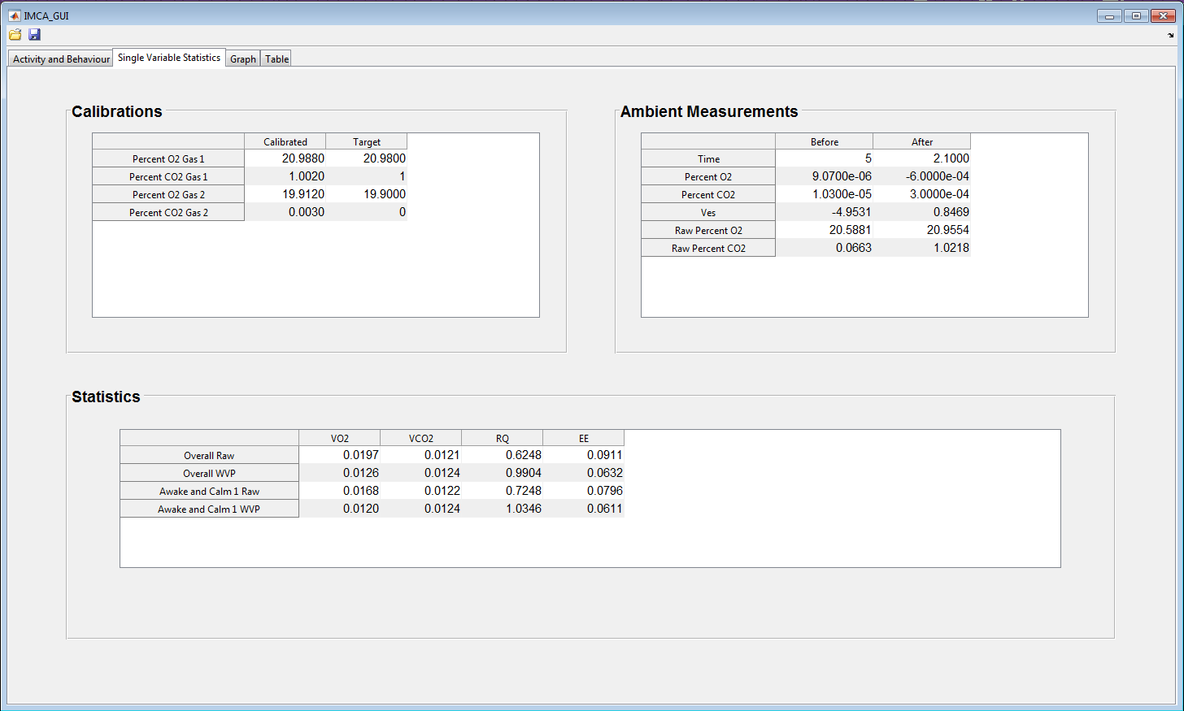
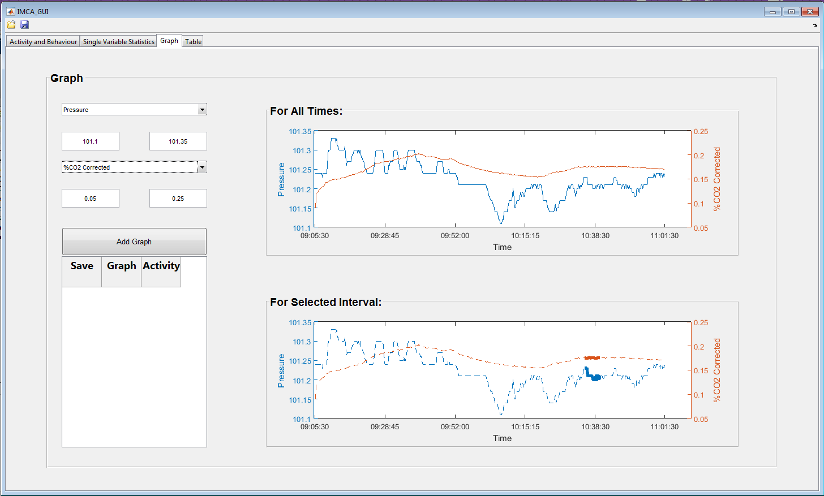
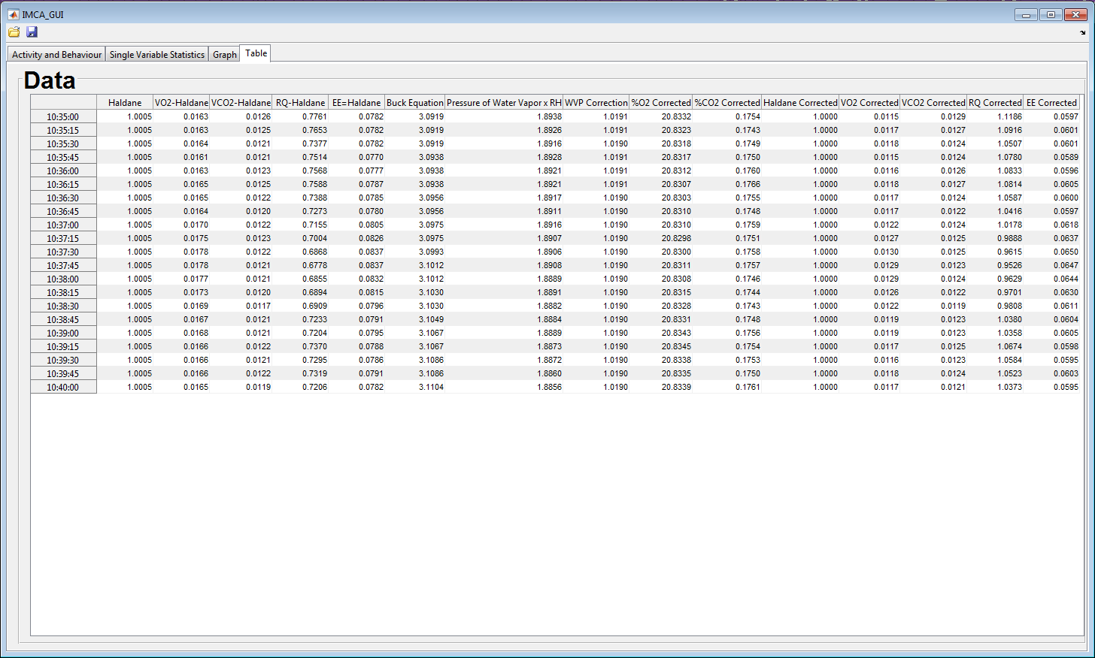
Infant Metabolic Chamber Analysis
Thomas Ayton, Sonia Azad, Zachary Bradshaw, Joshua Brock, Matthew Cabrera, Taylor Daigle, Alexander Dunkel, Rohin Gilman, Logan Hart, Shelby Hust, Timothy Mann, Marie Neubrander, Sima Sobhiyeh
Louisiana State University , Math Consultation Clinic, Supervised by Dr. Wolenski
Introduction
GUI Implementation
Results
This project improved the process of analyzing data from experiments on infant metabolism performed by researchers from Pennington Biomedical Research Center (PBRC) by creating a graphical user interface (GUI) in the Matrix Laboratory (MATLAB) programming software which allows researchers to study the data in various ways.
The GUI consists of four tabs: Activity and Behavior, Single Variable Statistics, Graph, and Table. After the user loads the data into the GUI from a spreadsheet, they specify in the first tab what parts of the data they want to analyze specifically, and the program uses the user’s specifications to display information throughout the GUI in the single variable statistics, graph, and table tabs.
The GUI significantly improved the efficiency with which the researchers from PBRC analyze the data from the experiments. Previously, the researchers performed calculations and saved them in and to a spreadsheet manually, a process that took hours to complete. The GUI takes approximately 6 seconds to load the raw data and 12 seconds to export the processed data to a spreadsheet.
The GUI enables the user to plot various graphs that are essential in interpreting the data. The user may zoom in on particular intervals within the GUI and choose specific graphs to export to the spreadsheet. The program formats the spreadsheet through MATLAB to the user-specified setup.
Figure 1:
Tab 1: Activity and Behavior
The first tab of the GUI loads the raw data from the spreadsheet. It contains fields for information about what activities the baby was performing and for the start and end times of the desired analysis. The user checks the box corresponding to the time interval they wish to analyze across the GUI.
Scientific background
The metabolic chamber is an open-circuit, indirect calorimeter that measures both the infant’s consumption of oxygen and its production of carbon dioxide, while simultaneously measuring various environmental factors during each experiment.
Raw Data Collection: The chamber draws in air from the room, and mixed air (air breathed by the subject and already present in the chamber) leaves the chamber through tubing. Detection sensor modules in the tubing measure the following values:
Raw O₂: percent of O₂ in the mixed air leaving the chamber
Raw CO₂: percent of CO₂ in the mixed air leaving the chamber
Flow: rate at which the chamber draws in air from the room
Temperature (Celsius)
Pressure (kPa)
Relative Humidity: ratio of actual vapor pressure to saturation vapor pressure
Raw Calculations:
Haldane (H): relates O₂ consumed and CO₂ produced with reference amounts of O₂ and CO₂ in the mixed air
Respiratory Quotient (RQ): ratio of CO₂ produced to O₂ consumed; indicates which macronutrients the infant is metabolizing
VO₂ (L/min): amount of O₂ consumed
VCO₂ (L/min): amount of CO₂ produced
Energy Expenditure (EE) (cal/min): number of calories necessary to carry out physical function.
WVP Corrections: In the process of measuring properties of gasses, water vapor from the air inevitably mixes with the target gasses, in this case O2 and CO2. Given a temperature, the Buck equation is used to calculate the vapor pressure of water in the chamber and ultimately is used to find a water vapor pressure (WVP) correction value for the calculations.
Figure 2:
Tab 2: Single Variable Statistics
The second tab of the GUI displays the calibrations, swing out measurements, and averages for the data from the user-specified interval from Tab 1.
Figure 3:
Tab 3: Graph
The third tab allows the user to construct two graphs with variable calculations assigned to the left and right y-axes and time assigned to the x-axis. One graph displays the data for the selected variables over all times and one shows it for the interval from Tab 1. The user can choose graphs to save into a spreadsheet.
Acknowledgements/References
We thank Dr. Peter Wolenski, for continuously providing undergraduates with valuable research experience, and Abby Altazan, for providing us with this research opportunity.
References:
Burns, Patrick, and Michael Snow. "Indirect Calorimetry.”
Eschenbacher, Hermann. "Haldane and Eschenbacher Transformation.”
Open Anesthesia. "Haldane Effect.”
Lighton, John R. B. Measuring Metabolic Rates.
Ravussin, Eric, Stephen Lillioja, Thomas E. Anderson, Laurent Christin, and Clifton Bogardus. "Determinants of 24-hour Energy Expenditure in Man.”
Robergs, Robert. "Indirect Calorimetry.”
Figure 4:
Tab 4: Table
The fourth tab contains all of the calculations and corrected calculations and displays them in a table format for the user to reference. There is also an option to save this information, as well as the selected graphs, into a spreadsheet by using the save button.

