Slide 1
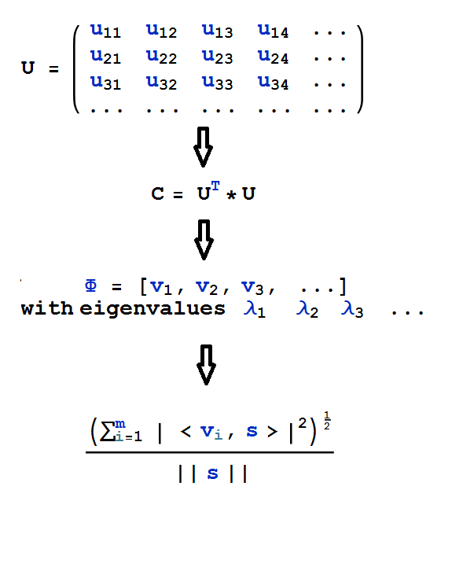
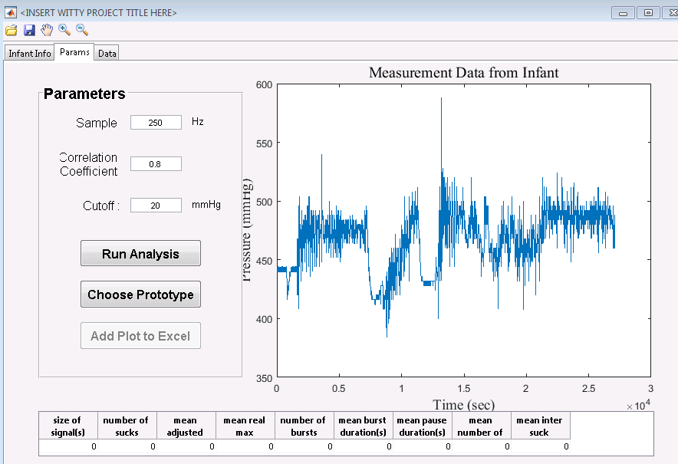
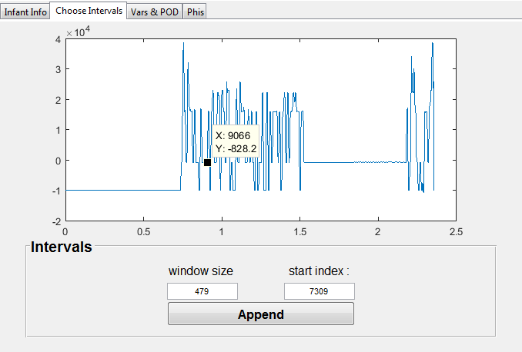
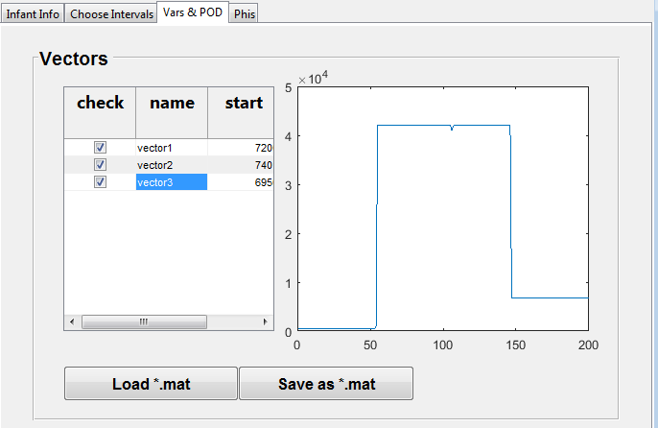
Developing Infant Suck Detection Interface
Amy Adair, Abiti Adili, Zachary Bradshaw, Joshua Brock, Brandon Dellucky, Heewon Hah, Margarite LaBorde, Hugo Leira, Miles Robicheaux, Sima Sobhiyeh, Mary Wang, Jerome Weston Louisiana State University , Math Consultation Clinic, Supervised by Dr. Wolenski and Dr. Harhad
Introduction
Proper Orthogonal Decomposition
GUI Implementation
We collaborated with Pennington Biomedical Center to improve data analysis on signals obtained from infant feedings for the purpose of detecting their sucks.
A convenient graphic user interface (GUI) was created for our collaborators.
We improved the efficiency and accuracy of the previous program.
Implemented the Proper Orthogonal Decomposition method to improve detection accuracy
Utilized Fourier analysis and convolutions to implement band-pass filtering
Streamlined detection process to improve computation time
Alternate Names for the POD Method:
Principal Component Analysis (PCA)
Karhunen-Loeve Decomposition (KLD)
Singular Value Decomposition (SVD)
Purpose for Choosing POD
Originally, sucks were found by comparing the input signal with a single prototype (initially a parabola) and determining if the correlation coefficient exceeded the specified cutoff
This process led to missed sucks and inefficient detection.
By using POD analysis, we replaced the previous single parabolic prototype with multiple ‘Phi’ prototypes generated from previously detected sucks
Procedure of POD Analysis:
A GUI is employed for the ease of the end-user of the program.
Aesthetic Improvements
The GUI is contained within a single window vs the previous version with multiple dialogue boxes
The data is organized into three tabs—the first with inputs for infant information, the second containing the input signal and parameters, and the third containing individualized suck data
Users can now save the graphic images as well as the suck data into an excel document
Computational Improvements
Achieved a 22x speed-up over previous version
Eliminated the need for extraneous toolboxes (i.e., The MatLab Curve Fitting Toolbox is no longer necessary)
Generated a programmatic code in place of a MatLab GUIDE template
Improved the prototype used for suck detection
The GUI is organized into three tabs as follows:
Generate a matrix, U, from data samples of manually selected snapshots
Generate a symmetric correlation matrix, C, from U
Choose the eigenvectors (v_{i}) associated to the dominant eigenvalues (λ_{i} ) of C .These eigenvectors will be our new prototypes, (Φ)
Calculate the projection of portions of our signal (denoted ‘s’) unto the components of Φ
Methods
Infant Info Tab: This allows the user to input data such as infant sex, age, ect.
Params Tab: This allows the user to edit the parameters, view the signal, and run the analysis. It also includes general signal information.
Data Tab: This tab displays the data for each suck detected within the signal, which can be saved to an excel file.
Software Used:
Matrix Laboratory (MatLab) programming software
Mathematics Employed:
Fast Fourier Transform (Low-Pass Filtering)
Convolutions (High-Pass Filtering)
Proper Orthogonal Decomposition
Finally, the projection was compared to a predetermined cutoff to determine whether or not the projection was sufficient for the signal to be a suck
This procedure is not yet perfected and requires further research, namely the application of POD Spectrum Analysis
Filtering & Preprocessing
POD Generation GUI
A second GUI was used to generate the POD prototypes
conclusions
Preprocessing measures were used for Band-Pass Signal Processing
Fast Fourier Transform and Analysis
Rendered original signal into a frequency space
Cut-off frequency defined as eighty percent of the transformed signal at zero
All components above this cutoff are set to zero
Return to original space
Smoothing Filter
Applied a moving average filter to the original signal via convolution
Reduces noise due to high frequency signal and preserves lower frequency
The new GUI features a user-friendly interface with saving capabilities and an organized presentation, as well as improved data analysis methods and preprocessing to allow for cleaner, more accurate detection.
The current program boasts a 22x speed up over its predecessor.
The POD analysis preforms an in-depth analysis of the signal, allowing for unambiguous detection, while also offering the user the ability to create specific prototypes based on factors such as infant age or gender.
We would like to thank:
Dr. Wolenski and Dr. Harhad
Pennington Biomedical Center
The POD GUI allows for manual data selection of sample signals
The user can then select and view the individual vectors to be saved, or load a previous file.

