Slide 1
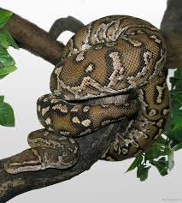
MAD-PYTHON
MATH 4020
ATT
LEK
YLAN

Slide 2
GROUP GOAL
Learn and understand python programing language
  Libraries:
    Pandas
    Numpy
    SKlearn
Use machine learning algorithms
  Decision trees
  Random Forests

Slide 3
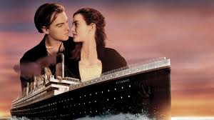
The project (to date)
Looking at data regarding passengers on the Titanic
Analyzing the data, and looking for ways to predict whether or not passengers survived based on limited information

Slide 4

Analysis of passengers on the Titanic
  891 observations
  Includes
    Gender
    Age
    Ticket class
    Cabin level
    Ticket price
    Family present
    Survival
  418 observations do not include the survival column
    This is the test data

Slide 5

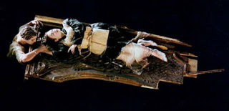
The Goal
Analyze data
Create prediction system

Slide 6
Progress
Excel:
  Pivot tables for analysis, helped devise a formula that could predict survival with greater than 75% accuracy
    “IF(E2="male",0,IF(C2=3,IF(J2>20,0,1),1))”
Python
  Analyzing the data in similar ways and developing the same formula to become familiar with the language

Slide 7
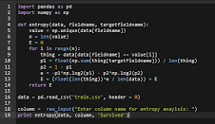
More progress
The numpy library allows matrix manipulations
  Similar to MatLab
The pandas library simplifies work with large data sets
SKLearn is a collection of machine learning algorithms

Slide 8
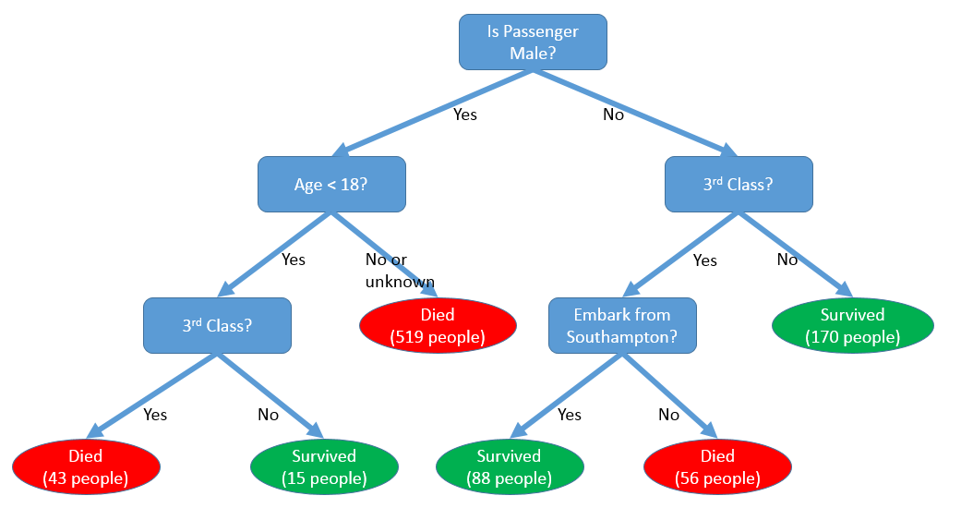
Decision tree
Tool that uses a tree-like graph to build an algorithm displaying possible outcomes

Slide 9
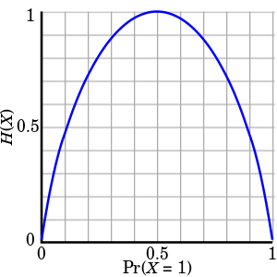

H $=−p_{1}\log_{2}{p_{1}}$ $−p_{2}\log_{2}{p_{2}}$
Entropy
This graph represents the relationship between probability (Pr(X=1)) and entropy (H(X)) of a coin flip

Slide 10
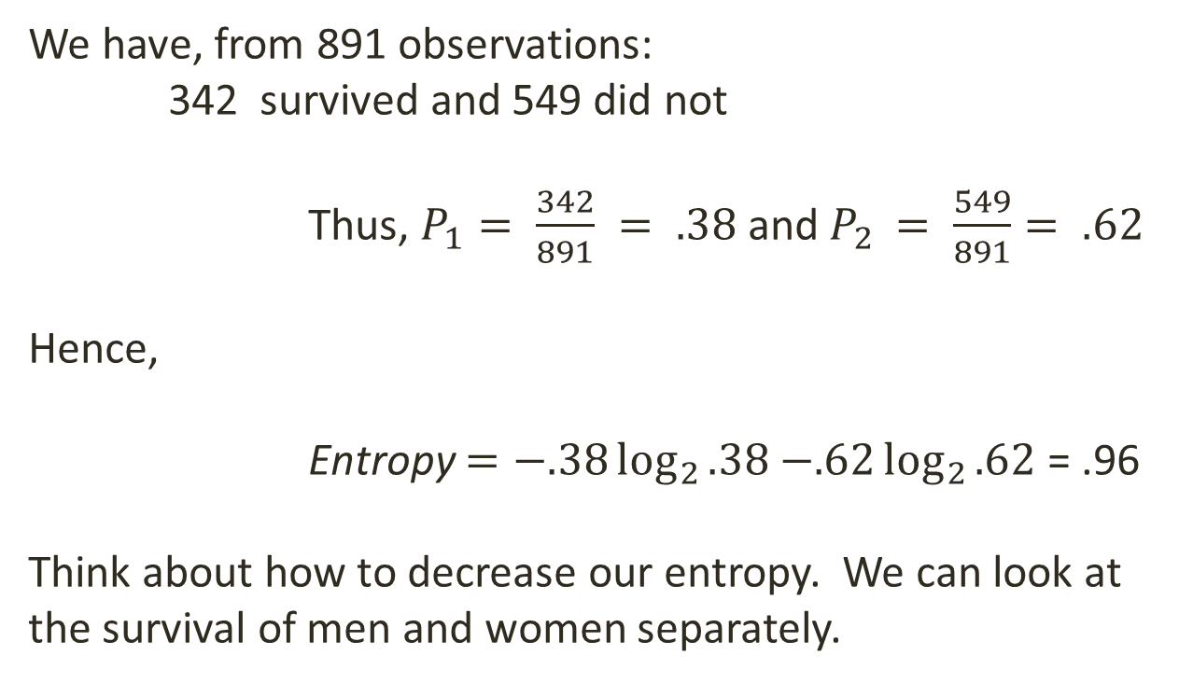
Entropy calculation
We have, from 891 observations:
342 survived and 549 did not
Thus, $P_{1}= \frac{342}{891} = .38$ and $P_{2 }= \frac{549}{891}= .62$
Hence,
Entropy $=−.38\log_{2}{.38}$ $−.62\log_{2}{.62}$ = .96
Think about how to decrease our entropy. We can look at the survival of men and women separately.
Notes:
Males = .7

Slide 11
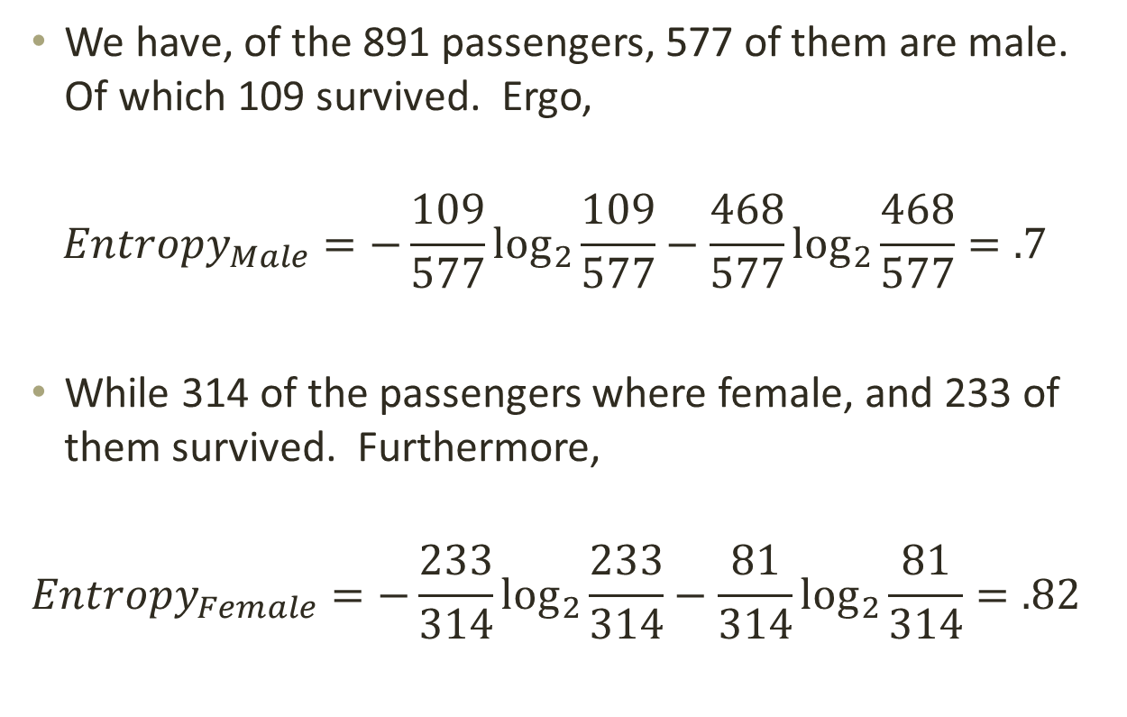
Entropy calculation
We have, of the 891 passengers, 577 of them are male. Of which 109 survived. Ergo,
$${Entropy}_{Male}=−\frac{109}{577}\log_{2}{\frac{109}{577}−\frac{468}{577}\log_{2}{\frac{468}{577}}}=.7$$
While 314 of the passengers where female, and 233 of them survived. Furthermore,
$${Entropy}_{Female}=−\frac{233}{314}\log_{2}{\frac{233}{314}−\frac{81}{314}\log_{2}{\frac{81}{314}=.82}}$$

Slide 12
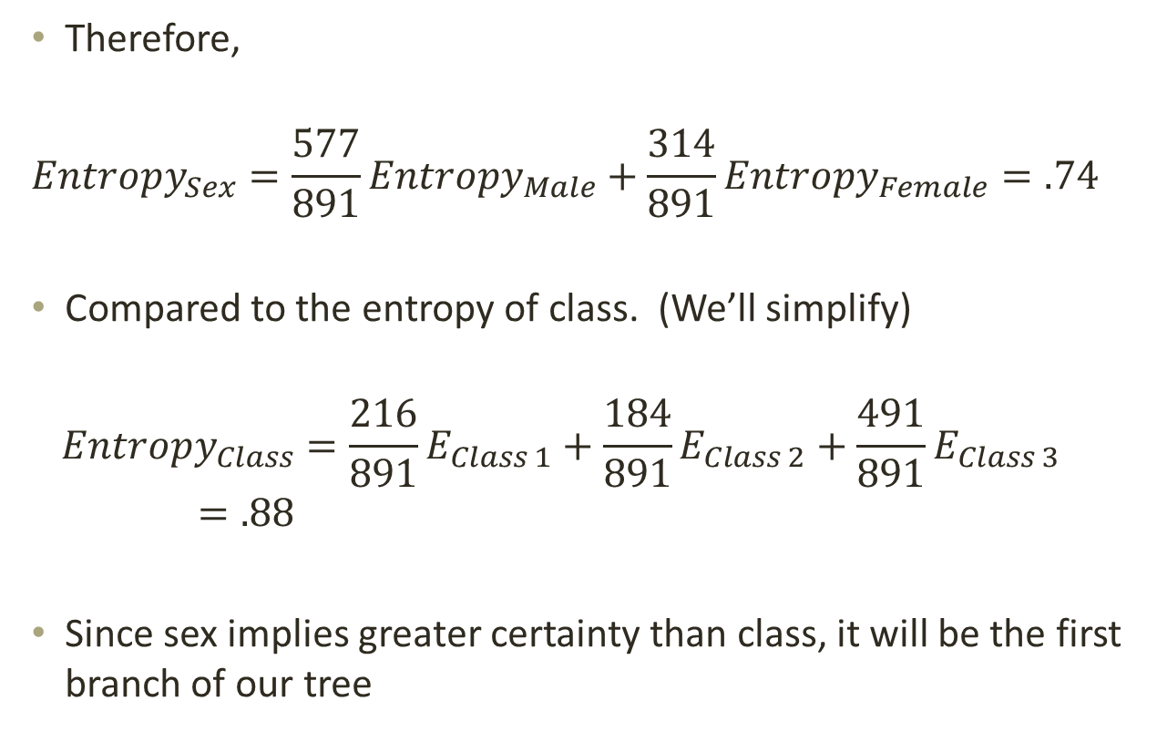
Entropy calculation
Therefore,
$${Entropy}_{Sex}=\frac{577}{891}{Entropy}_{Male}+\frac{314}{891}{Entropy}_{Female}=.74$$
Compared to the entropy of class. (We’ll simplify)
$${Entropy}_{Class}=\frac{216}{891}E_{Class 1}+\frac{184}{891}E_{Class 2}+\frac{491}{891}E_{Class 3}=.88$$
Since sex implies greater certainty than class, it will be the first branch of our tree

Slide 13
Where We’re Headed
Data Cleaning
  Some observations have insufficient data
    i.e. many ages and class levels are missing
Use of Random Forests to develop decision trees based on the entropies of certain variables.
  This will give the best approach for precise analysis and formula creation

Slide 14
FIN

