Slide 1
On D -Topological Complexity
John Oprea
Cleveland State University

Slide 3
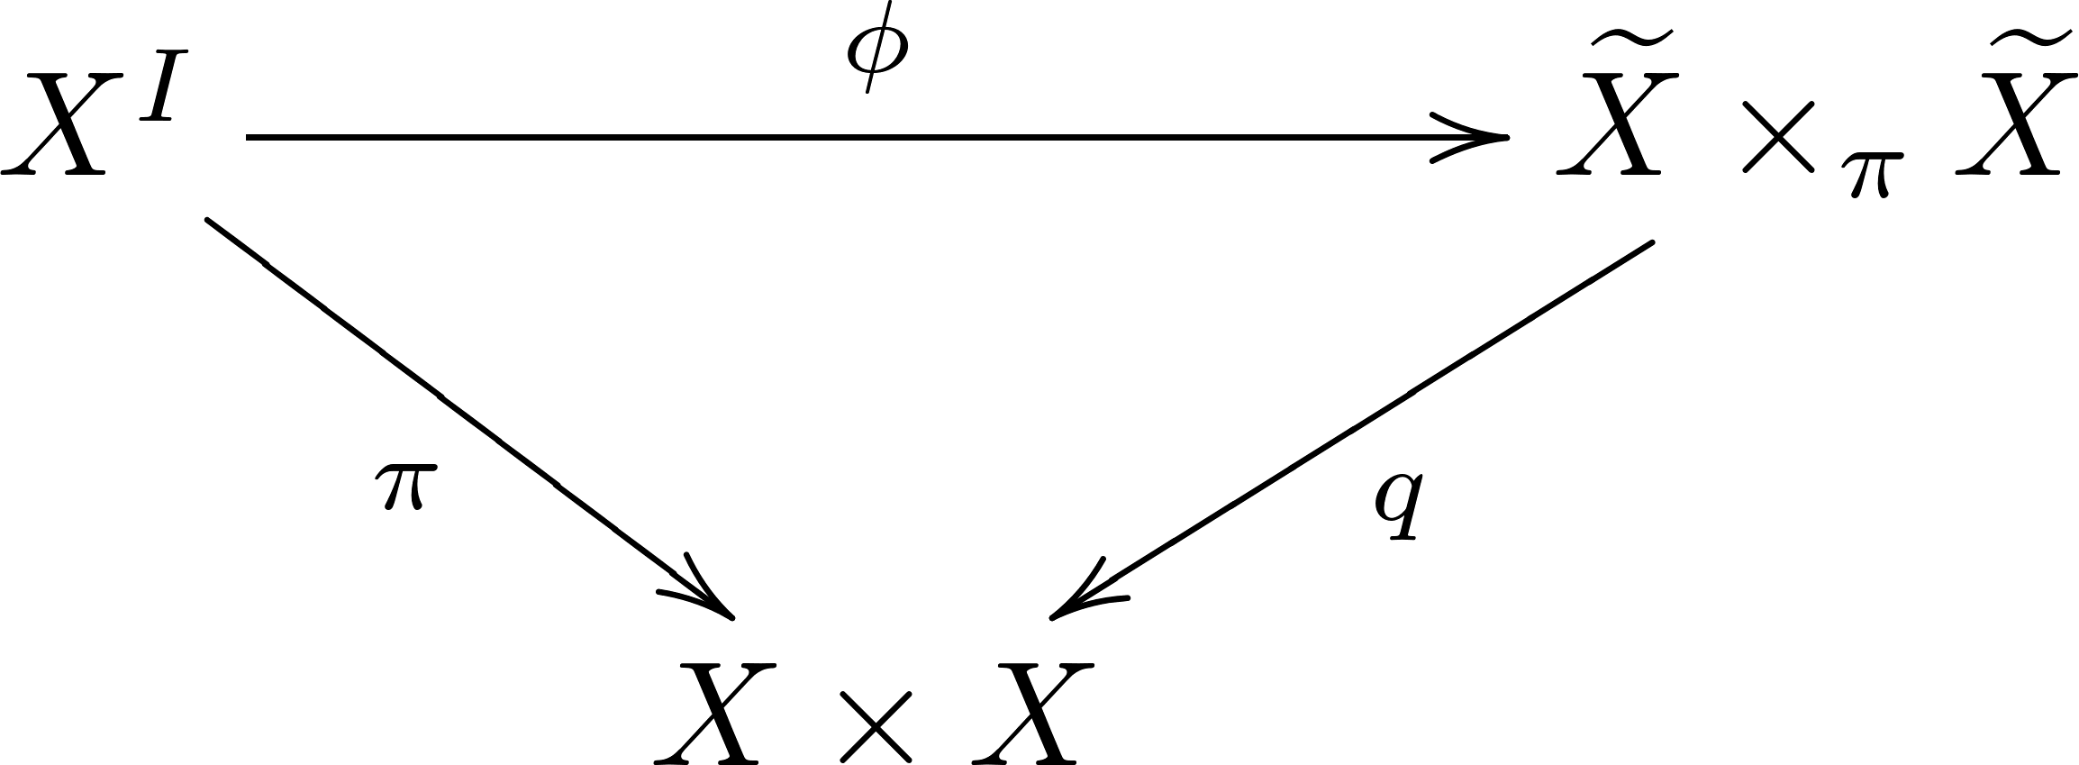

Slide 12
