Slide 1

GRADESCOPE
A Working Guide for
Instructors & TAs
Setting up a course, choosing assignment types, grading efficiently, building rubrics, and handling regrade requests.
Gradescope Training • Instructors & TAs

Slide 2




Agenda
01
02
Course & Roster Setup
Building an Assignment
Create in Moodle, link Gradescope, then add students and staff.
Pick a type, link it to Moodle, and outline the questions.
03
04
Grading & Returning Grades
Regrade Requests
Grade by question with rubrics, then publish and post to Moodle.
Respond to student appeals without losing the paper trail.
Gradescope Training • Instructors & TAs
02

Slide 3

01
Course & Roster Setup
Gradescope Training • Instructors & TAs
03

Slide 4
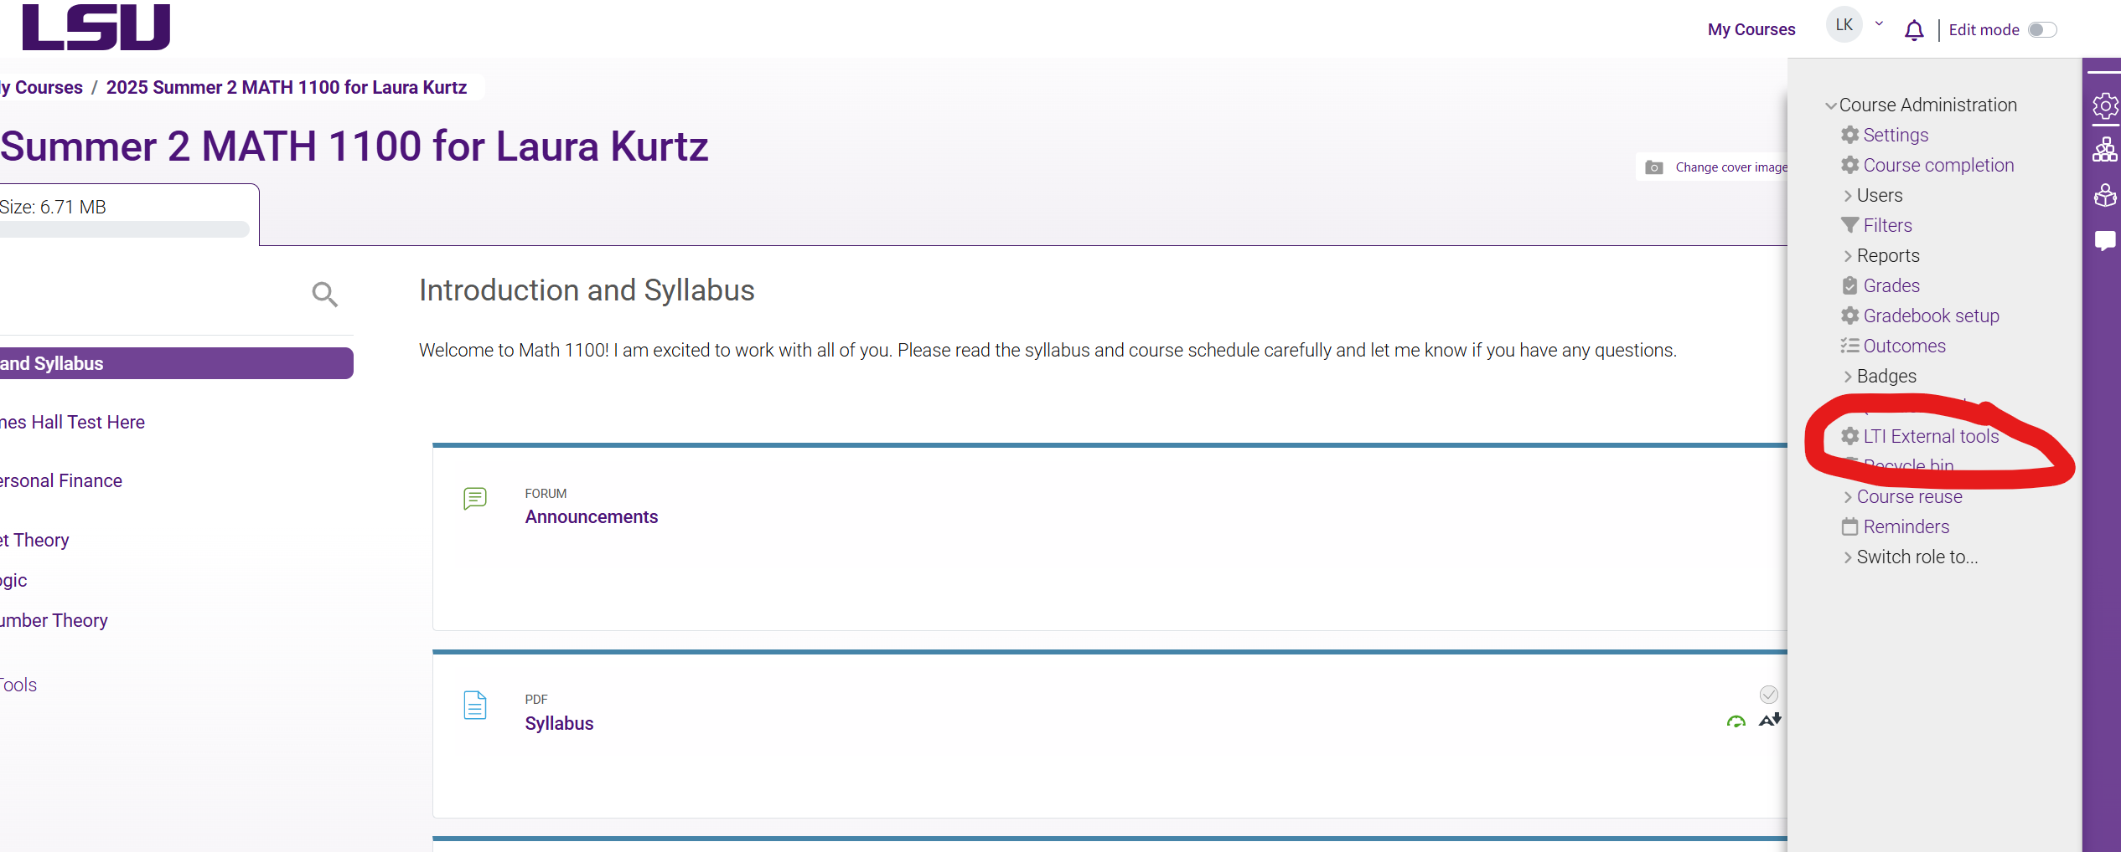
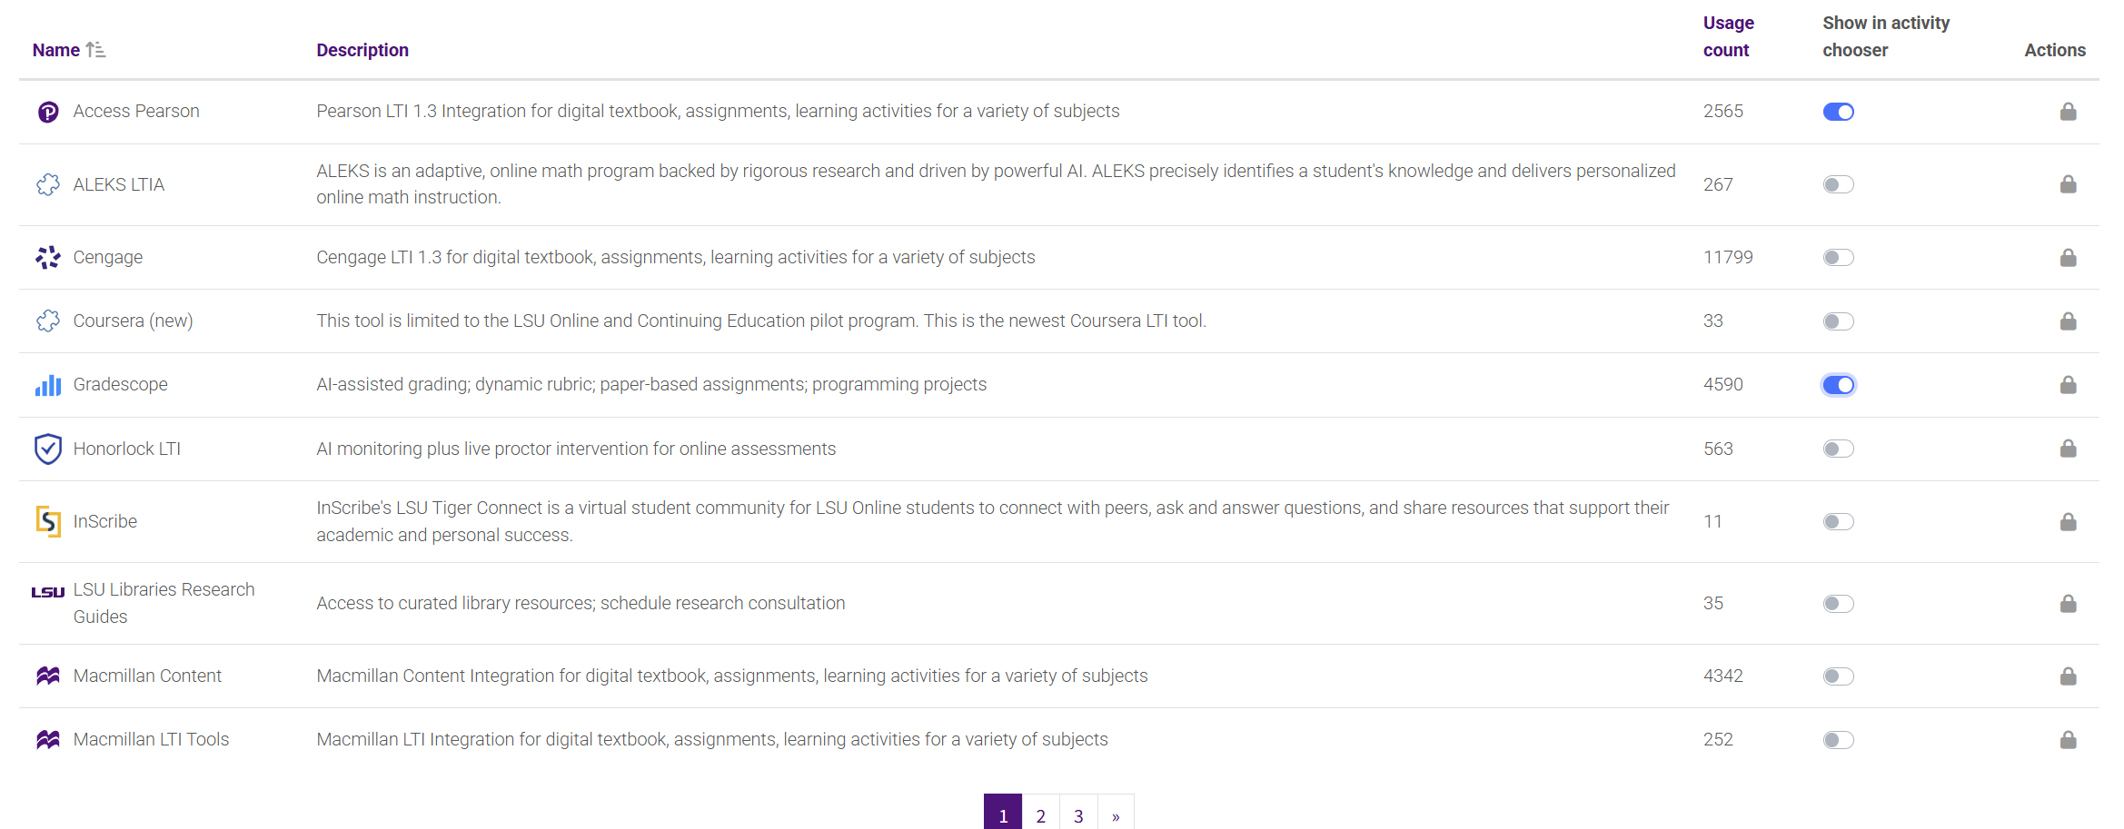
Create your Course in Moodle

Slide 5
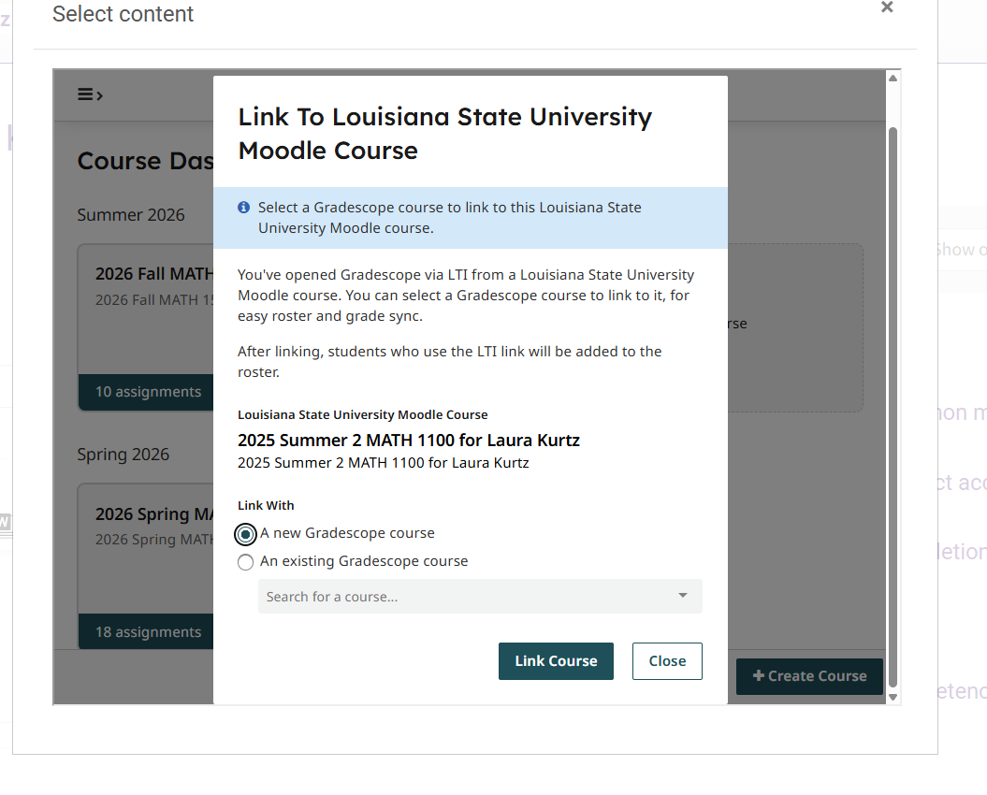

Slide 6

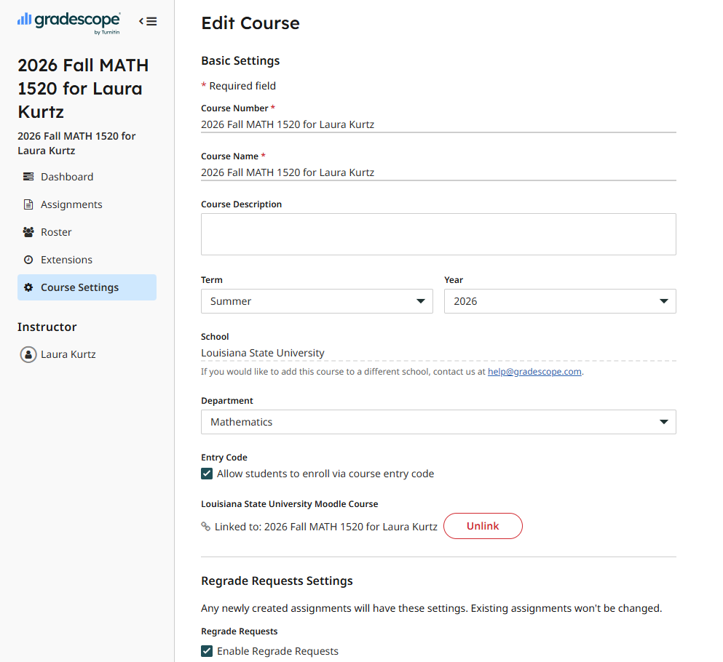
COURSE SETUP
Linking to Moodle
Linking to moodle will automatically sync your rosters and allow you to post directly to Moodle. If you linked to Moodle from the very beginning this should already be done. This is what allows you to post grades to the gradebook!
Gradescope Training • Instructors & TAs
06

Slide 7



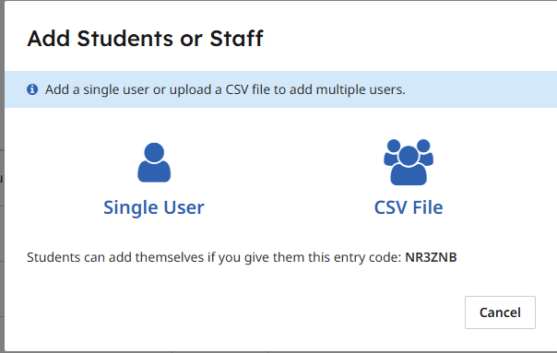
ROSTER SETUP
Rosters
Roster Upload
Entry Code
LMS Sync
Upload a CSV of names and emails; Gradescope matches the columns for you.
Turn on self-enroll and share the code shown in your course footer.
Canvas, Blackboard, Brightspace, Moodle, and Sakai rosters sync automatically.
Staff work the same way — go to Roster → Add Students or Staff, enter a name, email, and role, or upload a CSV of TAs/readers.
Gradescope Training • Instructors & TAs
07

Slide 8

ROSTER SETUP
Staff Roles & Permissions
Instructor
TA / Reader
Add/remove students and manage submissions
Duplicate or delete the course
Name shown to students on the dashboard
Full rubric editing, always
Add/remove students and manage submissions
Cannot duplicate or delete the course
Name not shown to students
Can edit rubrics only if the instructor allows it
Gradescope Training • Instructors & TAs
08

Slide 9

02
Building an Assignment
Gradescope Training • Instructors & TAs
09

Slide 10

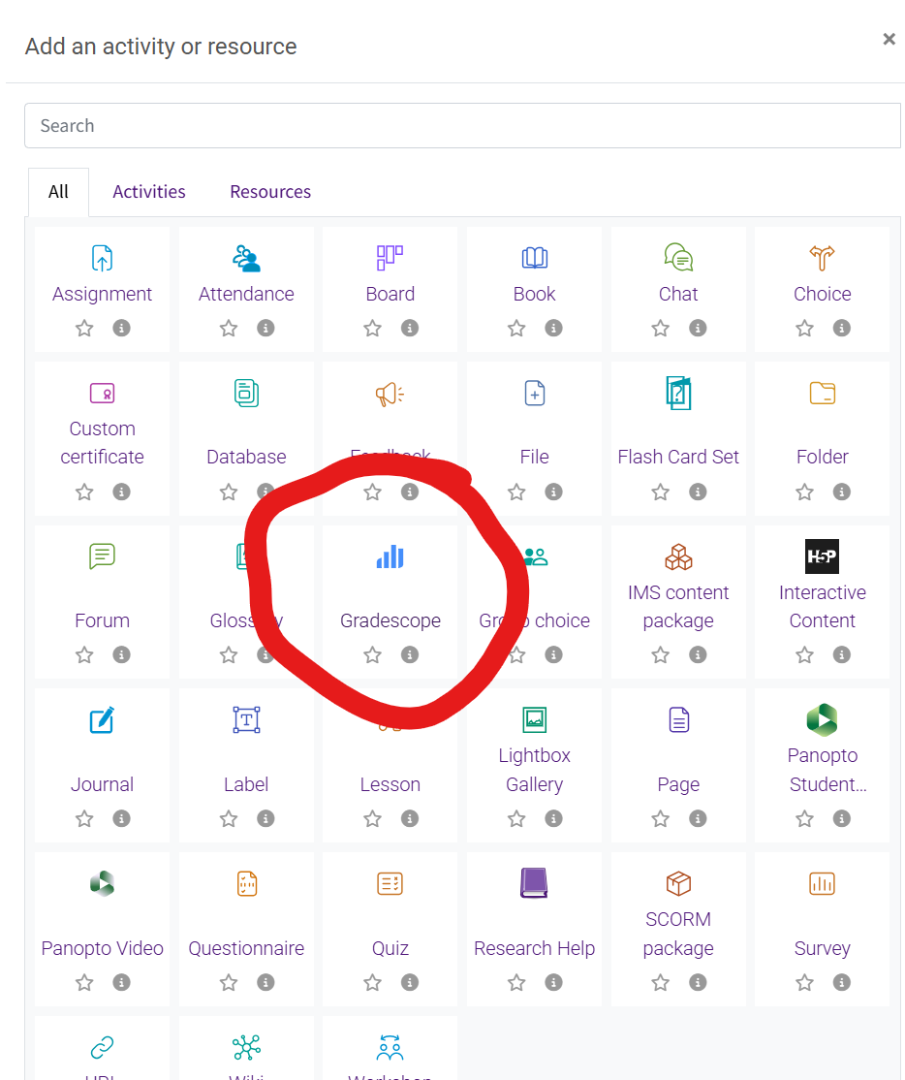
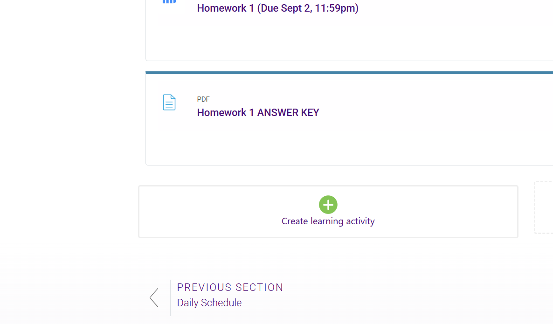
ASSIGNMENTS
Assignment Links to Moodle
Gradescope Training • Instructors & TAs
11

Slide 11
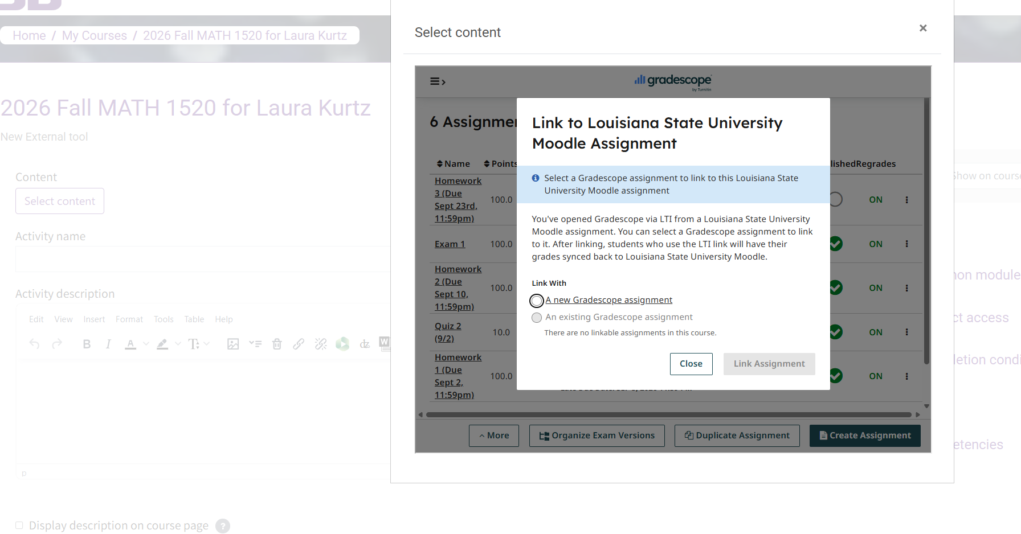
ASSIGNMENTS
Assignment Links to Moodle
Gradescope Training • Instructors & TAs
12

Slide 12


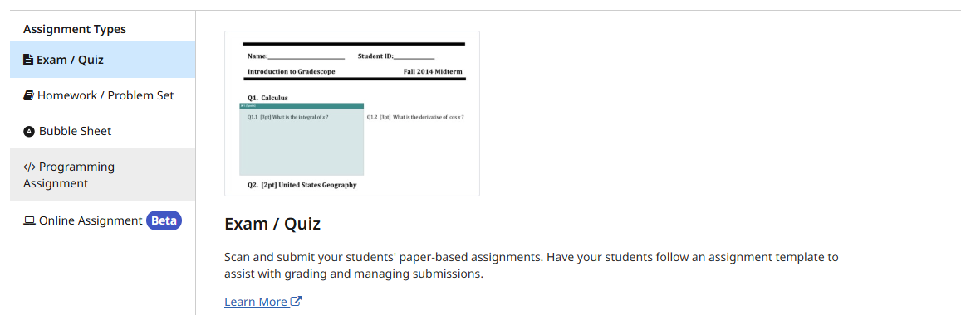



ASSIGNMENTS
Choosing the Right Assignment Type
Exam & Quiz
Only Exam & Quiz uses a scanned template — the other four types collect digital submissions directly, no printing or scanning involved.
Scanned paper exams. Mark question regions on a template, then grade by hand.
Homework & Problem Set
Students upload their work and tag which pages answer which question.
Bubble Sheet
Fully multiple-choice. Set an answer key and it grades itself — up to 5 versions.
Programming Assignment
Code submissions with a custom autograder, manual review, or both.
The assignment-type picker in Gradescope
Online Assignment
Build questions right in Gradescope; auto-grades multiple choice, select-all, and short answer.
Gradescope Training • Instructors & TAs
10

Slide 13

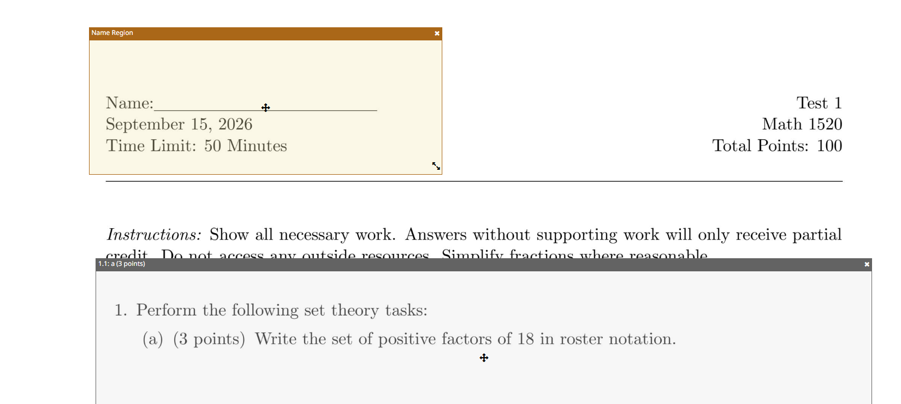
ASSIGNMENTS
Assign Pages to Questions for Exam /Quiz
On the outline, click a question and then the page (or pages) that answer it. This is also where you mark the Name/ID region and set up multi-part questions.
Gradescope Training • Instructors & TAs
13

Slide 14
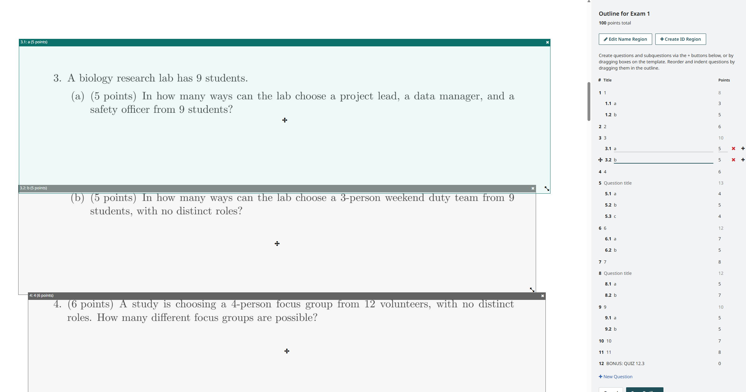
Outline- exams and quizzes

Slide 15
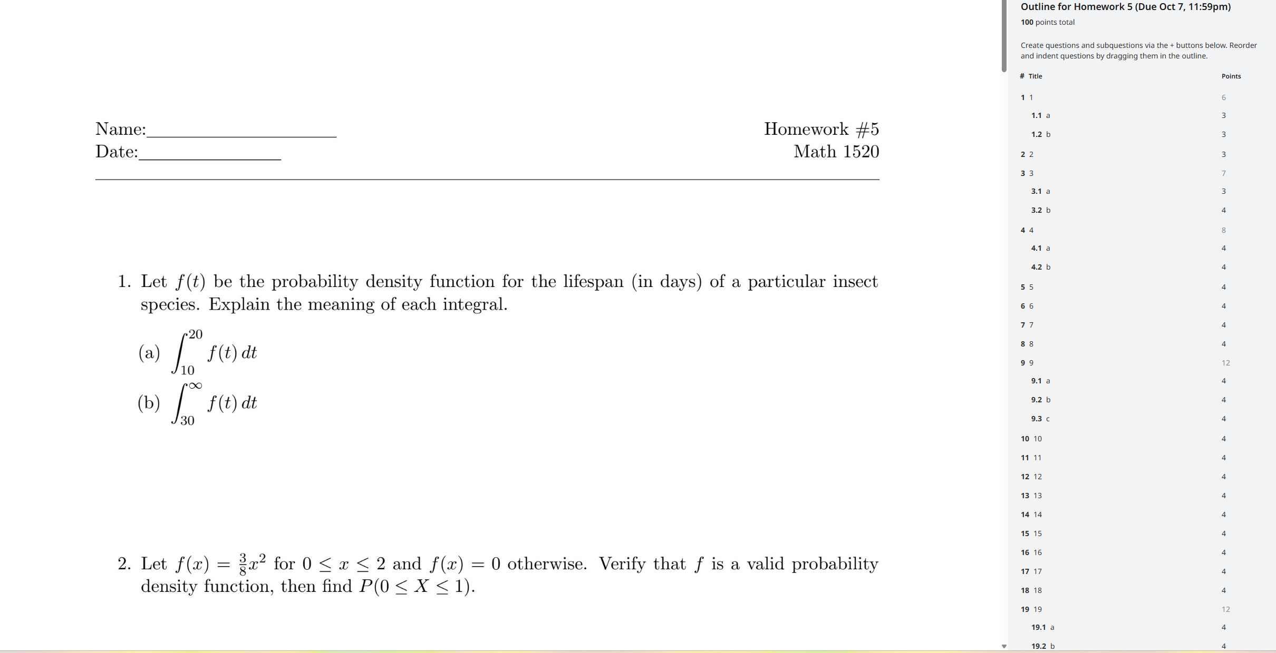
Outline- Homework

Slide 16

03
Grading & Returning Grades
Gradescope Training • Instructors & TAs
14

Slide 17
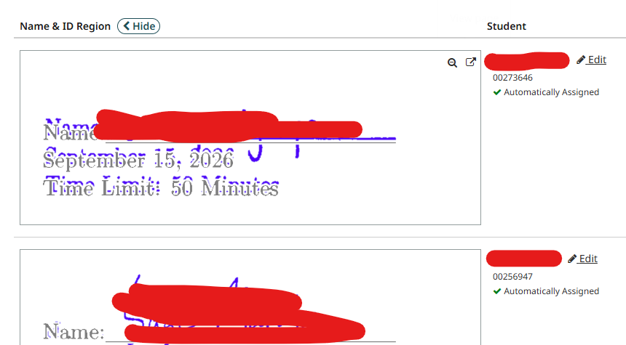
GRADING
Match Submissions
Gradescope auto-matches scans to students using the name/ID region. Anything it can’t place lands in the Unassigned tab, where you match it by hand — search by name or ID.
Gradescope Training • Instructors & TAs
15

Slide 18
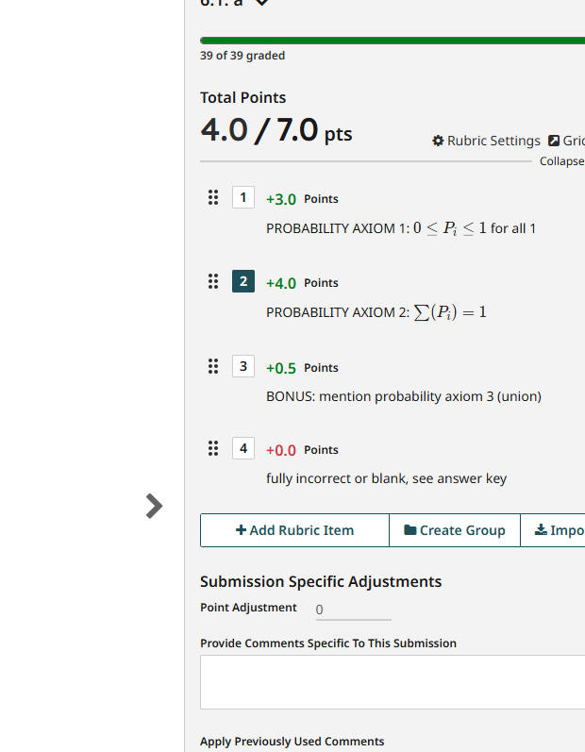



GRADING
Building Rubrics That Work
Negative Scoring (default)
Start at full points; each rubric item you apply subtracts from the total.
Positive Scoring
Start at zero; each rubric item you apply adds points. Flip the sign on any item to switch.
Rubric Groups (Institutional license)
Batch similar rubric items together, and optionally make a group mutually exclusive.
A rubric panel during grading
Gradescope Training • Instructors & TAs
16

Slide 19

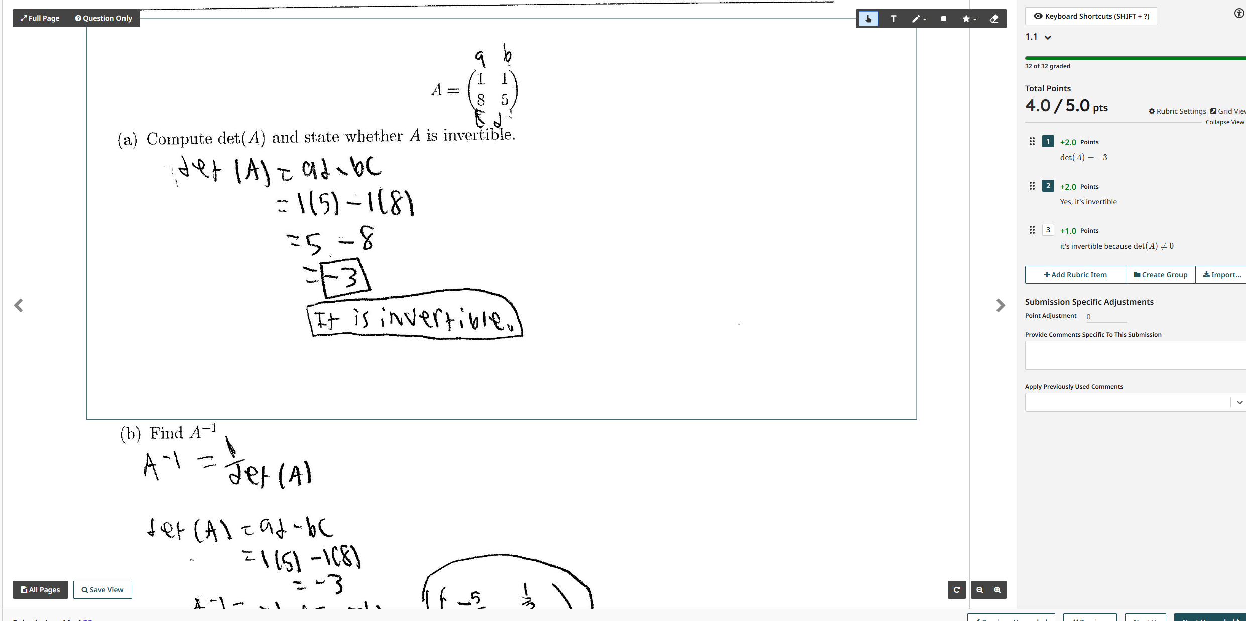
GRADING
Grade by Question- Individual Answers
Grade one question across every student before moving to the next. Gradescope groups matching answers together, so you can confirm several submissions at once instead of grading one at a time.
Gradescope Training • Instructors & TAs
17

Slide 20
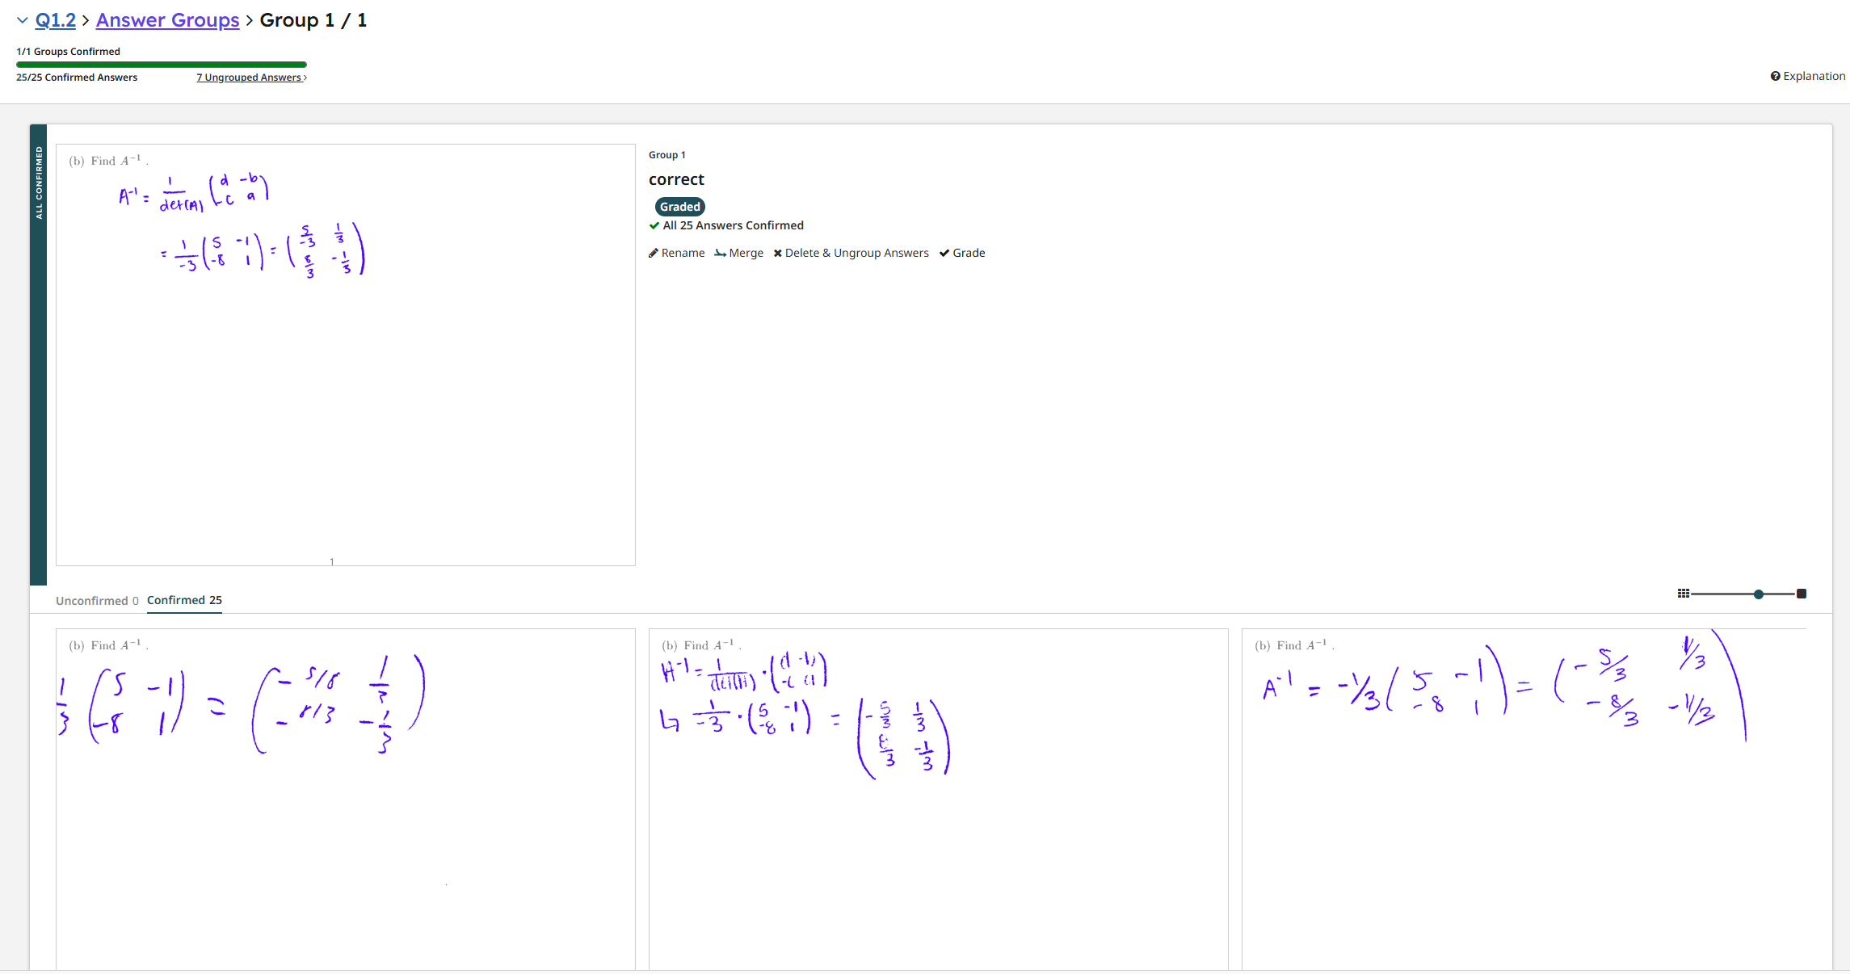
GRADING
Grade by Question- Grouped Answers
Grade one question across every student before moving to the next. Gradescope groups matching answers together, so you can confirm several submissions at once instead of grading one at a time.
Gradescope Training • Instructors & TAs
18

Slide 21
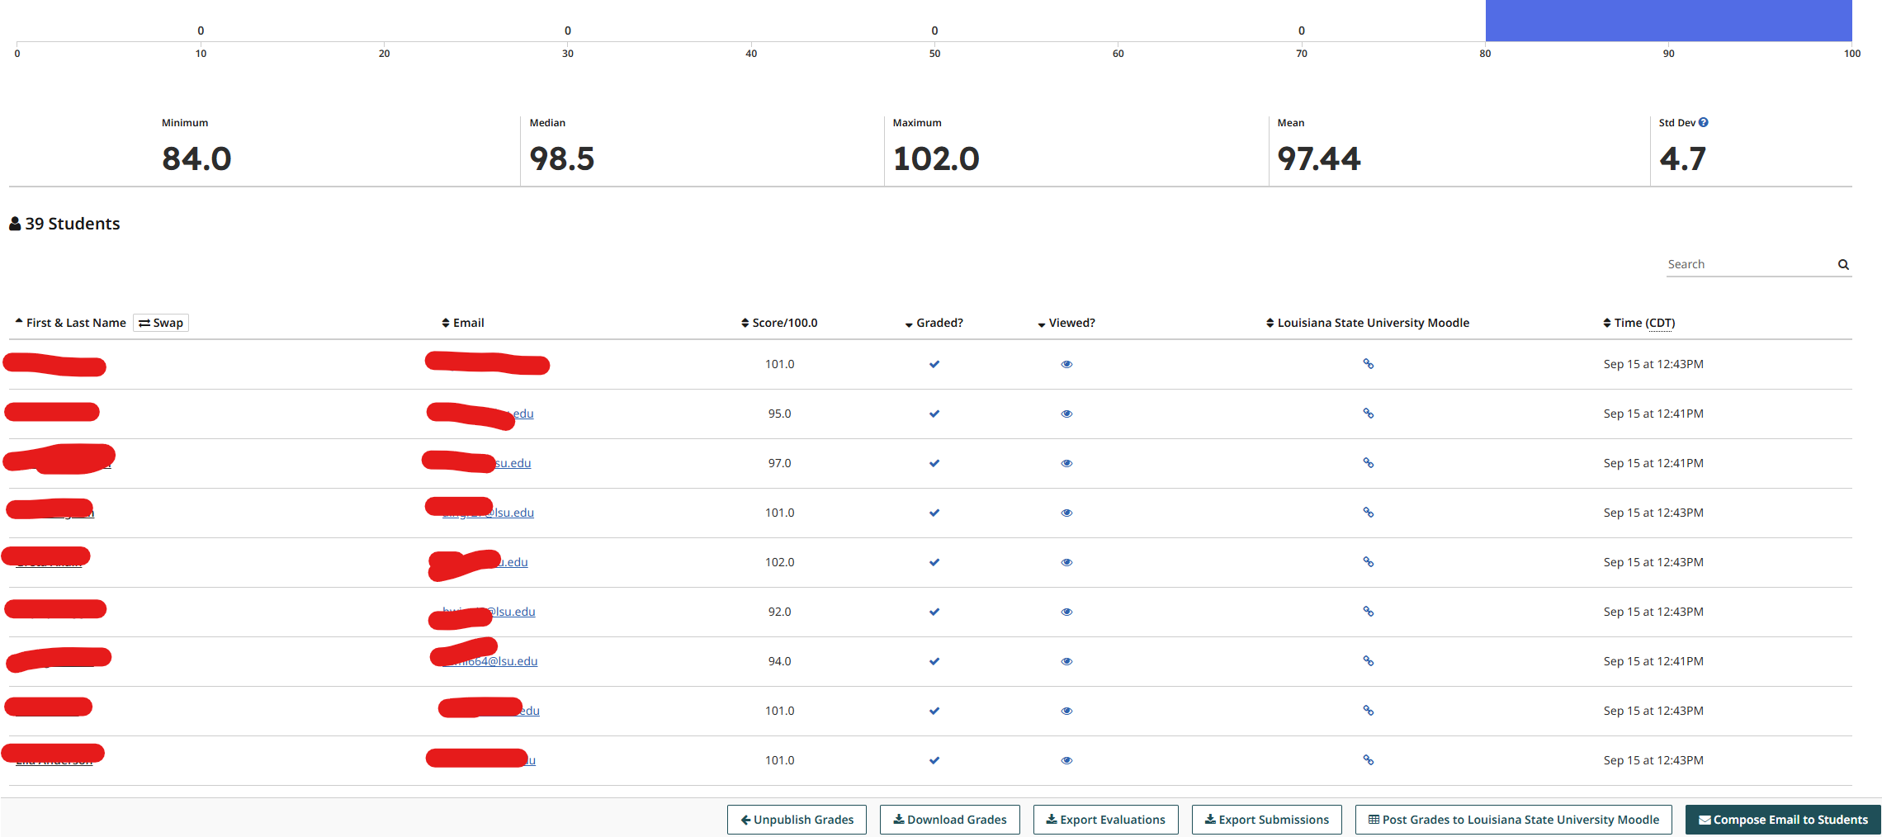
RETURNING GRADES
Publishing Grades
Gradescope Training • Instructors & TAs
19

Slide 22
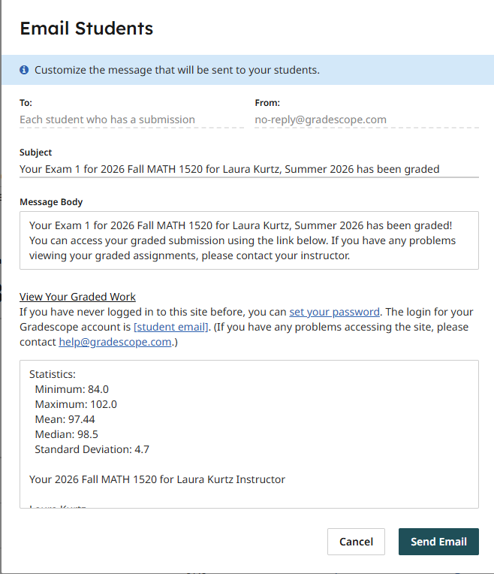
RETURNING GRADES
Sending Emails after Publishing Grades
Gradescope Training • Instructors & TAs
20

Slide 23
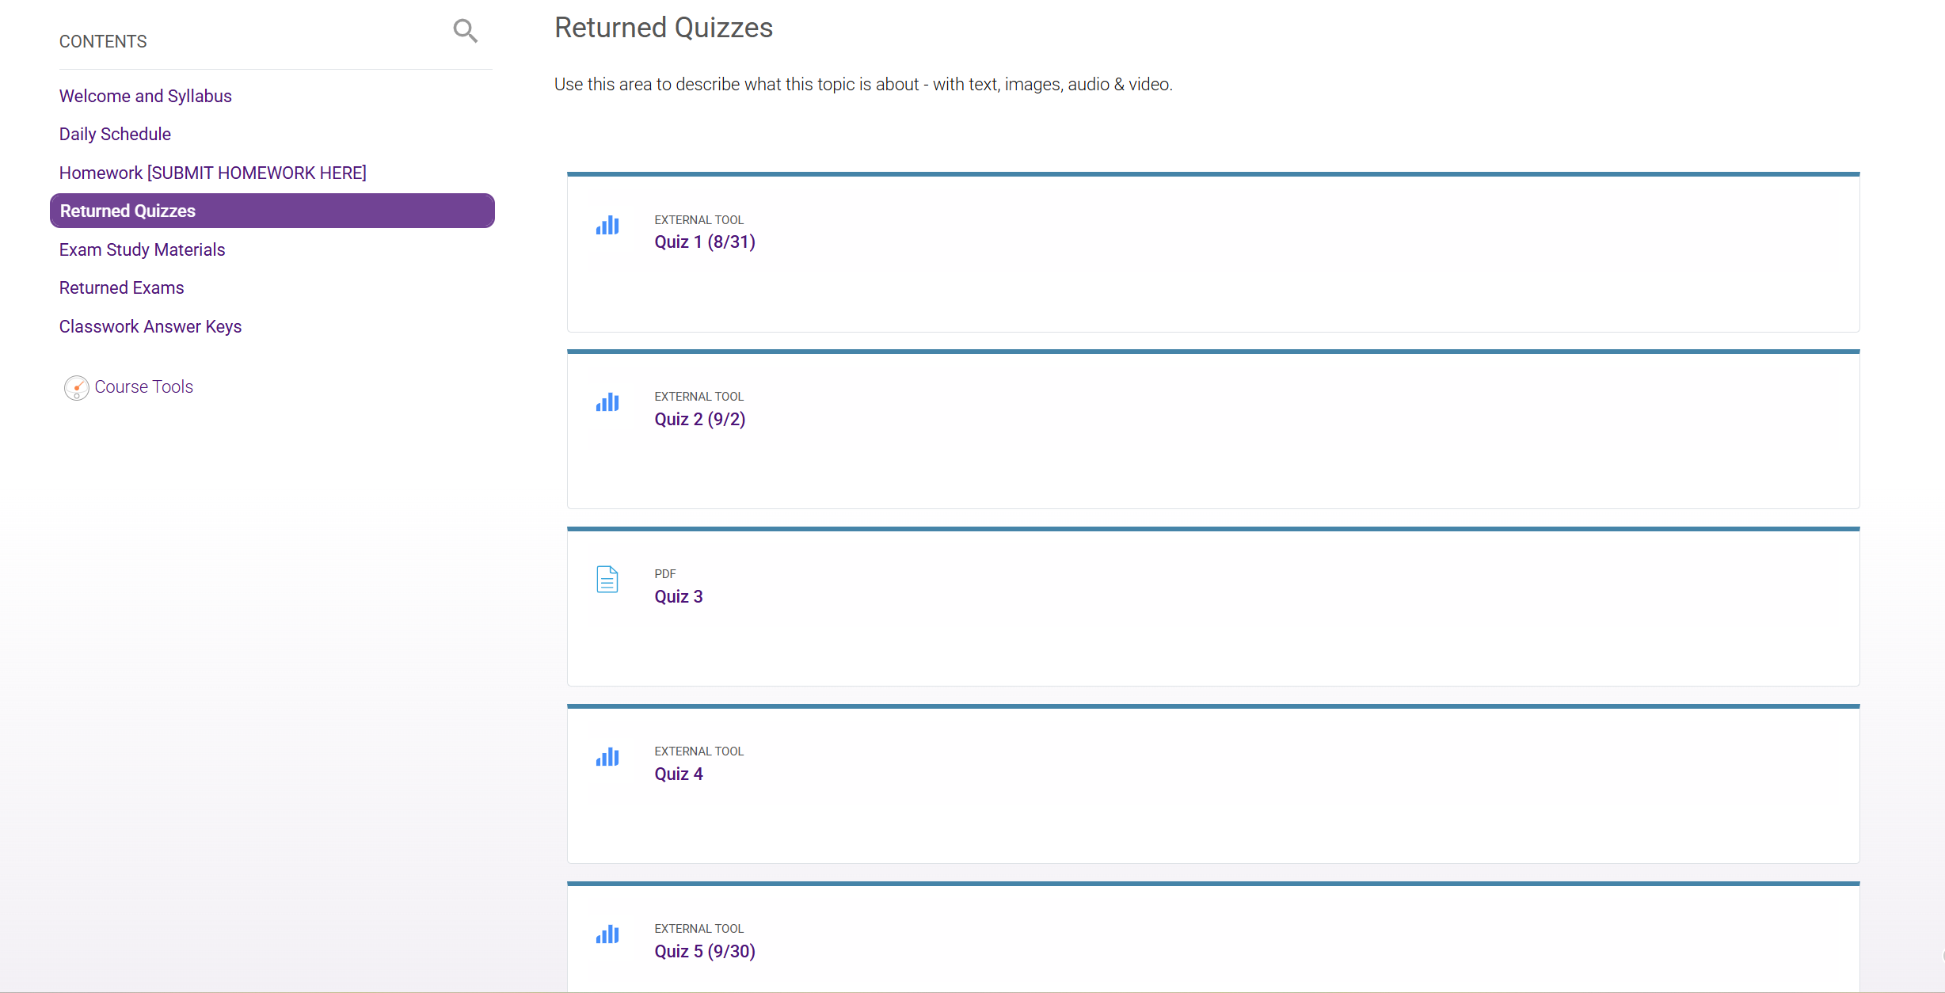
How the Gradebook Transfers Work

Slide 24
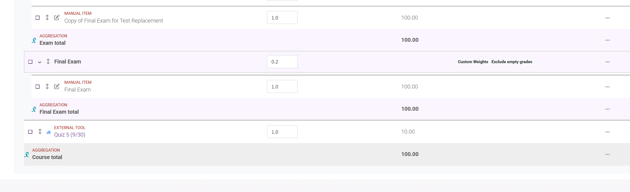
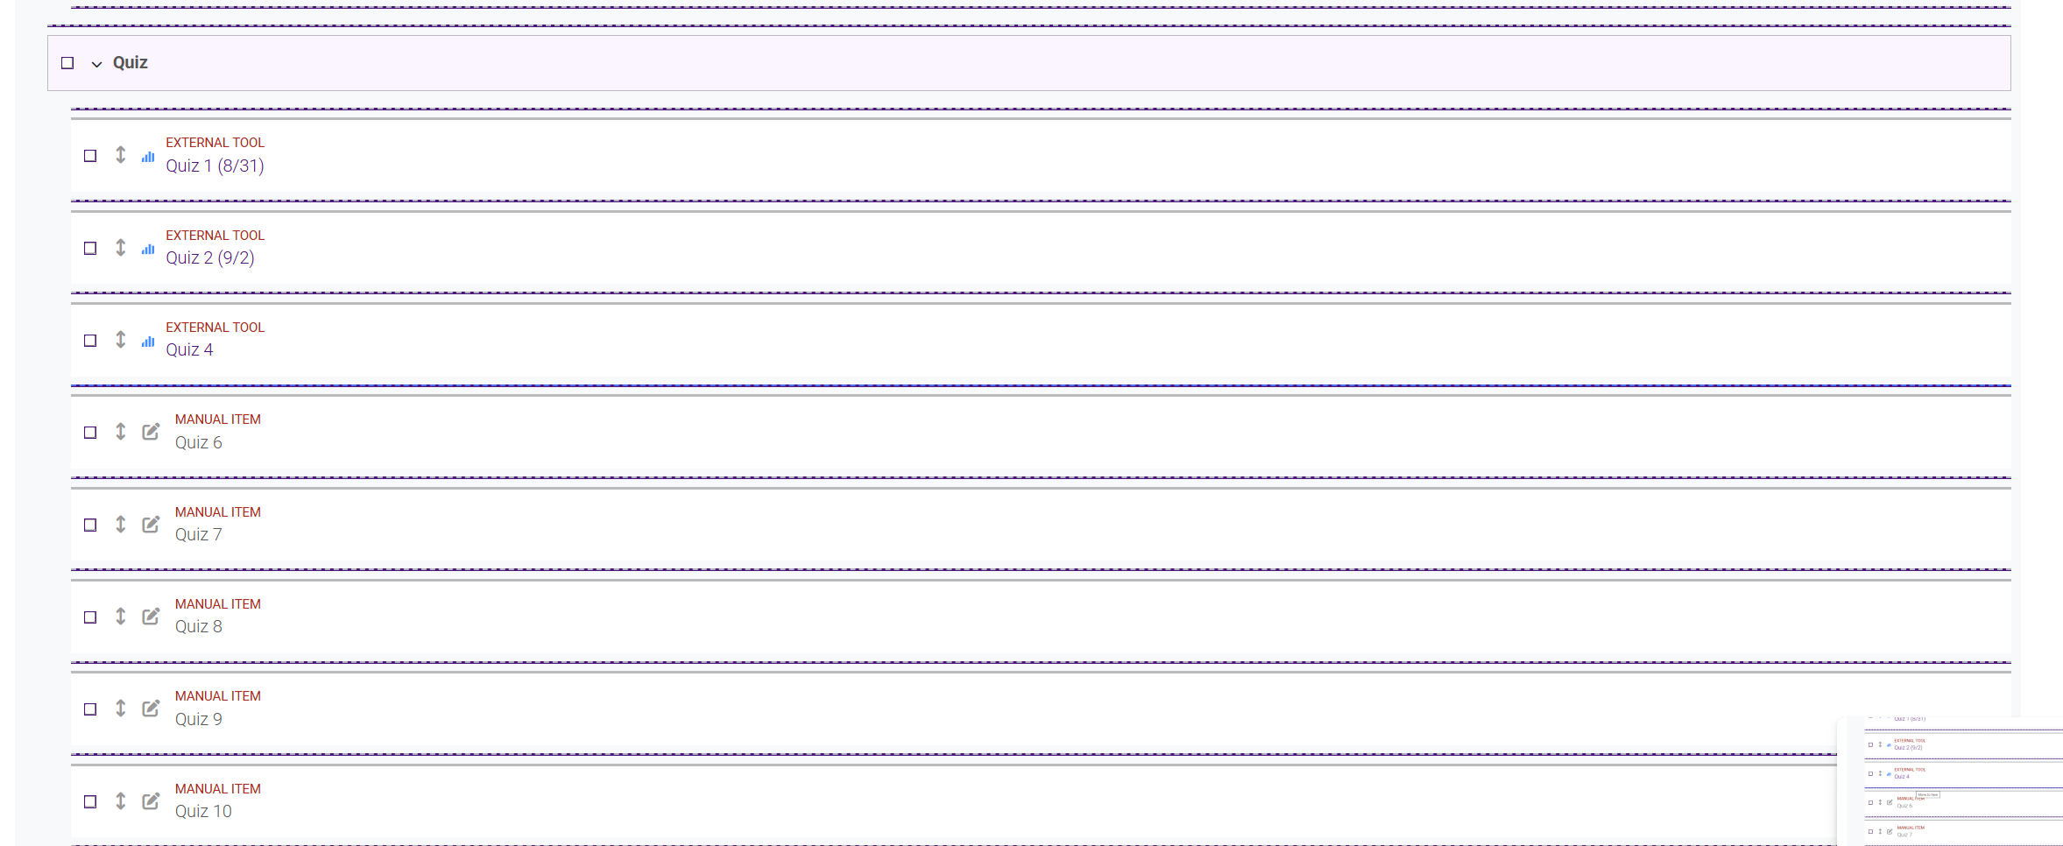

Slide 25
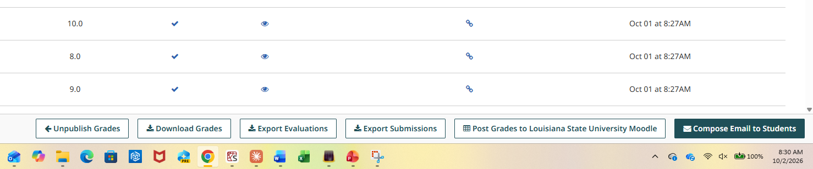
RETURNING GRADES
Sending Grades to Moodle
Click “Post Grades to Moodle” at the bottom
The grades will automatically transfer over, along with maximum grade.
Gradescope Training • Instructors & TAs
21

Slide 26
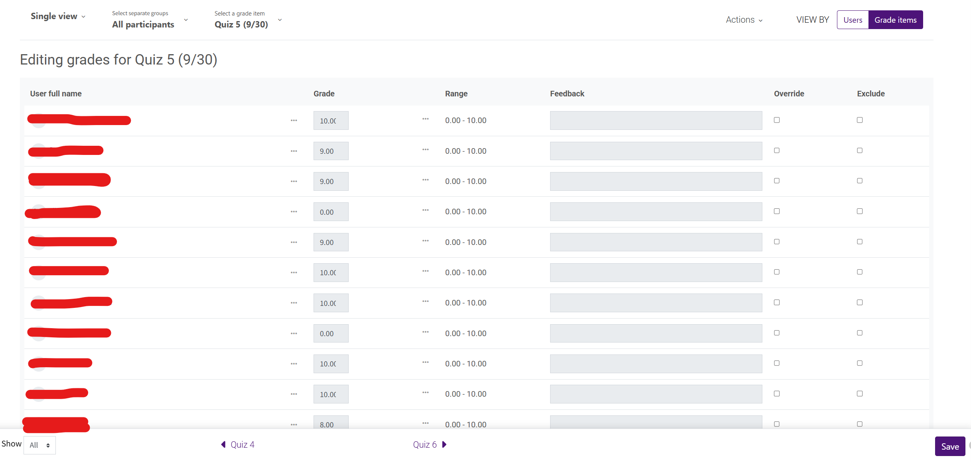

Slide 27

04
Regrade Requests
Gradescope Training • Instructors & TAs
24

Slide 28

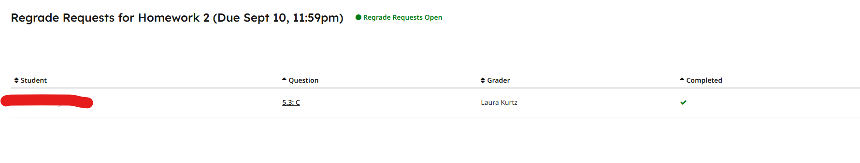
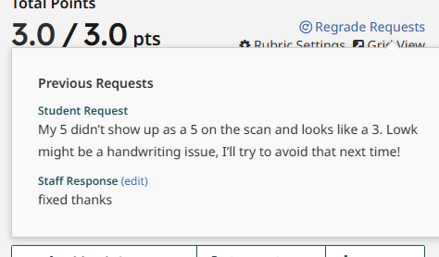
ON BY DEFAULT
Every published assignment allows regrade requests automatically.
REGRADES
Handling Regrade Requests
Set an open/close date, or disable requests entirely.
The grader who last touched a submission is notified first.
1
Open the request
From the assignment’s Regrade Requests page, select Review.
2
Read the question
Select the regrade notification badge to see what the student is asking.
3
Adjust the grade
Rubric edits apply to everyone; a point adjustment affects only this submission.
Regrade Requests list for an assignment
4
Reply and close
Click Close & Respond to email the student, then re-post grades to Moodle.
Gradescope Training • Instructors & TAs
25

Slide 29
05
Appendices
Gradescope Training • Instructors & TAs
24

Slide 30

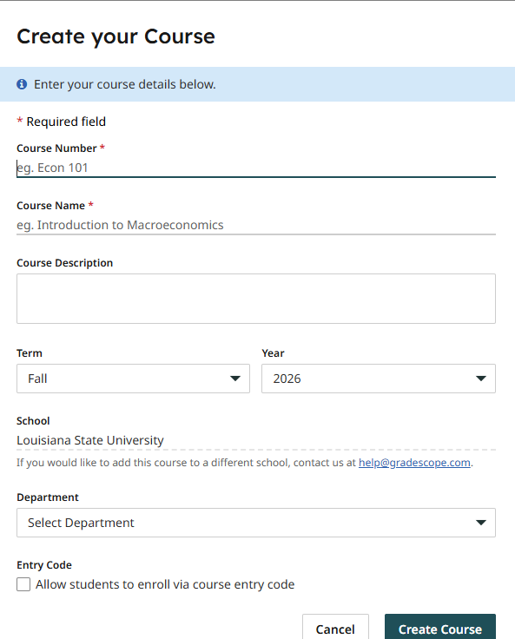
BACKUP — COURSE SETUP
Creating Your Course Manually (Not Recommended)
1
Open your dashboard
Log in and select the Gradescope logo, or go straight to your course dashboard.
2
Click “Create Course”
It’s in the action bar at the bottom right — any instructor account can create a course.
3
Fill in the basics
Course number, course name, term, year, and school.
You can then link your course to Moodle in settings.
The Create Course dialog
Gradescope Training • Instructors & TAs
27

Slide 31
What do your students see?

Slide 32

Questions as you go?
The full Gradescope Guides library covers every screen in more depth.
guides.gradescope.com
Gradescope Training • Instructors & TAs
26

