Slide 1
Comparing the Performances of Controllers under Time Delays using a Rotary Servo Plant
Aaron Faulkner
Louisiana State University
Department of Mechanical and Industrial Engineering
Research Supervisors: Profs. Marcio de Queiroz and Michael Malisoff
Sponsor: NSF Research Experiences for Undergraduates Program

Slide 2
Objectives and Importance of Research
Time delays are common in mechanical engineering, where the current state of the system is sometimes not available for measurement.
Using time-lagged state measurements in proportional derivative (PD) or other classical controls can produce poor control performance.
We compared the performances of two important recently developed delay compensating controls with that of the PD control on a test bed.
This filled an important gap in the literature, since there was no literature that compared the control performances on an actual test bed.
The hypothesis was that the predictor-based control would provide more stable tracking under control delays than the other two controllers.

Slide 3
Objectives and Importance of Research
Time delays are common in mechanical engineering, where the current state of the system is sometimes not available for measurement.
Using time-lagged state measurements in proportional derivative (PD) or other classical controls can produce poor control performance.
We compared the performances of two important recently developed delay compensating controls with that of the PD control on a test bed.
This filled an important gap in the literature, since there was no literature that compared the control performances on an actual test bed.
The hypothesis was that the predictor-based control would provide more stable tracking under control delays than the other two controllers.

Slide 4
Objectives and Importance of Research
Time delays are common in mechanical engineering, where the current state of the system is sometimes not available for measurement.
Using time-lagged state measurements in proportional derivative (PD) or other classical controls can produce poor control performance.
We compared the performances of two important recently developed delay compensating controls with that of the PD control on a test bed.
This filled an important gap in the literature, since there was no literature that compared the control performances on an actual test bed.
The hypothesis was that the predictor-based control would provide more stable tracking under control delays than the other two controllers.

Slide 5
Objectives and Importance of Research
Time delays are common in mechanical engineering, where the current state of the system is sometimes not available for measurement.
Using time-lagged state measurements in proportional derivative (PD) or other classical controls can produce poor control performance.
We compared the performances of two important recently developed delay compensating controls with that of the PD control on a test bed.
This filled an important gap in the literature, since there was no literature that compared the control performances on an actual test bed.
The hypothesis was that the predictor-based control would provide more stable tracking under control delays than the other two controllers.

Slide 6
Objectives and Importance of Research
Time delays are common in mechanical engineering, where the current state of the system is sometimes not available for measurement.
Using time-lagged state measurements in proportional derivative (PD) or other classical controls can produce poor control performance.
We compared the performances of two important recently developed delay compensating controls with that of the PD control on a test bed.
This filled an important gap in the literature, since there was no literature that compared the control performances on an actual test bed.
The hypothesis was that the predictor-based control would provide more stable tracking under control delays than the other two controllers.

Slide 7
Objectives and Importance of Research
Time delays are common in mechanical engineering, where the current state of the system is sometimes not available for measurement.
Using time-lagged state measurements in proportional derivative (PD) or other classical controls can produce poor control performance.
We compared the performances of two important recently developed delay compensating controls with that of the PD control on a test bed.
This filled an important gap in the literature, since there was no literature that compared the control performances on an actual test bed.
The hypothesis was that the predictor-based control would provide more stable tracking under control delays than the other two controllers.

Slide 8
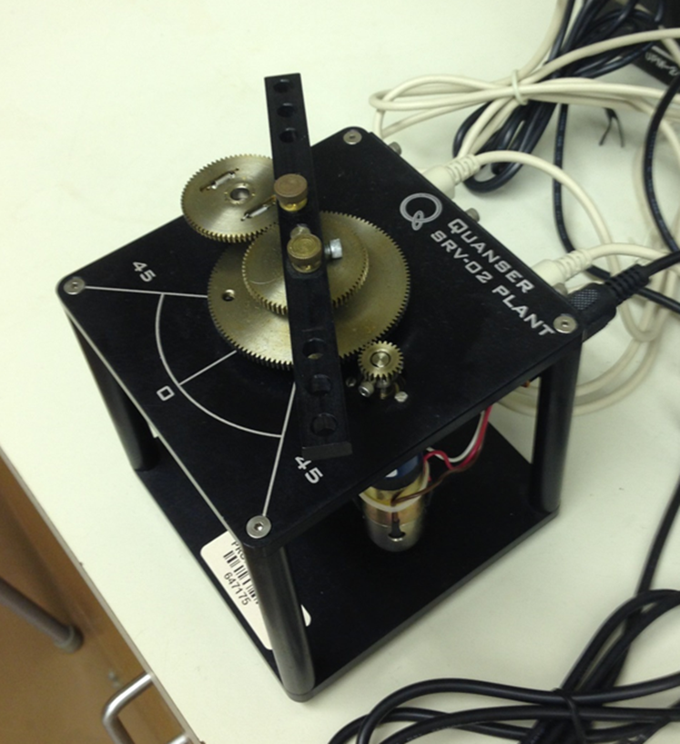
The Experimental Setup
Quanser rotary servo plant, which is a DC motor turning a mechanical load.
Goal was to track square waves, with controls controls coded in Simulink.
Tested benchmark PD, modified Smith predictor, and predictor based controls.
Ran many tests to see how long a delay D the controls could compensate.
The predictor controls are found by solving certain integral equations.

Slide 9
The Experimental Setup
Quanser rotary servo plant, which is a DC motor turning a mechanical load.
Goal was to track square waves, with controls controls coded in Simulink.
Tested benchmark PD, modified Smith predictor, and predictor based controls.
Ran many tests to see how long a delay D the controls could compensate.
The predictor controls are found by solving certain integral equations.

Slide 10
The Experimental Setup
Quanser rotary servo plant, which is a DC motor turning a mechanical load.
Goal was to track square waves, with controls controls coded in Simulink.
Tested benchmark PD, modified Smith predictor, and predictor based controls.
Ran many tests to see how long a delay D the controls could compensate.
The predictor controls are found by solving certain integral equations.

Slide 11
The Experimental Setup
Quanser rotary servo plant, which is a DC motor turning a mechanical load.
Goal was to track square waves, with controls controls coded in Simulink.
Tested benchmark PD, modified Smith predictor, and predictor based controls.
Ran many tests to see how long a delay D the controls could compensate.
The predictor controls are found by solving certain integral equations.

Slide 12
The Experimental Setup
Quanser rotary servo plant, which is a DC motor turning a mechanical load.
Goal was to track square waves, with controls controls coded in Simulink.
Tested benchmark PD, modified Smith predictor, and predictor based controls.
Ran many tests to see how long a delay D the controls could compensate.
The predictor controls are found by solving certain integral equations.

Slide 13
The Experimental Setup
Quanser rotary servo plant, which is a DC motor turning a mechanical load.
Goal was to track square waves, with controls controls coded in Simulink.
Tested benchmark PD, modified Smith predictor, and predictor based controls.
Ran many tests to see how long a delay D the controls could compensate.
The predictor controls are found by solving certain integral equations.

Slide 14
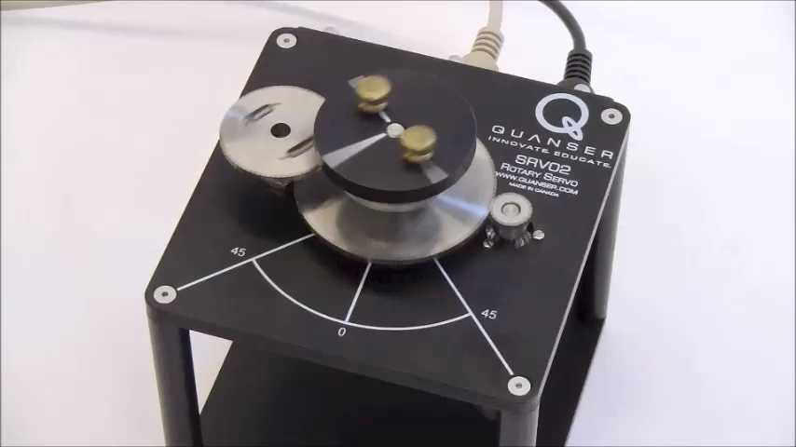
The Experimental Setup

Slide 15
Modified Smith Predictor with D = 0.04 s

Slide 16
Modified Smith Predictor with D = 0.11 s

Slide 17
Conclusions and Future Research
The verges of instability were D=0.05s for the PD, D=0.11s for the modified Smith predictor, and D=0.1s for the predictor based control.
Therefore, the Smith predictor and predictor based controls outperformed the classical benchmark PD control.
The modified Smith predictor performed best, but the two delay compensating controllers had similar performances.
In future work, we will compare the performances of controls on more complex test beds involving active magnetic bearings.
Active magnetic bearings are based on electromagnetic suspension and are often used in rotating machinery.

Slide 18
Conclusions and Future Research
The verges of instability were D=0.05s for the PD, D=0.11s for the modified Smith predictor, and D=0.1s for the predictor based control.
Therefore, the Smith predictor and predictor based controls outperformed the classical benchmark PD control.
The modified Smith predictor performed best, but the two delay compensating controllers had similar performances.
In future work, we will compare the performances of controls on more complex test beds involving active magnetic bearings.
Active magnetic bearings are based on electromagnetic suspension and are often used in rotating machinery.

Slide 19
Conclusions and Future Research
The verges of instability were D=0.05s for the PD, D=0.11s for the modified Smith predictor, and D=0.1s for the predictor based control.
Therefore, the Smith predictor and predictor based controls outperformed the classical benchmark PD control.
The modified Smith predictor performed best, but the two delay compensating controllers had similar performances.
In future work, we will compare the performances of controls on more complex test beds involving active magnetic bearings.
Active magnetic bearings are based on electromagnetic suspension and are often used in rotating machinery.

Slide 20
Conclusions and Future Research
The verges of instability were D=0.05s for the PD, D=0.11s for the modified Smith predictor, and D=0.1s for the predictor based control.
Therefore, the Smith predictor and predictor based controls outperformed the classical benchmark PD control.
The modified Smith predictor performed best, but the two delay compensating controllers had similar performances.
In future work, we will compare the performances of controls on more complex test beds involving active magnetic bearings.
Active magnetic bearings are based on electromagnetic suspension and are often used in rotating machinery.

Slide 21
Conclusions and Future Research
The verges of instability were D=0.05s for the PD, D=0.11s for the modified Smith predictor, and D=0.1s for the predictor based control.
Therefore, the Smith predictor and predictor based controls outperformed the classical benchmark PD control.
The modified Smith predictor performed best, but the two delay compensating controllers had similar performances.
In future work, we will compare the performances of controls on more complex test beds involving active magnetic bearings.
Active magnetic bearings are based on electromagnetic suspension and are often used in rotating machinery.

Slide 22
Conclusions and Future Research
The verges of instability were D=0.05s for the PD, D=0.11s for the modified Smith predictor, and D=0.1s for the predictor based control.
Therefore, the Smith predictor and predictor based controls outperformed the classical benchmark PD control.
The modified Smith predictor performed best, but the two delay compensating controllers had similar performances.
In future work, we will compare the performances of controls on more complex test beds involving active magnetic bearings.
Active magnetic bearings are based on electromagnetic suspension and are often used in rotating machinery.

Slide 23
References and Acknowledgements
[1] H. Khalil, Nonlinear Systems, Third Edition, Prentice Hall, Upper Saddle River, NJ, 2002.
[2] M. Krstic, "Compensation of Infinite-Dimensional Actuator and Sensor Dynamics," IEEE Control Systems Magazine, Vol. 30, No. 1, pp. 22-41, 2010.
[3] N. Sharma, S. Bhasin, Q. Wang, and W. E. Dixon, "Predictor-Based Control for an Uncertain Euler-Lagrange System with Input Delay," Automatica, Vol. 47, No. 11, pp. 2332-2342, 2011.
Supported by the NSF Research Experiences for Undergraduates Program.

Slide 24
References and Acknowledgements
[1] H. Khalil, Nonlinear Systems, Third Edition, Prentice Hall, Upper Saddle River, NJ, 2002.
[2] M. Krstic, "Compensation of Infinite-Dimensional Actuator and Sensor Dynamics," IEEE Control Systems Magazine, Vol. 30, No. 1, pp. 22-41, 2010.
[3] N. Sharma, S. Bhasin, Q. Wang, and W. E. Dixon, "Predictor-Based Control for an Uncertain Euler-Lagrange System with Input Delay," Automatica, Vol. 47, No. 11, pp. 2332-2342, 2011.
Supported by the NSF Research Experiences for Undergraduates Program.

Slide 25
References and Acknowledgements
[1] H. Khalil, Nonlinear Systems, Third Edition, Prentice Hall, Upper Saddle River, NJ, 2002.
[2] M. Krstic, "Compensation of Infinite-Dimensional Actuator and Sensor Dynamics," IEEE Control Systems Magazine, Vol. 30, No. 1, pp. 22-41, 2010.
[3] N. Sharma, S. Bhasin, Q. Wang, and W. E. Dixon, "Predictor-Based Control for an Uncertain Euler-Lagrange System with Input Delay," Automatica, Vol. 47, No. 11, pp. 2332-2342, 2011.
Supported by the NSF Research Experiences for Undergraduates Program.

Slide 26
References and Acknowledgements
[1] H. Khalil, Nonlinear Systems, Third Edition, Prentice Hall, Upper Saddle River, NJ, 2002.
[2] M. Krstic, "Compensation of Infinite-Dimensional Actuator and Sensor Dynamics," IEEE Control Systems Magazine, Vol. 30, No. 1, pp. 22-41, 2010.
[3] N. Sharma, S. Bhasin, Q. Wang, and W. E. Dixon, "Predictor-Based Control for an Uncertain Euler-Lagrange System with Input Delay," Automatica, Vol. 47, No. 11, pp. 2332-2342, 2011.
Supported by the NSF Research Experiences for Undergraduates Program.

Slide 27
References and Acknowledgements
[1] H. Khalil, Nonlinear Systems, Third Edition, Prentice Hall, Upper Saddle River, NJ, 2002.
[2] M. Krstic, "Compensation of Infinite-Dimensional Actuator and Sensor Dynamics," IEEE Control Systems Magazine, Vol. 30, No. 1, pp. 22-41, 2010.
[3] N. Sharma, S. Bhasin, Q. Wang, and W. E. Dixon, "Predictor-Based Control for an Uncertain Euler-Lagrange System with Input Delay," Automatica, Vol. 47, No. 11, pp. 2332-2342, 2011.
Supported by the NSF Research Experiences for Undergraduates Program.

