Slide 1
Math and a Second Discipline: Finance Asset Management Track
Kurtay Ogunc, PhD, MBA, MApStat
Email: financeadvisor@lsu.edu

Slide 2
What is Unique about the Program?
This program is designed to prepare students for ASSET MANAGEMENT, which is a mathematically and statistically intensive field within finance. Quantitative analysts, who build models to find patterns in financial markets, are called “quants.” Students may ultimately seek employment with asset management firms such as mutual funds, hedge funds, and ETF providers. In addition, there will be opportunities in quantitative research departments at major financial institutions.

Slide 3
What is a Financial Market?
“Any marketplace where buyers and sellers participate in the trade of assets such as equities, bonds, currencies, and derivatives.”
Investopedia

Slide 4
What is a “Fund”?
“A source of money that is allocated for a specific purpose…Investors can place money in different types of funds with the goal of earning money.
Examples include mutual funds, which gather money from numerous investors and invest it in a diversified portfolio of assets, and hedge funds, which invest the assets of high-net-worth individuals in a way that is designed to earn above-market returns.”
Investopedia

Slide 5
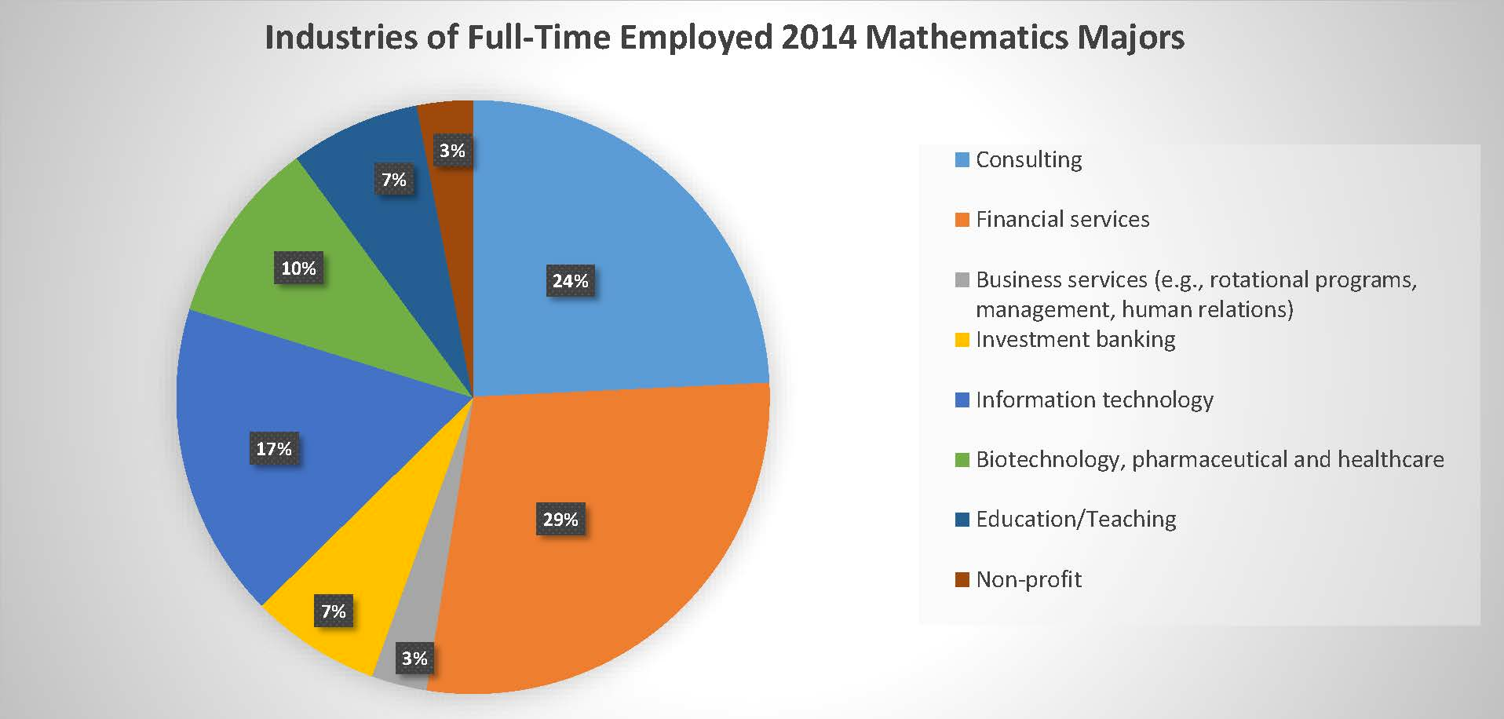
Why study Math + Asset Management? JOBS!

Slide 6
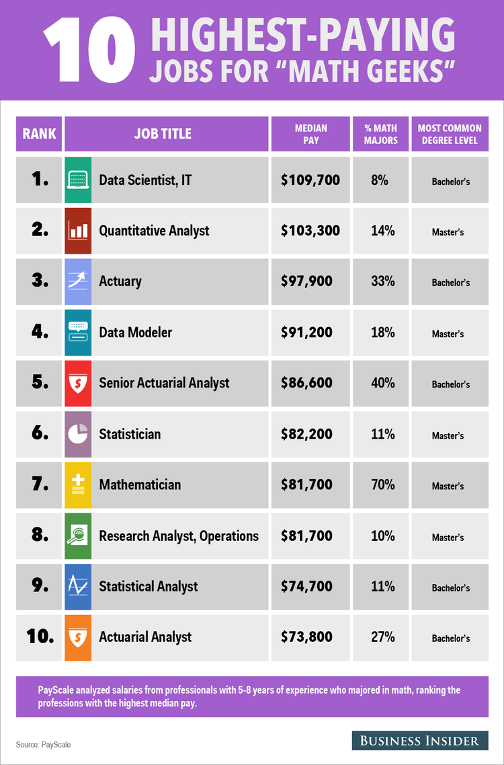
EIGHT out of Business Insider’s ten highest-paying jobs for “math geeks” are related to Asset Management!

Slide 7
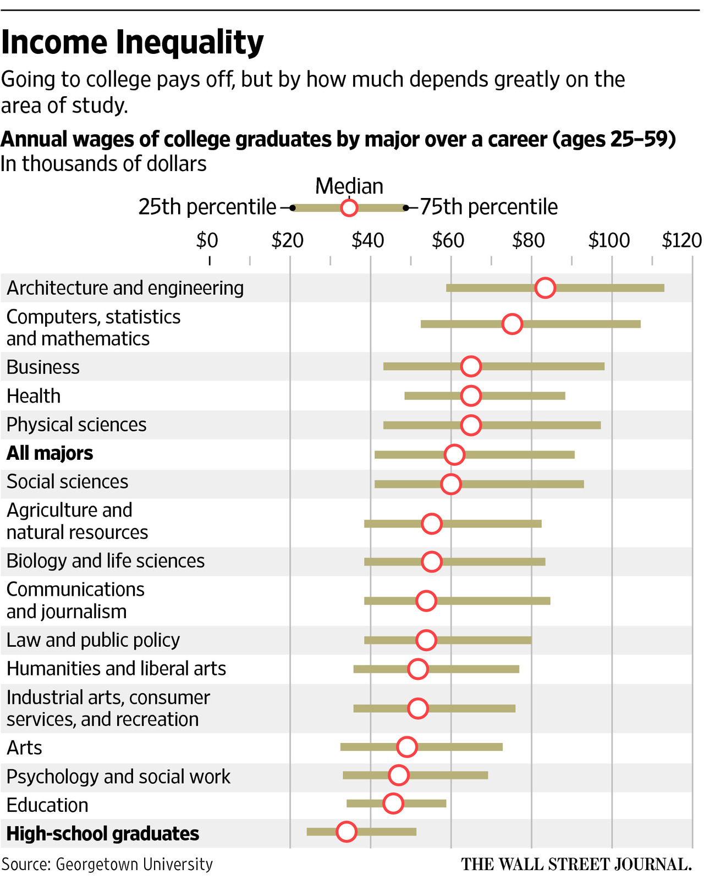

Slide 8
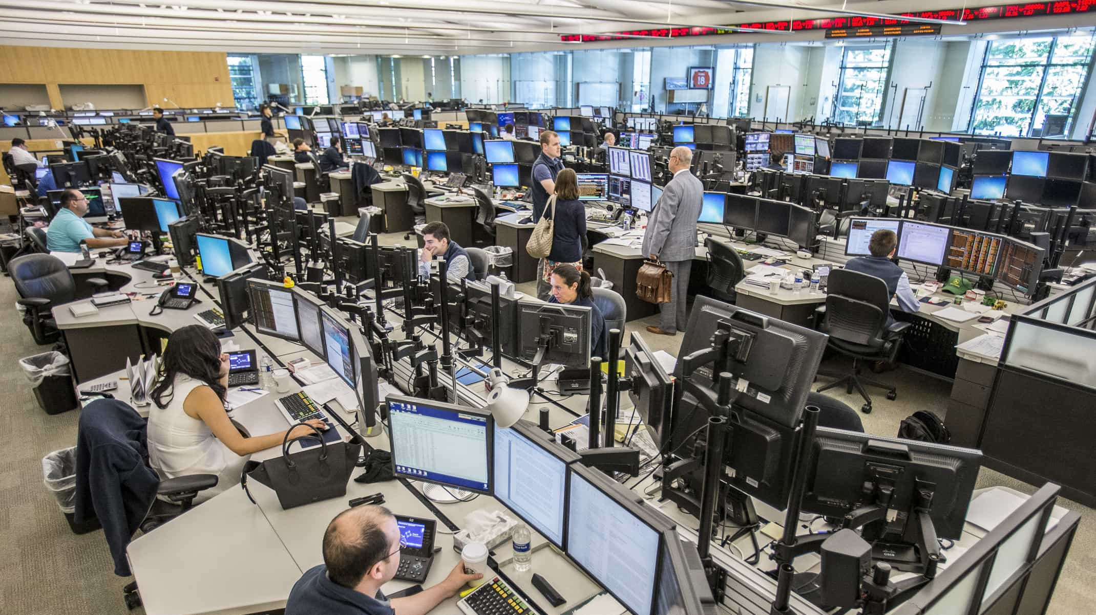
An Asset Management Career: Three Paths
Fund Management
Research
Marketing

Slide 9
Fund Management
Job Title: Portfolio Manager
Make strategic decisions to determine the composition of one or more funds
Fast-paced, requires strong multitasking and analytical thinking skills, high energy, high stress, work with a team
Compensation: $1,000,000+ (the sky is the limit!)

Slide 10
Research
Job Title: Research Analyst
Collect data on a particular company, industry, or financial product and analyze its financial strength
Intellectually stimulating, often self-paced, work may be individual or team-based, low stress, good for introverts
Compensation: $150,000-$1,000,000

Slide 11
Marketing
Job Title: Marketing & Client Service Associate
Sell complex financial products to institutional investors
Travel (up to 80% out of the office), requires excellent presentation and negotiation skills, high energy, periods of high and low stress, work independently or on a team, good for extroverts
Compensation: $150,000-$500,000

Slide 12
“A non-profit organization dedicated to increasing the number of women in portfolio management and executive leadership in the asset management industry” www.girlswhoinvest.org
Competitive Summer Intensive Programs at University of Pennsylvania and University of Notre Dame, and paid internship opportunities at global asset management firms.
Open to sophomore women ONLY!

Slide 13
Women in Investment Management Initiative
From the CFA Institute, “This initiative aims to improve investor outcomes by encouraging gender diversity in the investment management profession” – www.cfainstitute.org
Women In Investment Management Network: connect with peers, share articles, join the conversation
CFA Program Women’s Scholarships are available!

Slide 14
Young Women In Investment
New in 2018 from the CFA Institute, YWII is “an initiative to create awareness about, instill interest in and enable women to view the investment management industry as a viable long-term career option” www.empoweringyoungwomen.cfa
Competitive Summer Boot Camp Program in India (expanding ex-India in 2020)

Slide 15
Additional Questions?
Contact: Kurtay Ogunc, PhD, MBA, MApStat
Email: financeadvisor@lsu.edu
Office: 2904 Business Education Complex
Louisiana State University

